Slide 1
Implementing Universal Design Principles and Accessibility to Online Courses at a Large University
Nancy Swenson
Accessing Higher Ground
November 2014

Slide 2
Overview of session
Today we will be discussing:
Context of online learning at UCF
Accessibility Support Model for Online Courses
Incorporating Universal Design principles to improve the accessibility of online courses

Slide 3
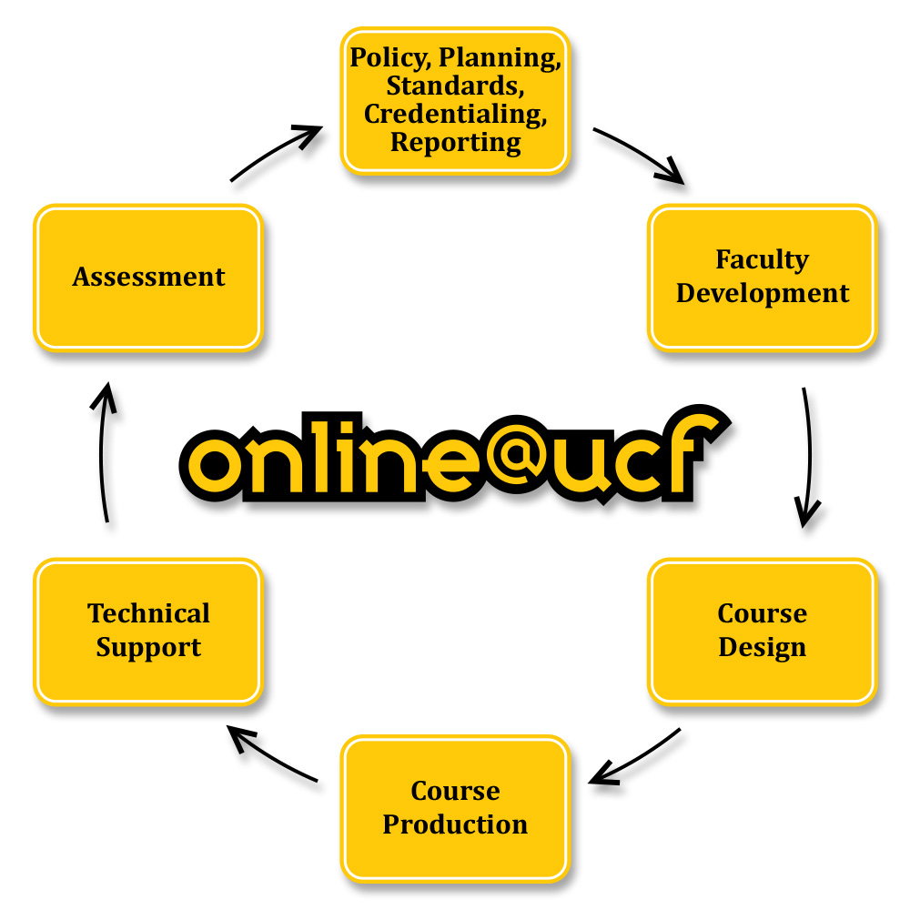
Center for Distributed Learning

Slide 4
UCF
2nd Largest Institution (60,000+ students)
35.89% of total university SCH
76.18% of all students took at least one online course
620 out of 1350 (46%) SWD are enrolled in online course. (web, hybrid, or lecture capture)

Slide 5
UCF SCH Growth

Slide 6
Diversity of Learners at UCF

Slide 7
Diversity of Learners at UCF
Disability Category | Fall 2004 | Fall 2013
Attention Deficit/Hyperactive Disorder | 129 | 399
Specific Learning Disability | 125 | 382
Deaf/Hard of Hearing | 20 | 50
Mobility/Physical Disability | 69 | 70
Blind/Low Vision | 23 | 44
Speech/Language | 4 | 9
Traumatic Brain Injury |  | 41
Psych/Emotional/Behavioral |  | 205
Autism Spectrum Disorder |  | 49

Slide 8
Need for Support Model
Face to Face
clear plan and procedures
Online
How and by whom was no longer clear
Requests handled on case-by-case basis
Increase in multimedia elements
Systematic process was needed

Slide 9
Campus Wide Initiative
Senior level campus administrators
Meetings to identify roles and responsibilities
Provost Letter
CDL
Researched what others were doing
Created a CDL Accessibility “Big Picture” Group
Identified media used by faculty online and typical accommodations requested
Identified internal workflow
SDS
Involved and consulted throughout

Slide 10
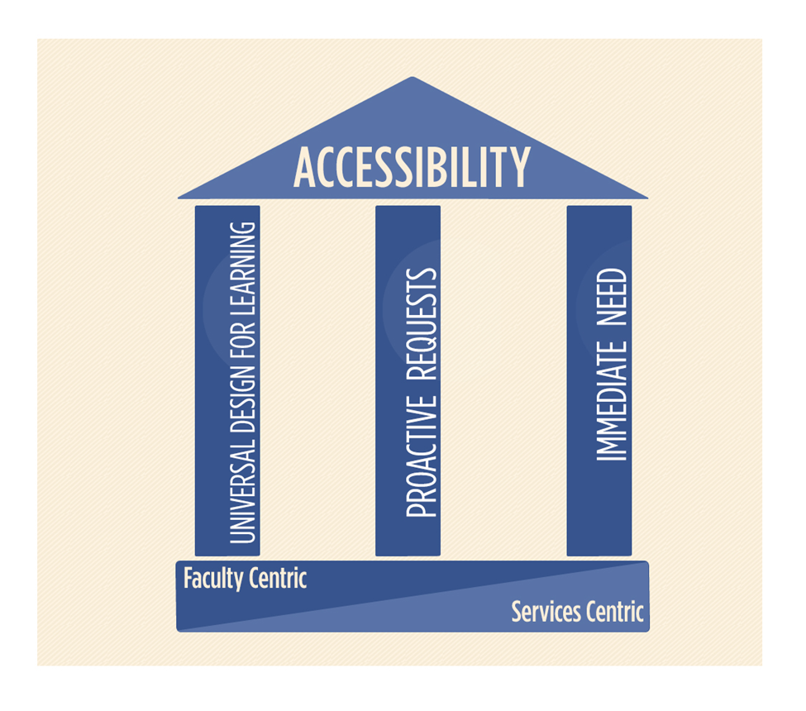
Online Course Accessibility Support Model

Slide 11
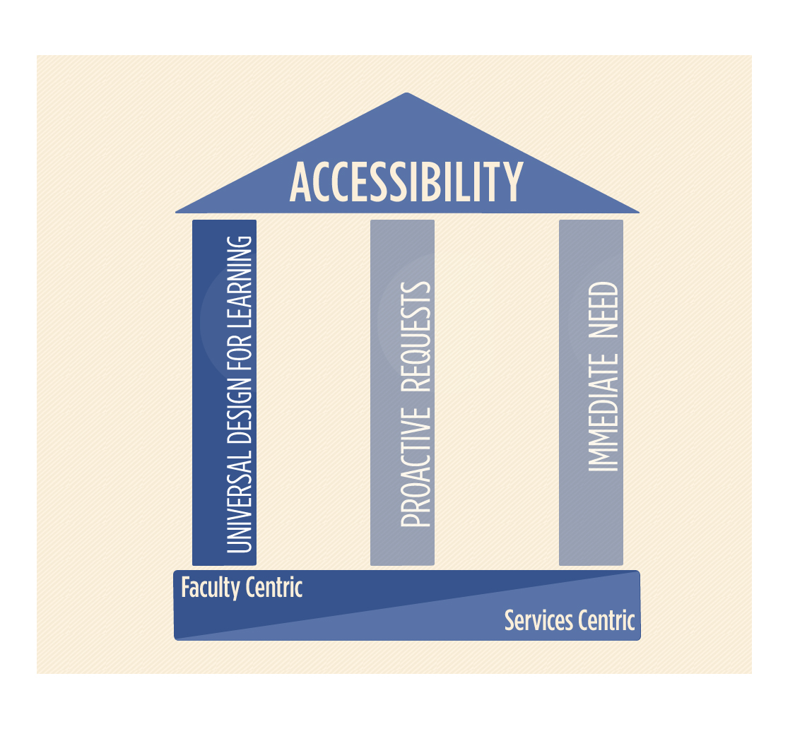
Universal Design for Learning

Slide 12
Universal Design for Learning Pillar
Enable faculty to apply Universal Design for Learning (UDL) principles when developing new online courses
Address the needs of diverse learners
Less time spent retrofitting courses when accommodation requests are received
All students benefit (e.g., ESOL students benefit from video captions)

Slide 13
Integrate UDL in Professional Development
Required
IDL6543 - to design and develop an M or W course
ADL5000 - to teach an M or W course
Optional
Faculty Seminars in Online Teaching
Faculty Multimedia Workshop Series
Faculty Center for Teaching and Learning
Course Improvement Project – Universal Design for Learning
Tech Time
Instructional Design Consultations

Slide 14
Integrate UDL in IDL6543
Addressed throughout the course
Online module on accessibility and UDL
Project based course: Build Your Course Activities
Content, interaction, assessment
Formatting guidelines
Creating Accessible Course Content
One-on-one consultations with instructional designer
Module and Course rubrics
Peer Review

Slide 15
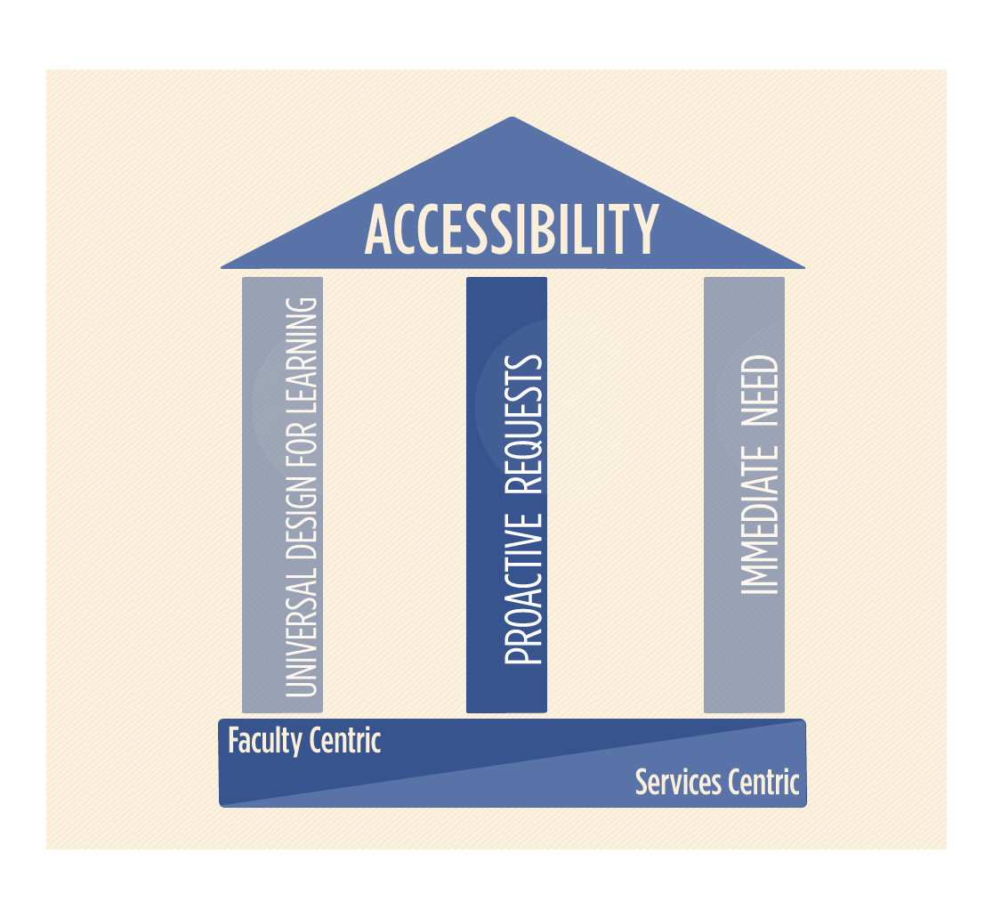
Proactive

Slide 16
Proactive Requests
Legacy Courses and Faculty
Attended faculty development years ago
Designing and developing courses for years
Adding their own content including media that has developed over the years

Slide 17
Proactive Requests
Address in two ways
Faculty member requests course review for accessibility
Instructional Designer recommends course review for accessibility
Services offered
Accessibility Evaluation of Content
Performed by Usability Checker
Report provided to ID
ID and Faculty member come up with plan
UDOIT – Coming soon

Slide 18
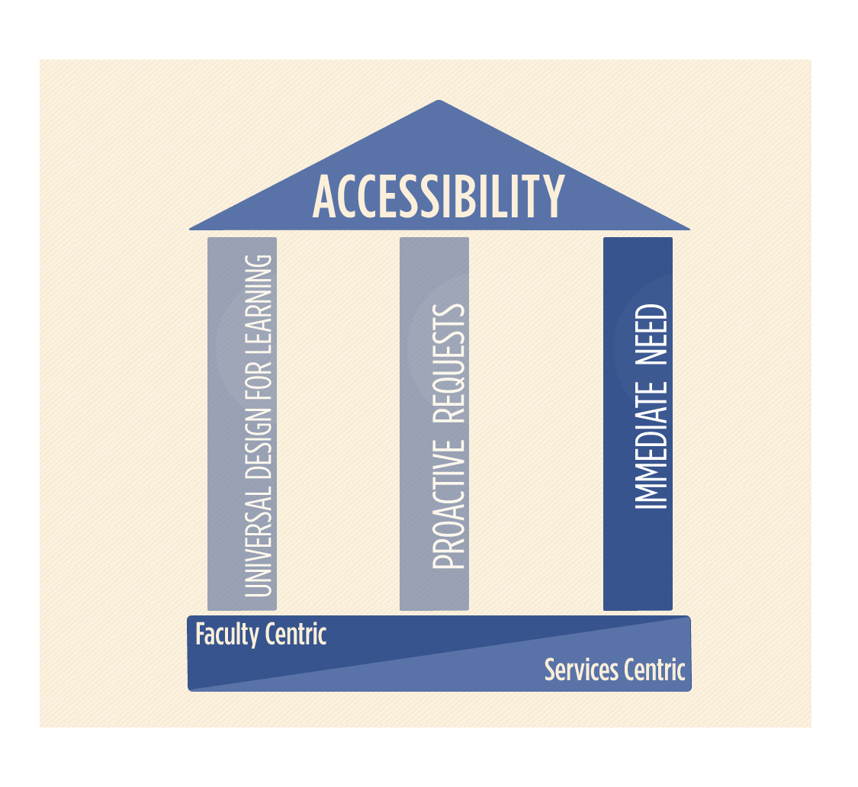
Immediate Need Pillar
Add Immediate Need UCF Accessibility Support Model

Slide 19
Immediate Need
CDL developed accommodation workflow
Identified tasks and responsibilities of CDL, SDS, faculty
Identified CDL teams that would make the accommodations
Identified a point person within CDL to oversee and coordinate all efforts inside and outside the unit
Identified one team to coordinate all accommodation efforts (within CDL and with SDS)

Slide 20
UCF Online Accessibility Accommodation Workflow

Slide 21
Benefits of Online Course Accessibility Support Model
More efficiency in meeting the needs of Students with Disabilities
Improved Communication Across Campus
Regular meetings
Within CDL
All units who support faculty to discuss accessibility
SDS, CDL, Faculty Center for Teaching and Learning, and Office of Instructional Resources
Benefits of meetings
Identify potential problem areas
Improve processes
Increase efficiency
Increased Faculty Awareness

Slide 22
Strategies for Supporting Accessibility/UDL
Develop a plan to address accessibility/UDL
Assign a Coordinator
Provide resources for faculty
Reach out to faculty by providing training
Provide short professional development opportunities
Hire a student to help as a Usability Checker
Search and purchase accessible software/technology
Include accessibility/UDL seamlessly into research, conferences, workshops, pilot studies

Slide 23
UCF Resources
UCF Provost letter
Accessibility Tips
Creating Accessible Course Content
Formatting Guidelines
IDL6543 Module and Course rubrics
Faculty Seminars in Online Teaching
Faculty Multimedia Workshop Series
Professional Development Pathways

Slide 24
UDL Resources
DO-IT
Universal Design in Education: Principles and Practices
Checklist for Inclusive Teaching
The Center for Universal Design in Education
CAST
UDL Wheel
UDL Guidelines Version 2.0
WebAim
CANnect
Seven Principles of Universal Design
EnACT UDL Syllabus Rubric

Slide 25
Contact
Nancy Swenson
nancy.swenson@ucf.edu

