Slide 1

The Disability Resource Center
How to evaluate web pages for accessibility

Slide 2
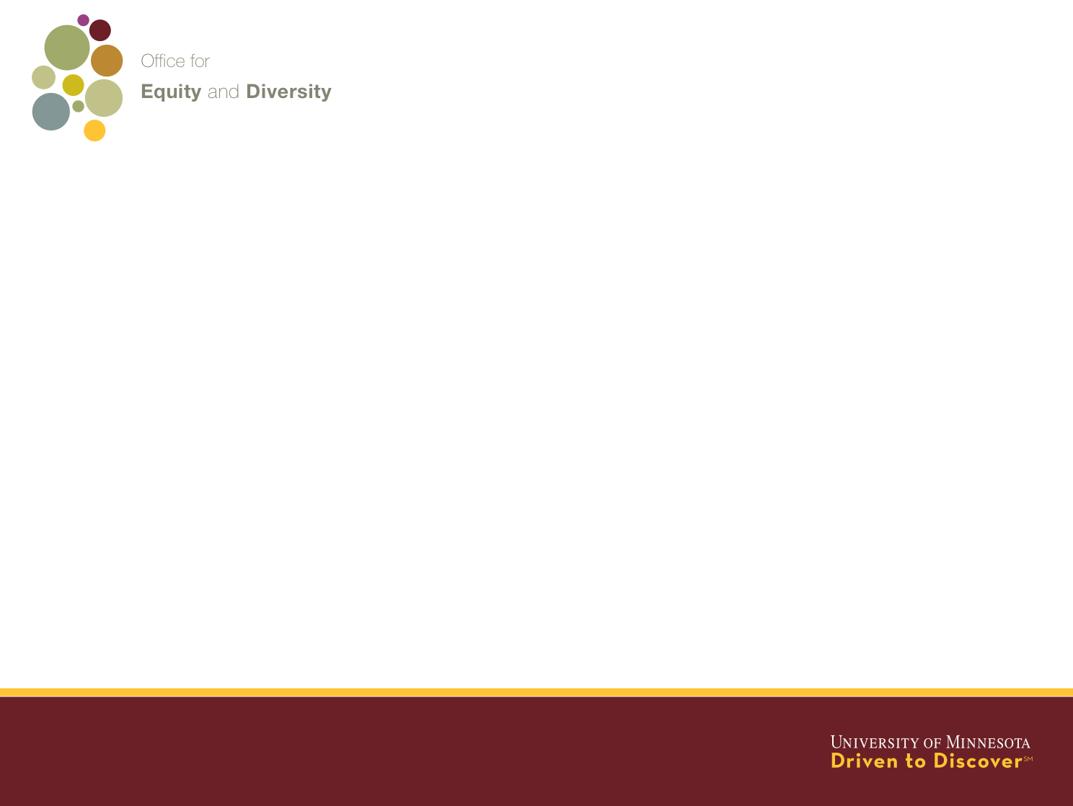
I believe in bicycles
The Disability Resource Center

Slide 3
Web accessibility issues are often invisible
The Disability Resource Center

Slide 4
Categories of disabilities
The Disability Resource Center
Learning disabilities
Deaf and hard of hearing
Vision impaired and blind
Mobility impaired
Notes:
Describe each in more detail.

Slide 5
Impacts of disabilities
The Disability Resource Center
Hearing impaired and Deaf – no speakers
Vision impaired and blindness – no monitor
Mobility impaired – no mouse

Slide 6
Elements of accessibility
The Disability Resource Center
Structure
Styling (font, color, spacing)
Images
Media
Keyboard navigation

Slide 7
Web accessibility standards
The Disability Resource Center
Web Content Accessibility Guidelines (WCAG) 2.0 AA
Web Accessibility Initiative (WAI)-Accessible Rich Internet Application(ARIA) WAI-ARIA
ATAG – Authoring Tool Accessibility Guidelines
Web Accessibility Issues and Techniques
Notes:
Notes

Slide 8
Web accessibility evaluation
The Disability Resource Center
WebAIM’s WCAG 2.0 checklist
A11yproject.com checklist
IBM web accessibility checklist
Notes:
Notes

Slide 9
Web accessibility evaluation process
The Disability Resource Center
Perform both manual and automated checks
Structure and keyboard navigation
Images and links
Color contrast
Media
Forms
Notes:
Notes

Slide 10
Web accessibility checking software
1. Comprehensive checkers
The Disability Resource Center
WAVE Firefox toolbar and WAVE online service
AInspector Sidebar Firefox extension
Web Accessibility Toolbar IE Extension
Chrome Accessibility Audit
FireEyes
CynthiaSays
Notes:
Notes

Slide 11
Web accessibility checking software
2. Automated tools
The Disability Resource Center
Functional Accessibility Evaluator
HiSoftware Compliance Sheriff – from HiSoftware
WorldSpace – from Deque
Accessibility Management Platform – from SSB Bart
SiteImprove – from SiteImprove
Notes:
Notes

Slide 12
Web accessibility checking software
3. ARIA roles and color contrast
The Disability Resource Center
Juicy Studio color contrast checker
WCAG contrast checker
Notes:
Notes

Slide 13
Web accessibility checking software
4. Screen readers
The Disability Resource Center
ChromeVox Screen Reader
NVDA – free screenreader
JAWS – screen reader
VoiceOver – Mac built in screen reader
WindowEyes – free with Microsoft Office
Notes:
Notes

Slide 14
Web accessibility checking
5. Additional checks
The Disability Resource Center
Use only the tab key, space bar and the Enter key on your keyboard.
Use screen magnification
Use browser based text magnification
Use Speech to Text software (Dragon Naturally Speaking)
Notes:
Notes

Slide 15
Example of using WAVE Firefox Toolbar
The Disability Resource Center
Issues
Requires manual checking
Image alt tags
Outline
ARIA roles
Notes:
Notes

Slide 16
Challenge:
Find as many web accessibility issues on http://z.umn.edu/scansample.
Download files to work on the desktop http://z.umn.edu/scansampledownload
The Disability Resource Center
Notes:
Notes

Slide 17
In conclusion
The Disability Resource Center
Web accessibility issues are often invisible
Making Web page elements accessible does not insure functional accessibility.
What components of the presentation struck home?
What components/techniques will you use in your work?
What would you like to know more about/plan to investigate?
Notes:
Notes

Slide 18
Contact info
The Disability Resource Center
Tonu Mikk Phil Kragnes
tmikk@umn.edu pmk@umn.edu
612 625-3307 612 626-0365
http://accessibility.umn.edu
http://cap.umn.edu
http://diversity.umn.edu/disability
Notes:
Notes

