Slide 1
Accessibility of HTML5 & WAI-ARIA
Accessing Higher Ground, 2014
The Paciello Group

Slide 2
HTML5

Slide 3
What is HTML5
More like a set of specifications for a new platform

Slide 4
New Elements
<video>, <audio> & associated elements
Sectioning elements
Form fields

Slide 5
<video> and <audio>

Slide 6
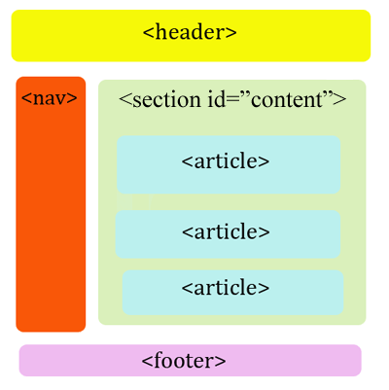
HTML5 section elements
Section elements
Using WAI -ARIA Landmark Roles

Slide 7
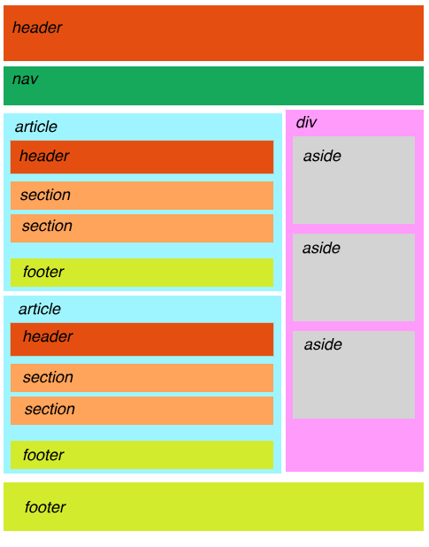
HTML5 section elements
Section elements

Slide 8
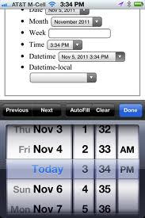
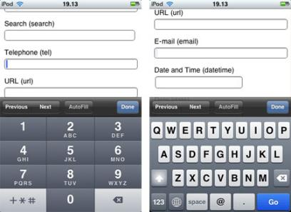
HTML5 Forms
New input types in HTML5
Color
Date / datetime / datetime-local
Email
Month
Number
Range
Search
Tel
Time
URL
Week

Slide 9
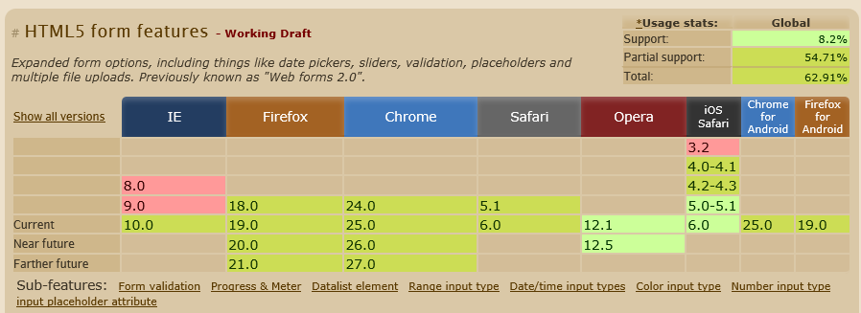
HTML5 Form Support
What happens if HTML5 form type is not supported?

Slide 10
WAI-ARIA

Slide 11
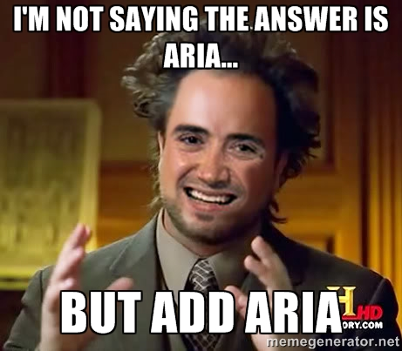
If you only leave with one take away

Slide 12
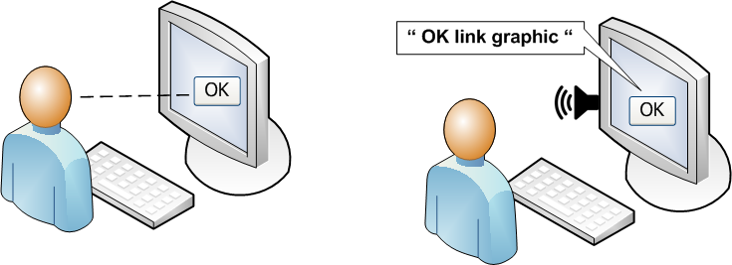
What does ARIA do for a Screen Reader?
Sighted user infers control’s role (purpose)
Screen reader perceives something different than sighted users
E.g. “link” rather than “button”
ARIA can correct this by provides the role and state properties
Notes:
Exposes the role information to accessibility APIs
Role="main"
Role ="alert"
Role="button"
Role="checkbox"
Provide instructions to screen reader users
Role="button" adds "to activate press space bar"

Slide 13
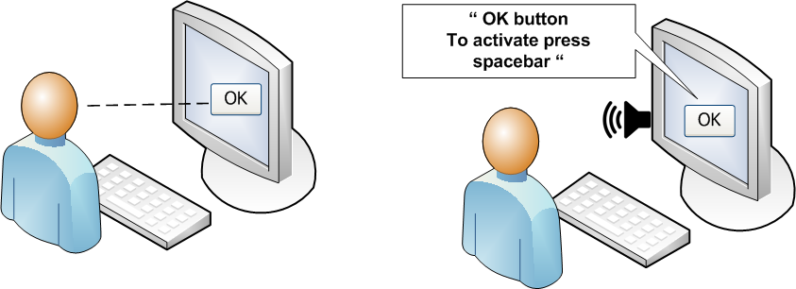
Screen Reader Provides Additional Instructions
Screen readers add instructions on how to interact with the control
Description varies based on control’s role
Notes:
ARIA adds information about a control’s state, as well. For example, "pressed."

Slide 14
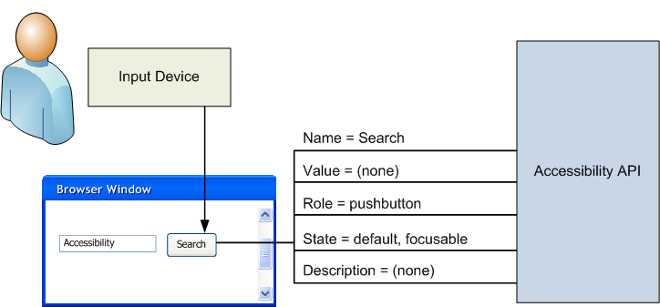
Under the Hood…
Assistive technologies learn about controls through accessible APIs (such as MSAA and IA2)
Notes:
Accessibility API Operating systems and other platforms provide a set of interfaces that expose information about objects and events to assistive technologies. Assistive technologies use these interfaces to get information about and interact with those widgets. Examples of this are the Java Accessibility API [JAPI], Microsoft Active Accessibility [MSAA], the Mac OS X Accessibility Protocol [AXAPI], the Gnome Accessibility Toolkit (ATK) [ATK], and IAccessible2 [IA2].

Slide 15
ARIA: What Doesn’t it Do
It’s not magic
It only changes how assistive technology interprets content.
Adding a ARIA does not:
Make an element focusable
Provide keyboard events
Add properties
Change visible appearance

Slide 16
What can ARIA do for RIA
Make custom widgets understandable to assistive technology users
Fix or correct inaccessible content without completely recreating widgets from scratch
Programmatically indicate relationships between elements
Hide irrelevant visible content from assistive technology
Notify users of dynamic updates

Slide 17
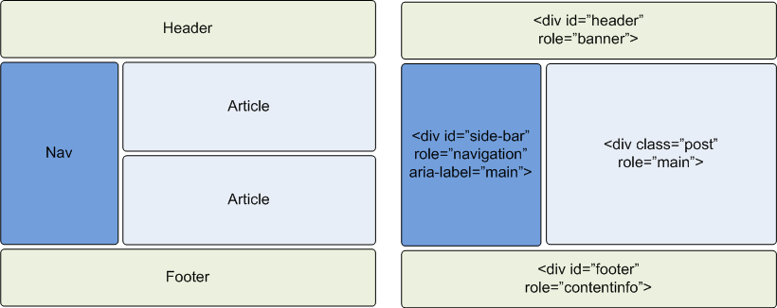
Landmark Roles
Notes:
Banner: A region that contains the primary heading or web site title. (site logo, login details, etc.)
Search: The search tool of a web document.
Navigation: The documents Navigation menus and links.
Main: The main content of web document.
Form: contains a collection of items and objects that, as a whole, combine to create a form.
Complementary: content that has meaning outside the page as well (e.g. a sidebar with related articles).
Contentinfo: Metadata that applies to the parent document (e.g. copy right disclaimers, company info).
Using WAI ARIA Landmark Roles

Slide 18
Landmark Roles
Banner assign to elements containing site-oriented content such as the name of the site, title and/or logo
Complementary assign to content that is supplemental to the main content
Contentinfo assign to copyright, privacy policy, terms of use or footnote areas
Form
Main assign to the main content of the page
Navigation assign to the element containing navigation links
Search defined where the main search function is on the page
NOTE:
Use once: Banner, Contentinfo and Main landmarks
Can be used more than once: Complementary and Navigation landmarks

Slide 19
Screen Readers & Landmarks
Regions of the page for navigation
Screen readers support navigating to these elements
AT users quickly recognize page sections and navigate to them
JAWS commands:
r (prior to JAWS 15 ; (semicolon)) jump to next landmark
Shift + ; (semicolon) jump to previous landmark
Ctrl + Ins + ; (semicolon) show list of available landmarks
NVDA commands:
D jump to next landmark
Shift + D jump to previous landmark
NVDA + F7 show list of available landmarks
Best Practices:
Label the areas with a descriptive name using aria-label, aria-labelledby or title attribute
Do not overuse
Notes:
Current browsers and AT support:
http://www.html5accessibility.com/tests/landmarks.html
http://www.accessibleculture.org/articles/2011/04/html5-aria-2011/ for summary on what works with HTML5 and ARIA

Slide 20
Where Do the Landmarks Go?
Banner
Navigation
Main
Complementary
Contentinfo

Slide 21
Labeling Landmarks
Pages use more than one "navigation" role
The screen reader user does not know which is which
Solution: label each landmark individually!
Can be done using common labeling techniques, e.g. aria-labelledby, aria-label and title attribute
<h2>
<span id="NavHeading">Account Types</span>
</h2>
<div role="navigation" aria-labelledby="NavHeading">
[Navigation Links]
</div>

Slide 22
Landmarks
The following roles are regions of the page intended as navigational landmarks.
banner = <header>
html5*
complementary = <aside> html5
contentinfo = <footer> html5*
form = <form> html4
main = <main> html5
navigation = <nav> html5
Search
Application = don’t use as a landmark

Slide 23
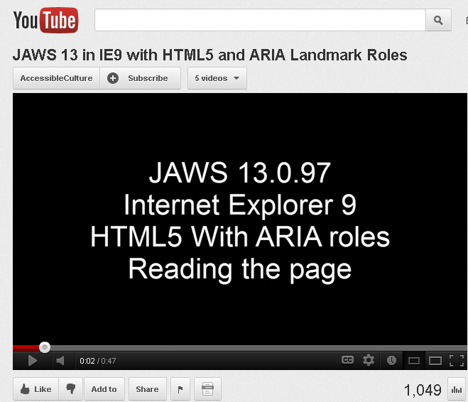
JAWS & Landmarks

Slide 24
Forms

Slide 25
Keyboard Handling
Every widget needs to be operable by keyboard. common keystrokes are:
Arrow keys
Home, end, page up, page down
Enter, space
ESC
Mimic the navigate in the desktop environment
ARIA Design Patterns: http://www.w3.org/WAI/PF/aria-practices/#aria_ex
Notes:
Every widget should have one stop
Composite widgets: menus, trees, grids, tabs
Ensure all widgets are reachable by keyboard
Depend on Tab order: default or custom?
Support global keyboard shortcuts
How do you notify your users?
Implement a custom focus manager
Might be best solution for very complex UI's
Let go of the traditional tab order idea: "all focusable elements must be reachable by tab order"

Slide 26
Checkbox
Why? HTML already has a checkbox!
Your widget might not look like standard checkbox:
A cell in a table that can be toggled
An icon that can be checked or unchecked
A specifically styled checkbox
Your widget might not behave like a standard checkbox, for example a tri-state checkbox:
<span role="checkbox" aria-checked="mixed">

Slide 27
Slider
To select a value in a range
Uses states:
aria-valuenow: current value updated on every value change
aria-valuemin: range minimum
aria-valuemax: range maximum
aria-valuetext: optional, for slider’s unit
e.g. ‘dollar’, ‘megabytes’, ‘strongly agree’
<div role="slider" aria-valuenow="34"
aria-valuemin="0"
aria-valuemax= "100"
aria-valuetext= "34 percent">…
</div>

Slide 28
Tablist & Tab
Tablists contain role="tab" elements
Can only expand one tab at a time
Indicated by ‘aria-expanded’ attribute
Expected keyboard shortcuts
Left / Up Arrow: Show the previous tab
Right / Down Arrow: Show the next tab
Home: Show the first tab
End: Show the last tab

Slide 29
Implementing Tabpanel
<div id="tabpanel1" class="tabpanel">
<ul class="tablist" role="tablist">
<li id="tab1" class="tab selected" aria-controls="panel1" role="tab">Crust</li> <li id="tab2" class="tab" aria-controls="panel2" role="tab">Veggies</li> <li id="tab3" class="tab" aria-controls="panel3" role="tab">Carnivore</li> <li id="tab4" class="tab" aria-controls="panel4" role="tab">Delivery</li>
</ul> <div id="panel1" class="panel" aria-labeledby="tab1" role="tabpanel"> <h3>Select Crust</h3> [radio buttons]
</div>
</div>
http://test.cita.illinois.edu/aria/tabpanel/tabpanel1.php

Slide 30
Buttons & Toolbars
Each button on a toolbar has role ‘button’
Turn buttons into toggle buttons with a ‘pressed’ attribute
Turn buttons into menu buttons with an ‘aria-haspopup’ attribute
<div onclick="dv.toggleFullScreenMode();" class="enable-full-screen-mode" id="fullScreenContainer" role="button" aria-pressed="false">
<span class="off-screen">Enable full screen mode</span>
</div>

Slide 31
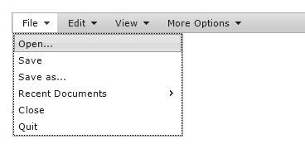
Menu Bars
Can have multiple menus, submenus and menu items with ARIA role structure
If a menu items has a sub menu add aria-haspopup="true" and aria-owns="<ID>" (Points to ID of submenu element)
<ul role="menubar">
<li role="menuitem" aria-haspopup="true" aria-labelledby="fileLabel">
<span id="fileLabel">File</span>
<ul role="menu">
<li role="menuitem">Open</li>
<li role="menuitem">Save</li>
…
</ul>
</li>
…
</ul>
See this example in action at:
http://access.aol.com/aegis/#goto_menubar
Notes:
Menu items can be special
role="menuitemcheckbox": checked state
role="menuitemradio": checked, part of group
Hans Hillen’s Example:
<ul id="sampleMenubar" aria-label="Sample Options" role="menubar">
<li class="ui-menubar-item" role="presentation">
<a href="#" role="menuitem" aria-haspopup="true">
File
<span class="ui-button-icon-secondary ui-icon ui-icon-triangle-1-s"></span>
</a>
<ul id="ui-menu-0" role="menu" aria-label="File" tabindex="0" aria-expanded="false" aria-activedescendant="ui-menu-0-1" aria-hidden="true">
<li class="ui-menu-item" role="presentation">
<a id="ui-menu-0-0" role="menuitem">Open...</a>
</li>

Slide 32
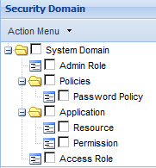
Trees
Nested structure of tree nodes
Nodes have ‘treeitem’ role
Branches contained by role="group" element
Branches have ‘aria-expanded’ to tell AT open/closed
AT announces nesting level
<div role="tree">
<span role="treeitem" aria-expanded="true">System domain</span>
<div role="group">
<span role="treeitem" aria-expanded="true">Admin Role</span>
</div>
...
</div>

Slide 33
Labeling in a Nutshell
All of these must have an accessible name:
Every interactive widget
Composite widgets (menu(bar), toolbar, tablist, tree, grid)
Groups, regions and landmarks
Browsers determines an element’s accessible name by checking the following :
aria-labelledby
aria-label
Associated label (<label for=“myControl”>) or alt attribute
Text contents
Title attribute
Optionally, add an accessible description for additional info

Slide 34
Label, Labelledby & Describedby
Aria-labelledby=“elemID”
Points to element ID that identifies the widget.
Can also use regular label element / title attribute
Aria-describedby=“elemID”
Optional, provides additional info besides identity
Useful for additional info, instructions, hints
Aria-label=“text”
Only use when no on-screen text
Title attribute will also work
<h2 id=“treeLbl”>My Folders</h2>
<p id=“treeDesc” class=“hidden”>Each tree item has a context menu with more options</p>
<div role=“tree” aria-labelledby=“treeLbl” aria-describedby=“treeDesc”>
Notes:
Can point to multiple Ids, to ‘concatenate’ labels / decriptions
AT Support Summary: http://www.paciellogroup.com/blog/aria-tests/aria-labelledby-input.html
When defining more than one of these, the order of precedence is:
If these are defined: aria-label, aria-labelledBy, and Title: JAWS reads title
If these are defined: aria-label, and aria-labelledBy: JAWS reads Label

Slide 35
ARIA Relationship Attributes
Attributes that indicate relationships or associations between elements
Used when structure cannot be determined
Attributes include:
aria-activedescendant
aria-controls
aria-describedby
aria-flowto
aria-labelledby
aria-owns
aria-posinset
aria-setsize

Slide 36
Labeling And Describing Widgets
Aria-labelledby=“IDREFS”
Value is one or more IDs of elements that identifiy the widget.
The elements ‘aria-labelledby’ targets can be any kind of text based element, anywhere in the document.
Add multiple Ids to concatinate label text:
Multiple elements can label one widget, and one element can label multiple widgets. (example)
Aria-describedby=“IDREFS”
Similar to labelledby, except used for additional description, e.g. Form hints, instructions, etc.
Aria-label
Simply takes a string to be used as label.
Quick and dirty way of making the screen reader say what you want.
Very easy to use, but only supported in Firefox at the moment.
<h2 id=“treeLbl”>My Folders</h2>
<p class=“hidden”>Each tree item has a context menu with more options</p>
<div role=“tree” aria-labelledby=“treeLbl” aria-describedby=“treeDesc”>
...

Slide 37
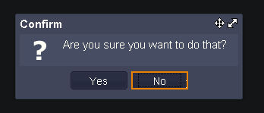
Labeling containers
Containers such as toolbars, dialogs, and regions provide context for their contents
When the user moves focus into the container, the screen reader should first announce the container before announcing the focused control
<div role="dialog" aria-labelledby="dialogTitle" aria-describedby="dialogDescription">
<h2 id="dialogTitle">Confirm</h2>
<p id="dialogDescription">
Are you sure you want to do that?
</p>
<button>Yes</button>
<button>No</button>
</div>
Notes:
Jquery dialog example

Slide 38
Live Regions

Slide 39
Live Regions
Allows user to be notified of content changes
Typically for content that changes automatically
Content change may exist separate to what has focus
Live Regions facilitate these notifications

Slide 40
“Built In” Live Regions
Role=“alert” for one-time, high-priority notifications
Shown for a period of time, or until the cause of the alert is solved
Basic message, no complex content
The element with the alert role does not need to be focused to be announced
Role=“alertdialog” is similar to alert, but for actual (DHTML) dialogs.
May contain other widgets, such as buttons or other form fields
Does require a sub-element (such as a ‘confirm’ button) to receive focus
Live regions ‘built into ‘ roles’
role="timer", "log", "marquee" or "status“ get default live behavior
Role=“alert” implicitly sets live to assertive
Notes:
The following politeness values are available for aria-live: off, polite, and assertive.
Aria-live="off"
Default value, identical to not setting aria-live. Examples:
A DHTML clock
Number of users currently online
Aria-live=“polite”
Updates are announced but won’t interrupt the user
Should be used in most situations involving live regions that present new information to users:
Updates to news headlines, twitter alerts, monitored stocks, etc.
Aria-live=“assertive”
Updates are announced and interrupt what the user is doing
Only use for important updates that require immediate attention.
Warnings & error notifications.
Session timeout notifications
aria-atomic="true | false"
Optional. Indicates if assistive technology should present all or part of the changed region to the user.
aria-atomic=“true”: assistive technology should announce the entire region when part of it changes;
aria-atomic=“false”: only the part of the region that changed should be announced on its own.
aria-busy="true | false"
Optional. Indicates whether region has finished updating, or whether certain parts are still expected to change.
aria-busy=“true”: region not fully updated yet, AT should wait.
aria-busy=“false”: region update is complete, AT can start announcing the update.
Fall back solution for dialogs
In IE, JAWS currently does not properly announce dialogs when moving focus into them
It's possible to provide a fallback solution for IE to fix this, using hidden fieldsets to apply the ARIA dialog markup to
Hide fieldset's padding, margin, and border
Move legend off-screen
<fieldset role="dialog" aria-labelledby="dialogTitle" aria-describedby="dialogDescription">
<legend id="dialogTitle">Confirm</legend>
<p id="dialogDescription">
Are you sure you want to do that?
</p>
<button>Yes</button>
<button>No</button>
</fieldset>
Fallback solutions for link buttons
Developers often use links as (icon) buttons
Side effect: screen reader will announce them as a link, not a button
This can be made accessible by setting role="button"
Screen reader announces link as button now, but also provides hint for using a button ("press" space to activate)
You lie! Links work through the Enter key, Space will scroll down the page
To make sure JAWS is not lying, you'll have to manually add a key event handler for the Space key.
<a role="button" onkeypress="handleKeyPress(event);">refresh</a>
Fixing Structure: Aria-owns
Sometimes a widget structure is not explicit via the DOM and logical structure of a page.
Aria-owns=“IDREFS”
Indicates that the element(s) referenced by the IDs should be considered a child of the element that has this attribute.
<h3 id="header">Vegetables</h3>
<ul role="list" aria-labelledby="header" aria-owns="external_listitem">
<li role="listitem">Carrot</li>
<li role="listitem">Tomato</li>
<li role="listitem">Lettuce</li>
</ul>
…
<div role="listitem" id="external_listitem">Asparagus</div>
Fixing Incorrect Grid Structure (1)
Some developers will use multiple HTML <table> elements to create one single grid. For example:
One <table> for the header row, one <table> for the body rows
One <table> for every single row
Why? Because this is easier to manage, style, position, drag & drop, etc.
Screen reader does not perceive one single table, but it sees two ore more separate tables
Association between column headers and cells is broken
Screen reader's table navigation is broken
Fixing Incorrect Grid Structure (2)
If using a single table is not feasible, use ARIA to fix the grid structure as perceived by the screen reader
Use role="presentation" to hide the original table elements form the screen readers
Use a combination of "grid", "row", "gridcell", "columnheader" roles to make the screen reader see one big grid.
Fixing Incorrect Grid Structure (3)
Using ARIA to create a correct grid structure
<div role="grid">
<table role="presentation">
<tr role="row">
<th role="columnheader">Dog Names</th>
<th role="columnheader">Cat Names</th>
<th role="columnheader">Cow names</th>
</tr>
</table>
<table role="presentation">
<tr role="row">
<td role="gridcell">Fido</td>
<td role="gridcell">Whiskers</td>
<td role="gridcell">Clarabella</td>
</tr>
</table>
</div>

Slide 41
What is this thing & what does it do?
Chat, error logs, etc.
role='log'
Status messages
role='status'
Urgent message req. immediate notice
role='alert’
Stock ticker
role='marquee'
Timer/ Clock
role='timer'
Progress indicator
role='progressbar'
None of the above?
role='region'

Slide 42
How important is the content?
Meh
OMFG
aria-live='polite'
Waits for queued output to be read/ paused
Default for most roles
aria-live='assertive'
Interrupts output
Default for alert role

Slide 43
What is being changed?
I’m adding stuff
aria-relevant='additions'
I’m removing stuff
aria-relevant='removals'
I’m changing text
aria-relevant='text'
I’m replacing stuff
aria-relevant='all'

Slide 44
What matters?
The New Hotness
All the things!
aria-atomic='false'
Default behavior
Only announces changed node.
aria-atomic='true'
Presents entire contents
Notes:
if no ancestor nodes have explicitly set aria-atomic, assistive technologies will present only the changed node to the user. If aria-atomic is explicitly set to false, assistive technologies stop searching up the ancestor chain and present only the changed node. If aria-atomic is explicitly set to true, assistive technologies will present the entire contents of the element.

Slide 45
What’s my name?
Aria-label
Aria-labelledby
aria-label='Chat'
aria-labelledby='foo'
<h2 id='foo'>Chat</h2>

Slide 46
You givin me static?
<div role='alert’ aria-label='Errors'>
Please correct the following errors: </div>

Slide 47
You givin me static?
<h2 id='lunchtime'>
How long until lunch?
</h2>
<div role='timer' aria-labelledby='lunchtime'>
10 minutes
</div>

Slide 48
But wait! There’s moar!
<div id="userList" role="region" aria-atomic="false" aria-live="polite" aria-busy="false" aria-relevant="additions" aria-label="User List">
<ol>
<li id="3xBCS2kJi" data-dateadded="1395160799” >
Karl</li>
</ol>
</div>

Slide 49
Let’s Chat
http://chat.karlgroves-sandbox.com
(Just for show)
Live Regions Plugin https://github.com/karlgroves/jquery-live-regions

