Slide 1
Instructional Technology and Accessibility:
Strategies and Techniques
Rick Dowling, Coordinator of Faculty Development
Dr. Rachel Thompson, Director of Emerging Technology and Accessibility
Center for Instructional Technology
The University of Alabama
Tuscaloosa, Alabama

Slide 2
Disclaimer
Materials presented are for general informational purposes only and do not constitute legal advice. The content and opinions expressed by the presenters do not constitute or imply endorsement by The University of Alabama.

Slide 3

The University of Alabama By the Numbers
Founded 1831
36,155 students
1800+ tenured/
tenure-track faculty
6000+ employees
81 undergraduate degree programs
120 graduate degree programs
13 colleges and schools

Slide 4
Technology Landscape
Center for Instructional Technology
  Faculty Resource Center
    Campus-wide instructional tech support for Blackboard and much more
    Faculty development via tutorials and workshops
  Emerging Technology and Accessibility
    Relatively new initiative
    Web site and course review
    Accessibility website
    Tutorials and workshops

Slide 5
Collaboration Opportunities
ODS representation on campus-wide technology and learning committee
IT representation on ADA/accessibility committee
Monitoring instructional technology for new features that might help with accommodations and accessibility
Adding assistive technology tools/features to tech choices and testing
Joint funding proposals: ZoomText

Slide 6
E-text Repository
Considerations:
  Simplified distribution
  Limiting access by user, semester
  Avoiding identifying information
Blackboard Learn Content Collection
Steps involved for admins and ODS, students

Slide 7
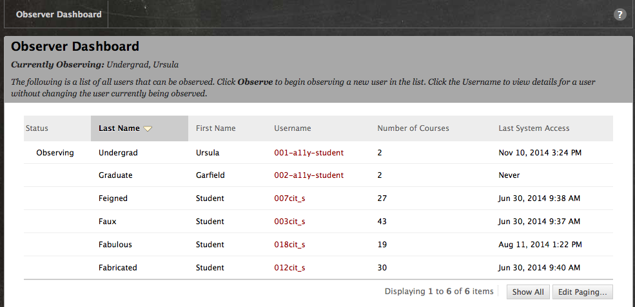
Observer Role
Commonly used for advisors, staff assigned a list of students and get view-only access to courses.

Slide 8
Course Review Challenges
Fall 2014:
  6,800+ sections using Blackboard
  ~75% of the 8500+ course sections taught in fall semester
  Growing number of fully online courses (700+ each semester)
  2500+ Blackboard instructors with adjuncts, clinical, Tas
Instructor permission
Institutional guidelines
Accommodations – YES! Accessibility? Huh?
Content Variation among and within courses

Slide 9
A Growing List of Options
Native Blackboard assignments, exams, discussions, and more
HTML, Word, PowerPoint, PDF, Excel, and other files
Video, audio, images, and other multimedia
Third-party and publisher content:
  Blackboard Collaborate web conferencing, voice tools, instant messaging
  OIRA Syllabus repository (created by UA)
  Respondus LockDown Browser exams
  Tegrity lecture capture
  Turning Technologies clicker registration
  Turnitin plagiarism prevention, grading, and collaboration tools for writing
  University of Alabama Libraries materials
  Publisher and other integrations: Cengage, Livetext, McGraw-Hill, Pearson, WebAssign, Wiley

Slide 10
Resources for Instructors
Tutorials addressing accessibility and accommodations
  Accessible content tips
  Extended time exams
  Captioning and Video Everywhere

Slide 11

Captioning Tegrity Lectures with Docsoft
UA uses Tegrity for lecture capture
Tegrity Supports “Captions”
UA has a Docsoft speech-to-text appliance purchased for the UA community in Fall 2013 by the Provost’s Office.

Slide 12
Basic Workflow
Make Tegrity Recording
Download mp3 Version
Upload mp3 file to Docsoft
Docsoft processes
Download and edit the transcript
Upload transcript to Tegrity

Slide 13
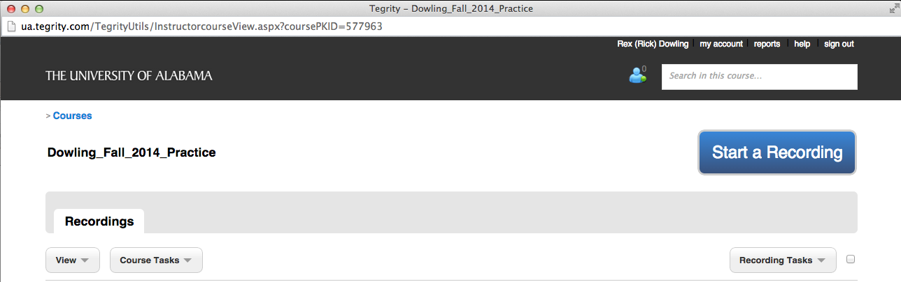
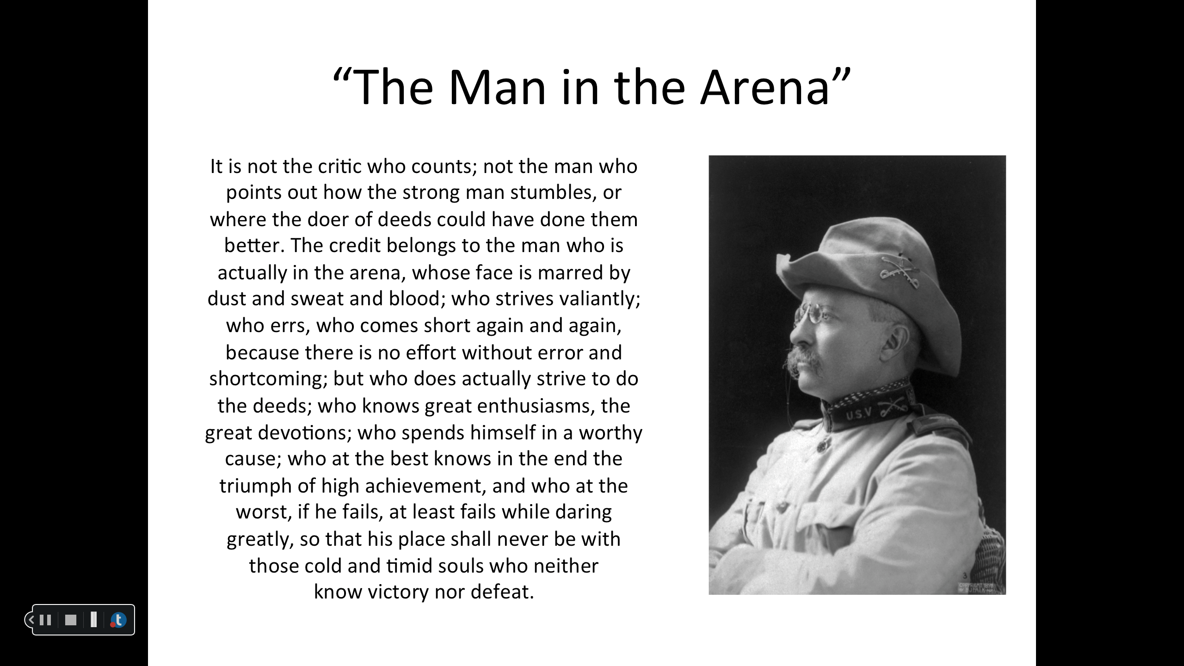
Create a Tegrity Recording
Tegrity course list accessed via Blackboard.
Tegrity records screen content, audio and (optional) instructor video. Recording controls float on screen.

Slide 14
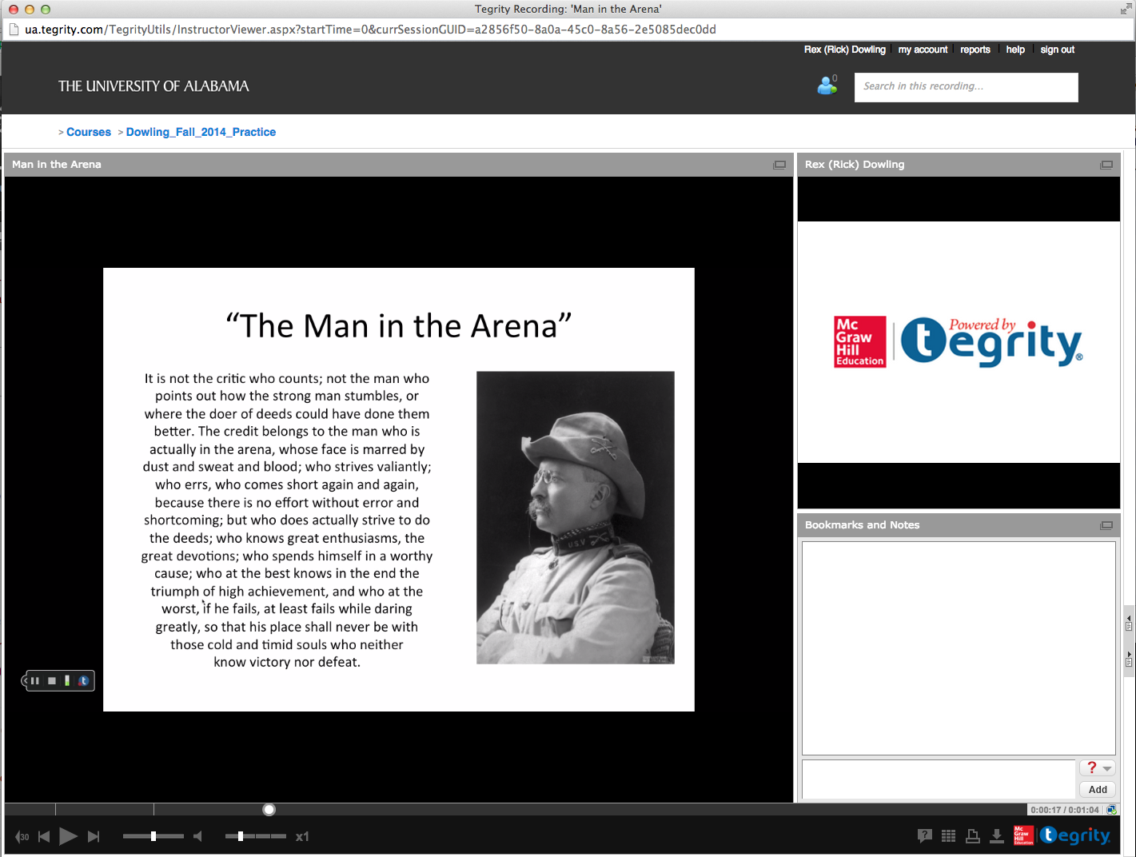
Uncaptioned Tegrity Recording
Tegrity playback interface with 3 windows: Main window contains slide with Teddy Roosevelt photo and text of "The Man in the Arena". Instructor video window displays Tegrity logo, indicating no video input. Bookmarks and Notes window is empty. No captions are present.

Slide 15
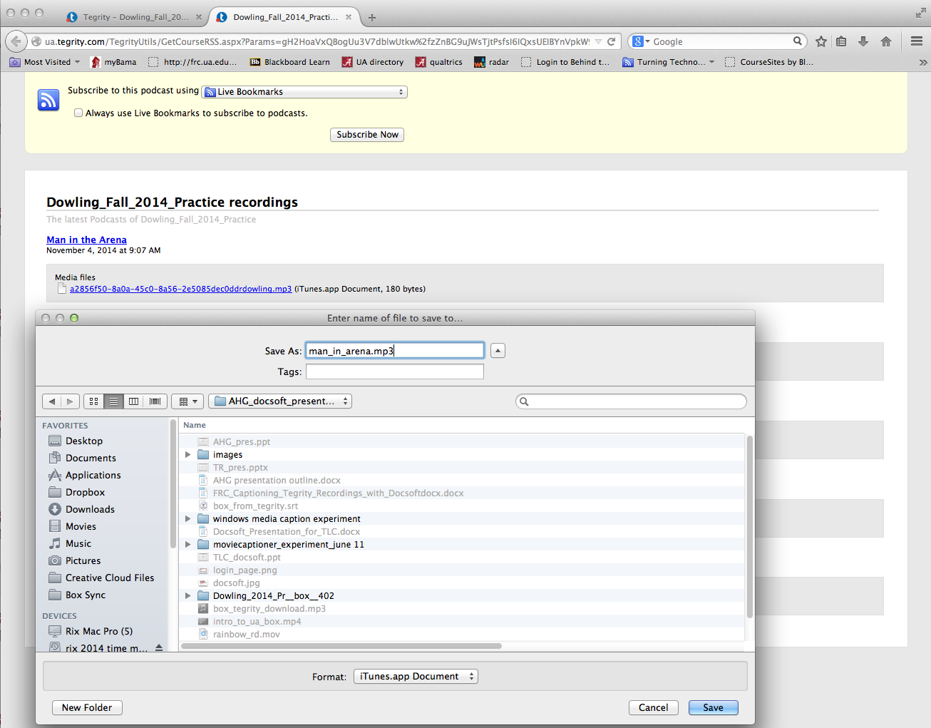
Download MP3 Version
Tegrity list of podcast MP3s. Save the MP3 locally. Note: The MP3 will have a non-intuitive name; Consider renaming it when you save locally.

Slide 16
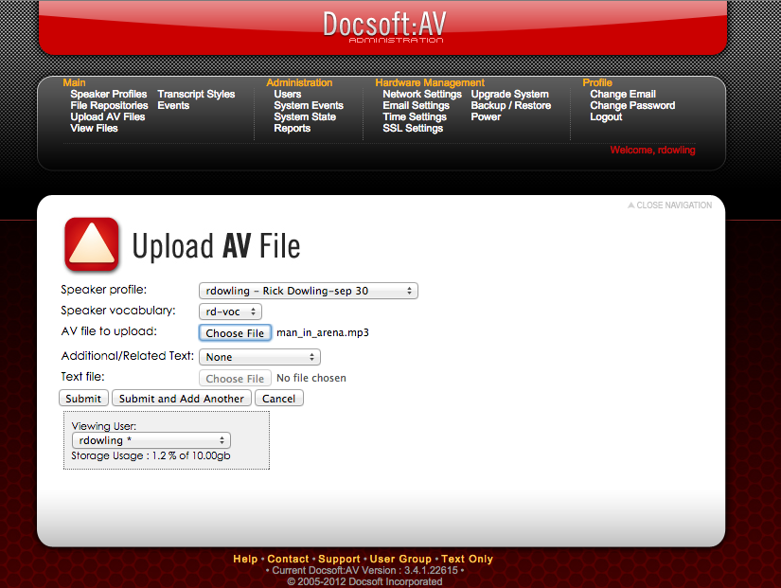
Upload mp3 to Docsoft
Docsoft AV file upload interface: Select the speaker profile. Browse to MP3 file saved from Tegrity. Add related texts, if available. Choose Submit.

Slide 17
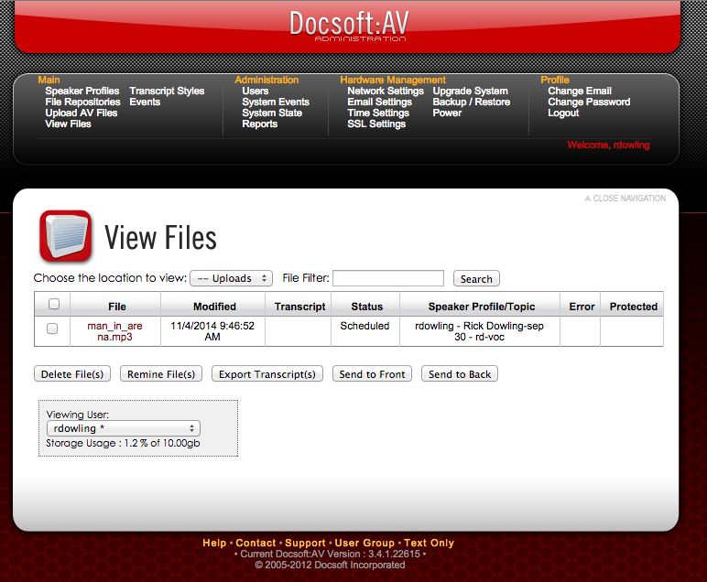
Docsoft Processes
The file is scheduled for processing and its status will update in the View Files list.

Slide 18
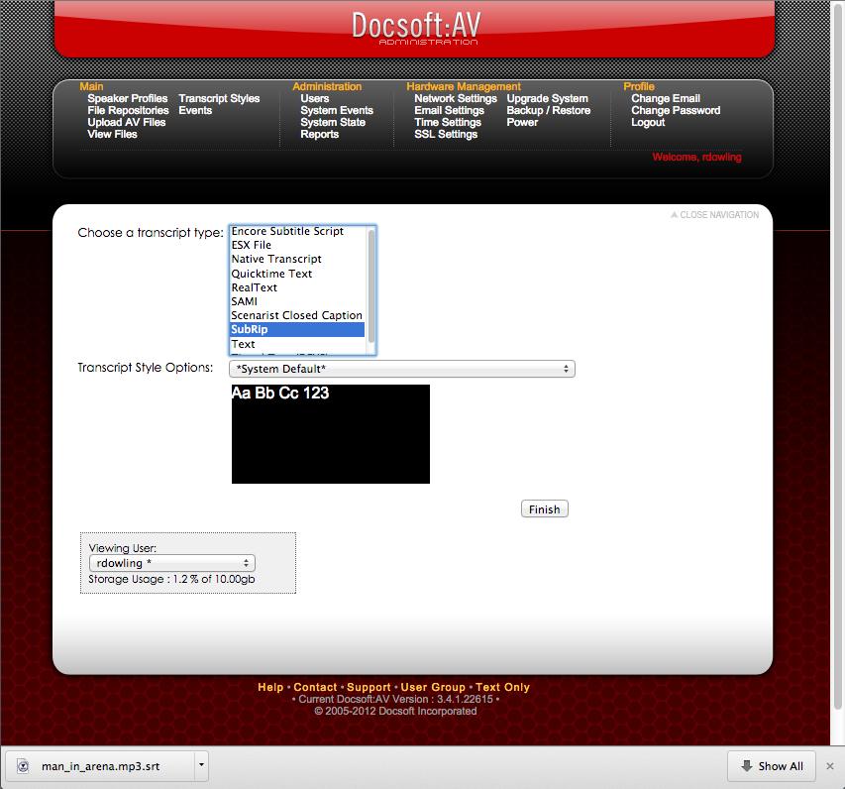
Download Transcript
Once Docsoft has processed MP3, export .SRT file. Edit in text editor. Do not alter time stamps or line numbers. Save the edited .SRT file.

Slide 19
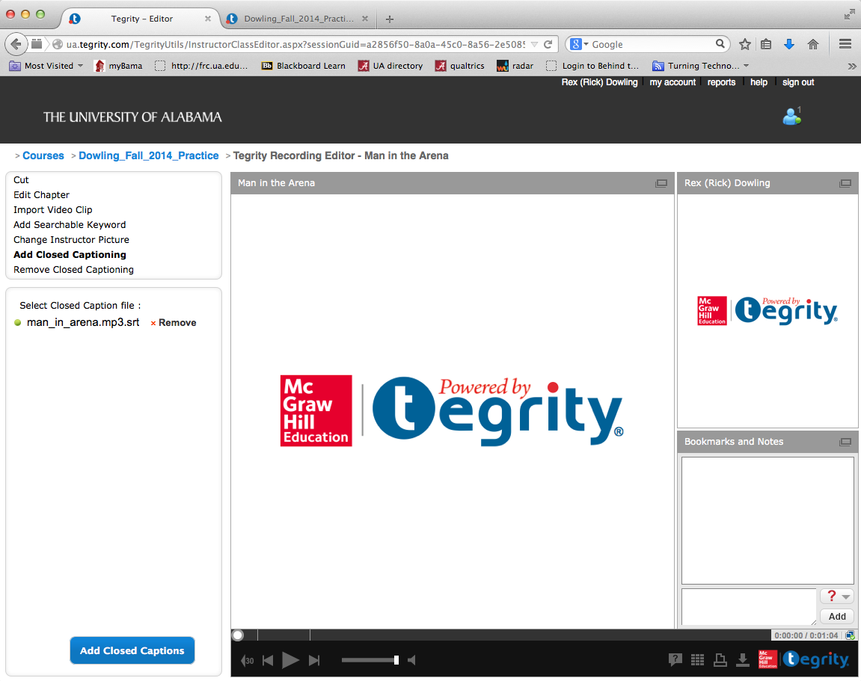
Upload .SRT File to Tegrity
Tegrity editing interface. Choose Add Closed Captioning. ‘Select Closed Caption File’ option appears. Select the edited .SRT file. Choose Add Closed Captions. A confirmation message is given when captions are added successfully.

Slide 20
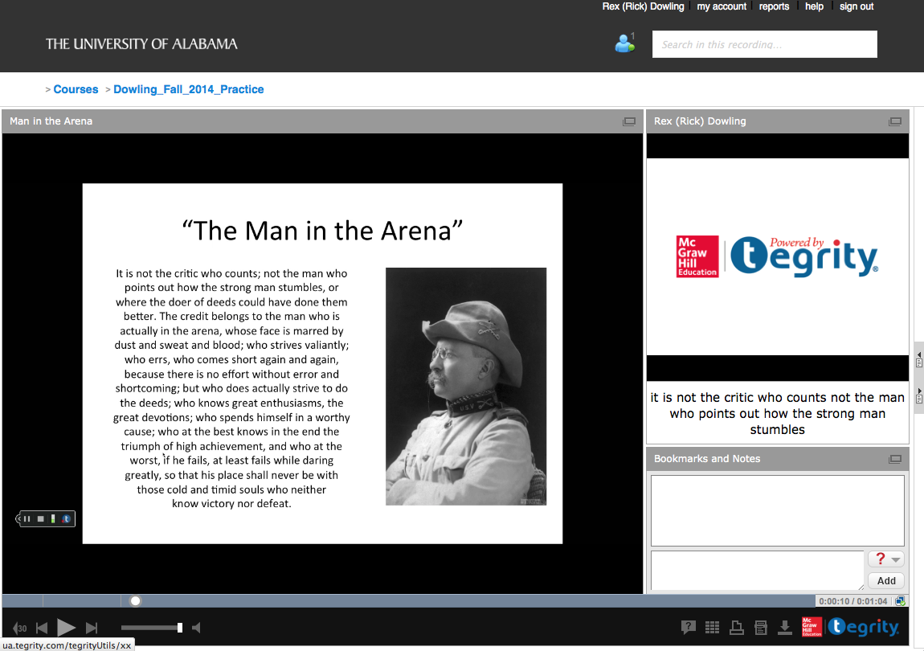
View Recording with Captions
Tegrity playback interface with 4 windows: Main window has slide with Teddy Roosevelt photo and text of "The Man in the Arena". Instructor video window displays Tegrity logo, indicating no video input. Caption window with newly-added captions appears beneath video window. Bookmarks and Notes window is empty.

Slide 21
Accuracy
Initial accuracy is in the 80% range, but you can improve that by creating a speaker profile
Docsoft works best for recordings of a single speaker
Score for this reading was 95%
Docsoft and Captioning

Slide 22
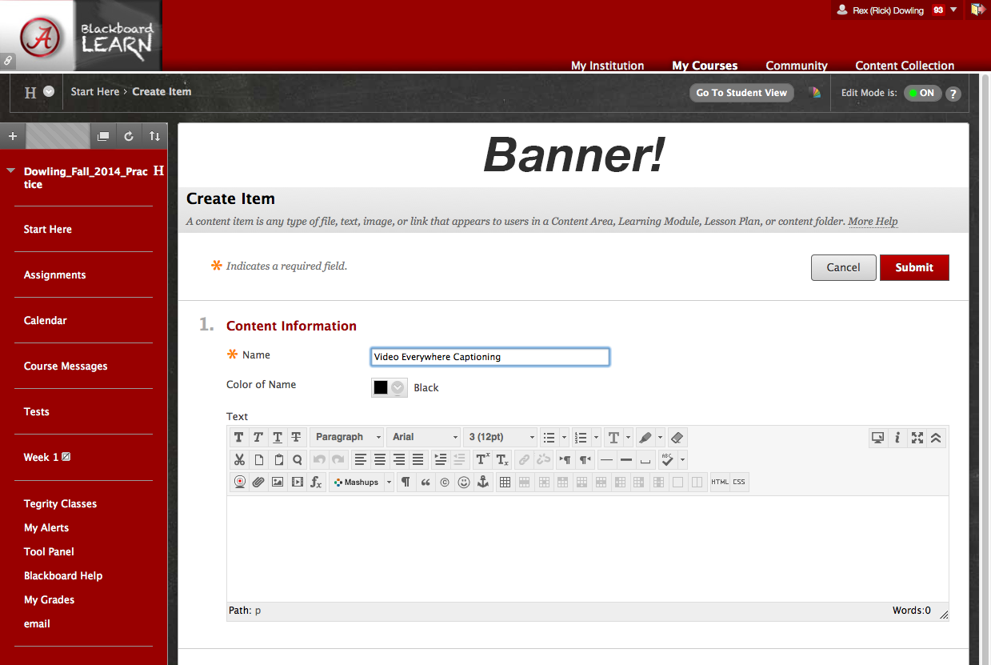
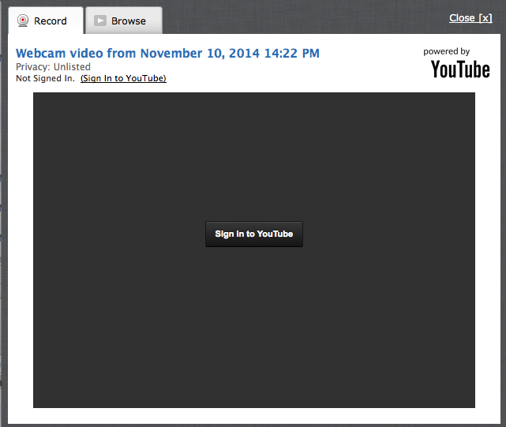
Captioning with Video Everywhere
Video Everywhere is linked to the instructor’s YouTube account.
In Blackboard Content Editor, Video Everywhere allows instructors to record using their webcam.

Slide 23
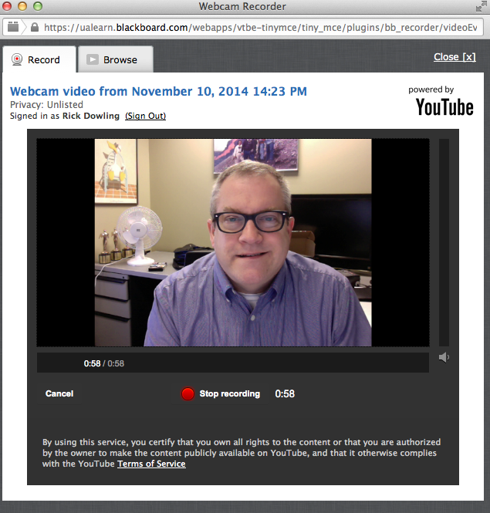
Record your Video Everywhere message
YouTube record and browse interface accessed via Blackboard Video Everywhere.

Slide 24
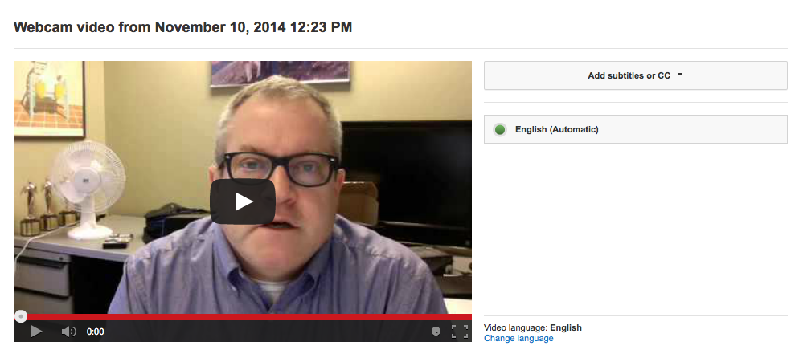
Log into YouTube and Choose Automatic captions
YouTube interface showing webcam video with English automatic captions selected.

Slide 25
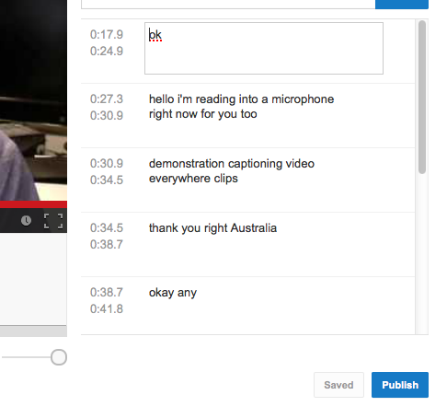
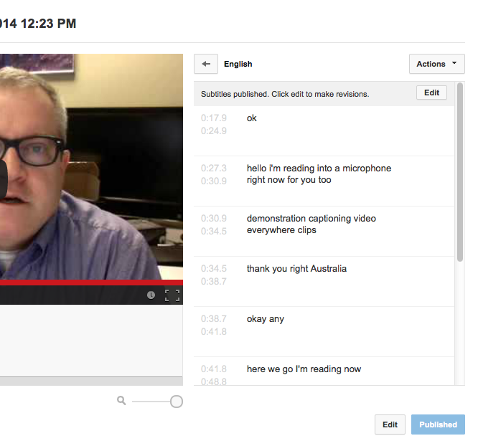
Edit and Publish Captions
Edit captions in YouTube
Publish the captions

Slide 26
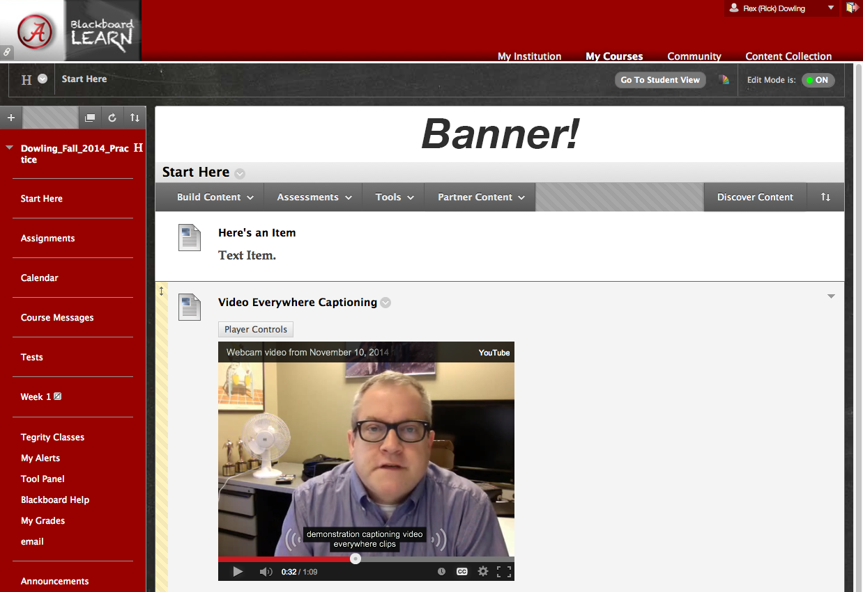
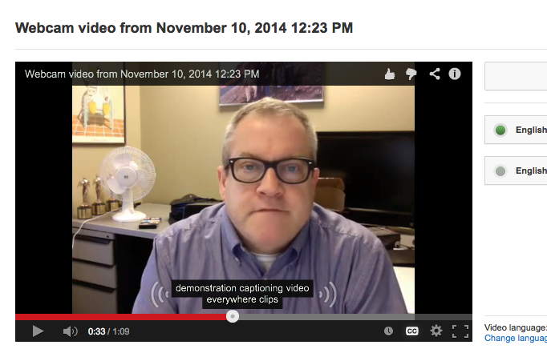
Captions are available in Bb
Captions appear in YouTube.
After refreshing the page, the captioned version will appear in Blackboard.

Slide 27
Future steps
Script to inventory courses
Vendor relationships and VPAT testing
Blackboard module for all users
Blackboard course for instructors

Slide 28
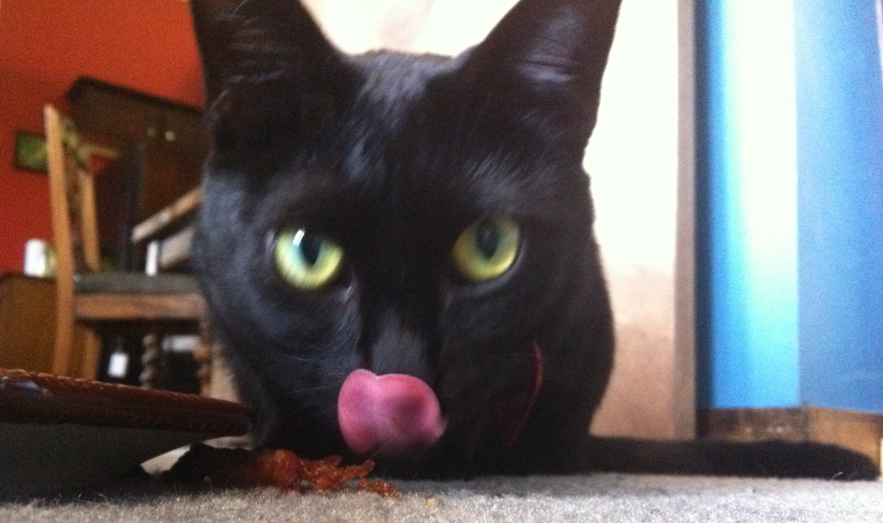
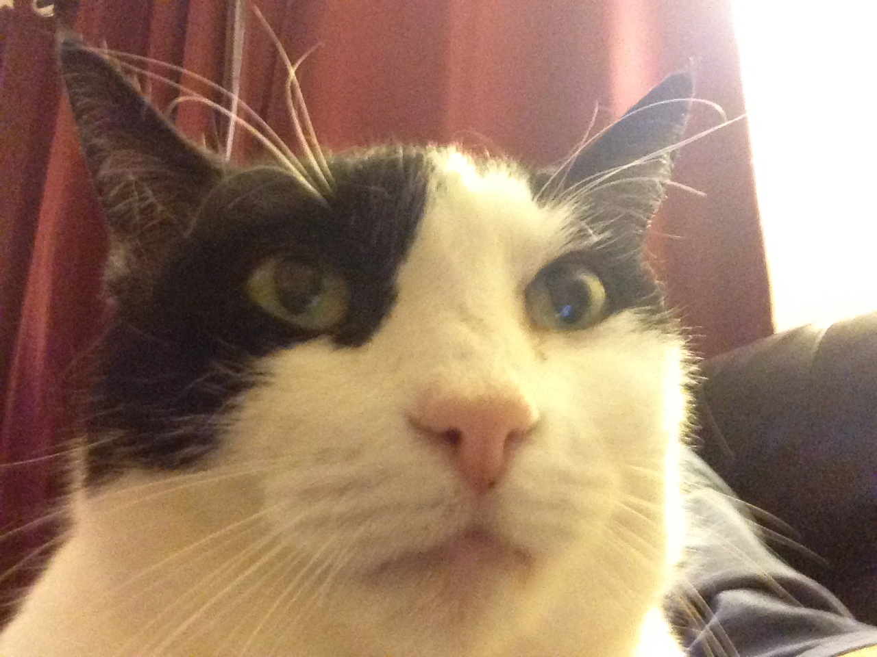
Contact us with questions or comments. Thank you!
Rick Dowling
rdowling@ua.edu
Rachel Thompson
rsthompson2@ua.edu
Wuska “The Wonder Cat” Dowling
Ninja Kitty Thompson

