Slide 1
Connecting the Dots for a Musician with a Visual Impairment
Accessing Higher Ground
Westminster, Colorado
November 20th, 2014

Slide 2
Presented by
Marion Stevens, Assistive Technology Specialist, Office of Disability Services, The University of Alabama
Heidi Lehmann, Music Braille Transcriptionist, Bach to Braille, Inc.
Denise Q. Smith, Assistant Director (Retired), Office of Disability Services, The University of Alabama

Slide 3
Connecting the Dots:
A Tale of How ODS
Made It Happen
Denise Smith, Assistant Director, Office of Disability Services

Slide 4
What do you do when a transfer student with a visual impairment walks into your office the day before classes start and says he needs accommodations?

Slide 5
Initial Contact With the University
The Admissions Office called the day before classes started for the Fall 2009 semester asking if ODS could provide accommodations for a blind student who wanted to take the Advanced Placement test for Spanish.
ODS had no record of his admission to UA—He did not register with ODS until after it was suggested that he would need accommodations
  He transferred from a Community College in the NE where he had received accommodations
Discovered that he was completely blind and would need everything in audio format when classes started the next day!!!
His major?—Music Therapy

Slide 6
HELP!
ODS immediately called all of his professors to determine what materials and books would be used that semester
Immediately tried to get all of his texts in audio format
Discovered that the student had other issues as well
  Couldn’t get around campus independently
  Couldn’t figure out how to access his materials in audio format
  Outdated computer and computer programs (JAWS in particular) with no idea how to update them
  Student was almost 1000 miles away from home with very little support (he knew one person in town but she backed out of the picture)

Slide 7
What To Do Now?
Started researching other Music Therapists who were blind
Discovered MENVI (Music Education Network for the Visually Impaired)
Got names of 2 MT’s who were blind and currently practicing MT
Gave names to student after ODS talked to them and they offered to consult with ODS and student
Student followed up after several months of ODS encouragement but did not follow their advice
Got names of music transcriptionists who could transcribe musical scores into a Braille musical format
Contracted with Heidi Lehmann to transcribe musical scores and text for this student

Slide 8
Process for Acquiring Materials
In the Beginning-
  Got music from professors and sent it to Heidi
  She returned it asap since the semester had already started
  Arranged with student to pick up the transcribed music as soon as it was received
  Arranged with professors to extend deadlines since it was difficult to get information to student in a timely manner
  Met with all professors several times during the semester about how to work with student

Slide 9
In Reality…
Student didn’t pick up transcribed work when notified
Student didn’t turn in work within extended time frames
Blamed ODS for not getting the work to him
ODS had emails that verified he had been notified
It became apparent to his professors that he would not be able to meet the standards of practice to become a MT
Meetings with everyone in Music Therapy Department, School of Music, and College of Arts and Sciences to determine how to address these concerns

Slide 10
Reality Continued
Finished the first semester with good grades due to coordinated efforts between ODS and School of Music and other Departments/Colleges
Was late turning in schedule for Spring semester and ODS again had to play “catch up” for Spring 2010 semester
Continued with the process in the Spring but problems persisted
It became more obvious during this semester that the student was not going to be able to keep up or meet the course requirements for MT
His behaviors of not picking up materials when notified and blaming ODS continued

Slide 11
Process Refined
ODS developed a system of delivery to the Music Building so the materials were in the building
  This took a step out of the “pick up” process
  It provided a written document that showed when the material was requested, received from the transcriptionist, delivered to the Music Building, and who received the material when it was delivered
    Some of the professors wanted the material delivered to them so they could personally hand the materials to the student
    Most of the professors wanted the student to be responsible and pick up his materials himself
  ODS hand delivered the materials to the Music Building and had someone in the Music office sign for it
  The receipt was then filed in the student’s file in case there were any concerns about when and where it was delivered and the student was notified

Slide 12
Problems Continued
Student often failed to pick up his music materials
Or lost them in his room and said ODS did not provide the materials
Student continued to turn in late assignments or didn’t turn them in at all
Checked materials out of the library reserved section and caused other students to miss an assignment because the reserved material wasn’t available
Other behavioral issues surfaced
Student failed most classes in the Spring 2010 semester

Slide 13
Then What Happened?
Student was told he would not be able to continue in the MT program
  Due to grades
  Due to behavioral issues
  Due to inability to follow course and professional expectations/standards
Student and mother met with Associate Dean of Arts and Sciences and threatened a lawsuit if student was not allowed back in MT program because he wasn’t given the appropriate accommodations by ODS
ODS instructed to provide a time line of all activity generated on student’s behalf for the past two semesters
  ODS spent the entire summer semester(s) putting the time line together
  Student’s file took up a drawer in the filing cabinets
  ODS Case Manager had a file in computer devoted to this student filled with several hundred emails and other documents

Slide 14
What Happened Next?
Beginning Fall 2010, the student was on an “action” plan/contract with the Assistant Dean of Arts and Sciences to help everyone (faculty, ODS, other students and the student) address this student’s academic and social issues
The Dean helped coordinate communication between all parties
A new major was chosen
  Music Theory
  Then changed to General Music
Student became somewhat more consistent in working with ODS and professors but continued to have problems being consistent

Slide 15
Information Sharing and Recordkeeping
Marion Stevens,
Assistive Technology Specialist,
Office of Disability Services

Slide 16
Central Point of Contact
Dr. Carmen Burkhalter, an Associate Dean in the College of Arts & Sciences, served as a central point of contact for all information relating to the student. This served two purposes:
  Provided a single person for faculty and staff to contact with questions or information regarding the student. Since not all contacts were disability-related, not all contacts needed to come to ODS. Dr. Burkhalter redirected contacts to the most appropriate department.
  Served as a mentor for the student, addressing any academic or other issues not related to his disability.

Slide 17
Pre-Semester Faculty Meetings
Before the start of each semester, ODS organized a meeting with all of the student’s professors. Topics covered included:
The student’s challenges
The format and content of each course
ODS’ text conversion process
Q&A from faculty
Any past issues were generally not discussed, so as not to unintentionally influence faculty attitudes.

Slide 18
Text Conversion Requests
ODS received three main types of text conversion requests:
Books assigned for use in classes before the semester began
Material assigned by faculty during the semester, including handouts, scores, quizzes, and exams
Material that the student obtained from the library for research papers, such as book chapters, journal articles, and scores
Normally, once a conversion was completed, the embossed Braille document would be delivered to the School of Music main office for pickup by the student. We asked faculty to, whenever possible, allow for two weeks for a conversion to be completed.

Slide 19
Text Conversion Requests (continued)
For material that did not contain musical notation, the student preferred electronic documents over Braille. These would usually be converted in-house and provided on CD. The student would usually pick these discs up at the ODS office, since they were often for non-music courses.

Slide 20
Books
ODS attempted to obtain book information as early as possible, preferably several months before the semester began.
Ideally, complete conversions could be done before the start of classes, but this usually wasn’t possible.
Books would usually be converted in sections, based on the dates each part would be needed.

Slide 21
Material Assigned in Class
Faculty members were asked to submit any material they needed to be converted directly to ODS at least two weeks before it was needed in class.
Orders would usually be completed on a first come, first served basis, although very simple or very complex conversions could be completed out of order.
If our transcriptionist believed that the Library of Congress held a copy of the requested material, she would refer us there before beginning the conversion.

Slide 22
Research Material
Material would normally be converted on a first come, first served basis.
In theory, student would be responsible for bringing ODS hard copies of material obtained from library.
In practice, UA’s music librarian would usually send copies of material to us for conversion. She would assist student in locating relevant material, then either scan hard copies or provide purely electronic copies, if available.

Slide 23
Recordkeeping
ODS employed two recordkeeping methods to track the progress of all material produced for the student, both that which was sent to Bach to Braille for conversion and that which was converted in-house:
Paper tracking sheet
Spreadsheet

Slide 24
Tracking Sheet
Sheet prepared for each order
Items included:
  Class and faculty member the order was associated with
  Title of item to be converted
  Date request received by ODS
  Date item sent to transcriptionist
  Date Braille file received from transcriptionist
  Date file embossed
  Date order delivered to School of Music
  Signature of recipient and initials of ODS staff who delivered order.

Slide 25
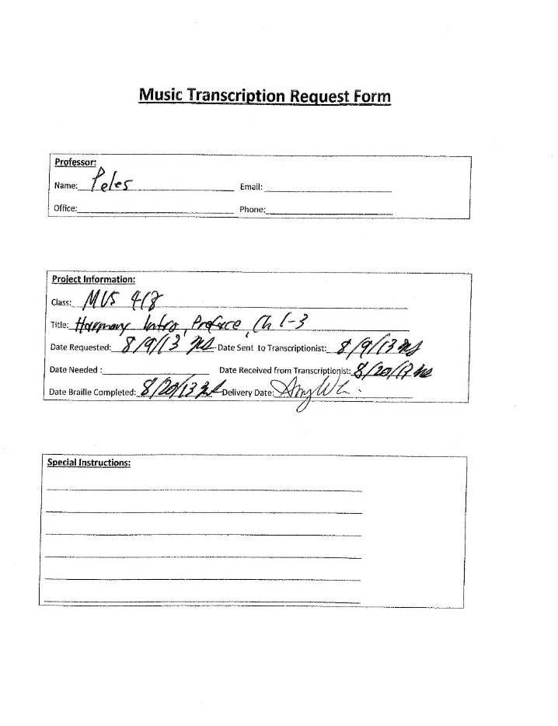

Slide 26
Spreadsheet
Used to track conversions performed throughout the semester
Contained basically the same information as individual tracking sheets
Organized by class and date orders received
Spreadsheet allowed ODS staff to quickly see which orders had been placed and the status of each, making it easy to see which ones were outstanding.

Slide 28
Best Practices/Lessons Learned
Since the student did not always pick up material from the music office in a timely manner, it was sometimes necessary to send e-mail notifications that material had been delivered, especially for particularly time-sensitive items.
The student had a tendency to misplace material and either ask if he had received it or state that he had not received it, so good recordkeeping was essential. Being able to tell the student when an item was delivered would prompt him to either check the music office for it or look for it in his dorm room.

Slide 29
Best Practices/Lessons Learned (continued)
Although it was never needed, it would have been preferable had the School of Music documented when the student retrieved material from the music office.
A close working relationship with the music librarian was vital, both so that ODS would receive research material in the best possible format and quality, and also because she provided assistance in locating better copies of scores, journal articles, and book chapters when copies provided by faculty were of poor quality.

Slide 30
Best Practices/Lessons Learned (continued)
Always keep at least one extra box of Braille paper on hand. APH can occasionally be slow to ship orders, and large embossing jobs can appear unexpectedly.
Ensure that faculty understand the conversion process and the amount of time conversions will take. While some rush orders are inevitable, they shouldn’t become common practice.
Communicate any times that you will be away from the office, such as for conferences or vacations, to faculty and your transcriptionist so that conversions can be planned accordingly. Train a backup person to handle emergency conversions.

Slide 31
The Bottom Line
Never assume that a student’s disability will dictate the challenges that he/she will face. While a disability can necessitate a certain set of accommodations, how well those accommodations will work is more heavily influenced by how the student interacts with faculty, the DSS office, and his/her Accommodations Specialist.
Assess the student’s disability and develop an accommodation plan.
Assess the student’s personality, maturity level, and general demeanor, and adjust your implementation strategy accordingly.
Communicate regularly with everyone involved in the process.
Make adjustments, as needed.
Document, document, document!

Slide 32
From the Transcriptionist’s Perspective
Heidi Lehmann, transcriptionist
Bach to Braille, Inc.

Slide 33
The Transcription Process
Professor
ODS
Transcriber
ODS
Student

Slide 34
Faculty
Transcriber
Disability Services

Slide 35
How Do I Find A Transcriptionist?
Exhibitors at Professional Development Conferences
National Library of Congress
National Braille Association
Internet Search

Slide 36
What is Initially Needed from the Transcriptionist?
Price quote based on the scope of the project
Completed W9 as subcontractor with the university
  ODS contacts Purchasing/Procurement Department to obtain purchase order number valid for one academic year

Slide 37
What is Needed from the Music Faculty?
Early submission of textbook titles, including ISBN number to assure correct edition
  Early summer for Fall semester
  Mid-Fall for Spring semester
Class syllabus
Clear, legible scans of scores or resource material
Material submission:
  Handouts, quizzes, mid-terms and final exams at least 2 weeks in advance
  Vocal and instrumental parts: 2 weeks
  Orchestral score: 3 weeks
  Music Theory: 3 weeks
  20th Century Music: 4 weeks

Slide 38
What is Needed from ODS?
Accessible PDF of the requested textbook
Word file of the requested textbook
Class syllabus
Send material to transcriber as email attachment with cc to everyone involved
Or, upload to shared Dropbox folder
Purchase order confirmation number so project can begin

Slide 39
The Transcription Process Begins
Email confirmation sent that material was received and successfully downloaded with ETA
Transcription process begins
Project ready for production
Embossing
University
Student
Embossing
Bach to Braille
Ship via UPS to ODS

Slide 40
Payment
Once package or .BRF file has been received, invoice is sent via email to ODS or Accounts Payable Department with cc to ODS
Payment is allocated by form of check

Slide 41
Contact Information
Marion Stevens
marion.stevens@ua.edu
Heidi Lehmann
heidi@bach2braille.com
www.bach2braille.com
Denise Q. Smith
smith9001@bellsouth.net

