Slide 1
Creating Accessible Content in Adobe Acrobat
Tim Springer
Brenda Roukey

Slide 2

Agenda
About SSB BART Group
Overview
Laws and Standards
User Impact
PDF Background and Overview
Native Document Preparation
Testing Things
Fixing Things
Resources

Slide 3
About SSB BART Group
Unmatched Experience
Accessibility Focus
Implementation-Oriented Solutions
Solutions That Reduce Legal Risk
Organizational Stability and Continuity
Knowledge That Is Up-to-Date, All the Time
Published and Peer Review Auditing Methodology
Fourteen hundred organizations (1452)
Fifteen hundred individual accessibility best practices (1512)
Twenty-three core technology platforms (23)
Twenty-two thousand audits (22,408)
Fifteen million accessibility violations (15,331,444)
One hundred twenty-one thousand human validated accessibility violations (121,290)
(Statistics provided as of January 2013)
Notes:
₃
Unmatched Experience
Founded in 1997 by engineers with disabilities, SSB BART Group has been in the accessibility business since before Section 508 and the WCAG existed and longer than any of our competitors. SSB has completed accessibility projects for hundreds of enterprise-class firms, has over 10,000 active AMP users and maintains a database of over 1,000 accessibility best practices across 13 core development platforms. SSB actively works with all major industry development platform vendors, assistive technology vendors, regulatory agencies and public sector organizations to constantly refine and update our understanding of the proper level of accessibility for your firm.
For clients who must comply with the Section 508 of the Rehabilitation Act, many clients find it helpful to know that over half of SSB’s client services staff have worked directly as staff and contractors for the Section 508 compliance teams in U.S. Federal Government agencies. This means that we have experience in both working with vendors selling to the Federal Government and as part of the workforce validating the compliance of vendor solutions provided to the Government.
Accessibility Focus
SSB BART Group only does accessibility. Other firms we commonly are compared to provide products and services that run a wide gamut, including general usability, privacy, security, brand compliance and SEO. These solutions tend to be effective as jack-of-all-trade solutions but, in practice, leave most customers working with organizations that provide a variety of services poorly. SSB’s sole focus is on providing IT accessibility compliance solutions and our team’s depth in accessibility is unmatched. Given the complexity of IT accessibility and the difficulty of implementing solutions, such a focus tends to be the only match for customers serious about rapidly and cost effectively implementing accessibility.
About half of SSB’s client services staff have disabilities, and this number is often far higher than total employees at competing companies. This means that we recommend what we know works for users with disabilities in the real world. Furthermore, this ensures that your organization can achieve compliance both with the technical and functional requirements of leading accessibility standards.
Implementation Oriented Solutions
Our organizational focus is implementing accessibility in the real world. Many accessibility companies focus on providing diagnostic information to clients often of the form "this doesn’t work in JAWS." While helpful in identifying an issue, this feedback provides no guidance on how to address the issue. In contrast, for all issues we identify, SSB provides specific, actionable guidance that can readily be implemented of the form "change this piece of code on this line." This includes providing code-level implementation and unit test guidance for all best practices in AMP and all content delivered in audits.
Our implementation focus grows out of our team’s background—a group of people that have development experience in the context of enterprise-class IT systems. Competing companies tend to specialize in web accessibility testing but with little-to-no experience in the development of enterprise-class websites, web-based applications and software. While it is important for accessibility firms to understand the inner-workings of JAWS, the world’s leading screen reader, far more benefit is provided to the customer if they understand how to modify an AJAX application so that it works properly in JAWS. This is our focus as an organization: how to make systems compliant in the real world.
In evaluating different accessibility consultants many of our clients have found that some firms live in a black-and-white world where nothing but fully compliant information technology is acceptable or tolerated. In the real world, trade-offs are required and dollars go to projects that provide the best ROI for an organization. As part of making systems compliant in the real world these constraints must be considered. As an organization, our goal is to ensure that we use your accessibility budget in an optimal fashion — ensuring that every dollar you spend on accessibility has the most impact.
Solutions That Reduce Legal Risk
SSB provides solutions that address the actual requirements of the law—rather than those that are just simple to test. Automated testing tools can only validate a sub-set of accessibility requirements and any validation process that solely uses automated testing cannot make an accurate claim of compliance. SSB utilizes automatic testing to address the set of requirements that can readily be validated using such testing and utilizes the cheapest first testing for the remaining requirements.
SSB’s approach was born out of being the first company to release a commercial accessibility validation tool, InFocus, 12 years ago. As part of that, SSB became well acquainted with the capabilities and general limitations of accessibility testing software. To address that, SSB has spent the last ten years investing in and developing the Accessibility Management Platform. AMP is focused at solving the broader problem that customers actually face, which is how to manage all the aspects of accessibility—Auditing, Training and Standards Management—over the course of many years and development cycles.
Organizational Stability and Continuity
SSB BART Group has the largest staff of W2 employees of any company of our kind. The vast majority of firms in accessibility use 1099 contractors that are hired on demand on a per-project basis. This has a significant, negative impact on the quality of work delivered, the consistency and repeatability of testing results and the accuracy of contractor work. With SSB, the people you talk to today will be available to help address your problems tomorrow. This ensures a consistent set of recommendations and allows us to develop organizational knowledge on how our accessibility solutions should be adopted to your business environment.
SSB’s size also ensures that we can staff and handle the volume of business from large customers. Smaller companies or sole consultants cannot handle the volume of work of enterprise-class customers, whether private IT manufacturers, financial institutions or large government organizations.
Knowledge That Is Up-to-Date, All the Time
SSB uses AMP to deliver all our accessibility services, meaning that AMP is a system in constant use by the largest accessibility consulting firm in the world. This gives SSB the ability to include improvements to AMP that are born through a continuous feedback loop that includes our own staff using the product for client services work on a daily basis. As new standards are deployed, new requirements identified, new implementation techniques developed and issues resolved in real world developments, these experiences and lessons are immediately provided in AMP. This ensures that customers have instant, ongoing updates to all best practices, rule sets, tests and training content in AMP. This is in sharp contrast to competing firms, where compliance data is hard-coded and updates infrequently at best.
Published and Peer Review Auditing Methodology
All SSB testing engagements conform to SSB’s Unified Audit Methodology, a mature methodology meant to ensure the relevance, accuracy and repeatability of results in a manner which ensures thorough coverage. This auditing process includes a mix of automated, manual and assistive technology validation, as well as the use of individuals with disabilities performing actual system tasks. Audits are performed against a unified set of conformance criteria based on industry best practices, public compliance requirements and internal standards relevant to the client’s compliance needs. All audits published under the methodology are immediately available in AMP and include a description of accessibility issues, media types, non-compliant code examples, compliant source code examples, recommended approaches and options for addressing issues, unit tests allowing for validation of the issues and source public standards associated with each rule.
Unmatched Support Capabilities
SSB BART Group’s support policy defines our same-day response policy on all high-priority support requests. All licensed users of AMP are covered under our support policy, which includes full support for the product and all information within it. In addition, SSB provides the following support capabilities to all customers as part of our standard engagement:
Upon sign-up, all licensed users of AMP are entitled to a free training session to understand how to use the product to the best of its abilities;
When new versions of AMP are released on a quarterly basis, free training is provided to all customers on the new version and its use;
AMP Support Hours covers standard working hours across all regional U.S. zones and can provide full 24x7 support as needed;
SSB BART Group has no less than three staff members available to support the product at any given time during the support hours;
SSB BART Group accepts support requests via telephone, e-mail or online form.
All support is provided as part of SSB’s standard AMP license—no additional support or training contracts are required.
Advocacy Group Relationships
SSB has partnered with numerous industry and advocacy groups focused on promoting accessibility to IT systems. Partner organizations focused principally on web accessibility include G3ict, W3C WCAG, and the U.S. Access Board. SSB has also partnered with the following organizations, institutions and research firms focused on general accessibility, including IT access: U.S. Business Leadership Network (USBLN), NDI, National Organization on Disability (NOD), BBI, Syracuse University, Cornell University, Buffalo University, VCU RRTC. In addition, we also have relationships with NISH, Ability One, NFB and UCP.
SSB has worked with the National Federation of the Blind (NFB) since 2001 to support advocacy activities in the blindness community. SSB launched the NFB’s Non-Visual Access (NVA) certification program in conjunction with the Federation in 2003 and provided the certification services for the first three program clients—Hewlett-Packard, Wells Fargo and the U.S. Social Security Administration—all of which remain active SSB clients. The American Action Fund for Blind Adults and Children—a proxy NFB investment vehicle—has an investment in SSB as part of SSB’s Series B stock. Finally, Ray Kurzweil, an SSB angel investor, sits on the NFB board and owns an NFB co-developed company for the Kurzweil reader.

Slide 4
Laws and Standards
Laws and standards relevant to document creation and remediation
Section 508
  Federal procurement requirements
Section 504
  Accommodation for federally funded programs
WCAG 2 standards
  ADA
    Employment, education, public accommodation
  International disability law
    Equality Act in UK
    AODA in Ontario

Slide 5
User Impact
Document accessibility affects:
Users who are blind or have visual impairments
Users with cognitive disabilities
Interactive document accessibility affects:
Users with mobility impairments
Users who are deaf or hard of hearing (when sound is used)
Examples
When images do not have a text equivalent a person who cannot see the image will not know the purpose
When headings are not used, document structure cannot be understood by someone without visual perception

Slide 6
PDF Background
The Portable Document Format (PDF) is a destination- based format for preserving the look of documents across platforms and mediums.
PDFs documents have an internal tagging structure that represents the document’s visual and structural components
  The visual portion of the PDF document is essentially rendered as an image
  The image portion of the PDF documents are not accessible and cannot be directly translated into text by screen readers
  The text and structural portions are represented as text and tags in PDF

Slide 7
PDF Background
The PDF format can provide a logical (tag) structure tree, permitting documents to be accessible when viewed with an accessible reader such as Adobe Reader on the Windows platform
  We have a lot of control over how these work in assistive technology
Some PDF files are simply scanned copies of print documents

Slide 8
Overview
There is no magic “Make Accessible” button
Accessible content creation is a process
Achieving accessibility requires human testing in addition to automated checking
  Automated checking can only detect for the presence or lack of required items
  Automated checking cannot determine if an item is correct or appropriate
Accessibility is a new item for the production workflow – similar to authoring, layout, proofreading, etc.
Document creators need to use a variety of techniques and methods

Slide 9
Adobe Acrobat Accessibility Tools
Tools
  Make Accessible Wizard
  Accessibility Checker
  Touch-up Tool
Tags Panel (F6)
  Create, move, edit tags
  Set AT reading order
Content Panel
  Move/order/artifact on page content
Order Panel
  Set reflow and Read Out Loud order
Pages Panel
  Specific use of tag structure for reading order
Bookmarks Panel
  Multiple ways of access

Slide 10
Formats and Workflow
Source -> Destination Formats
Word, InDesign -> ePUB, PDF, HTML documents
Workflow Guidance
Accessibility is important and effective in the design and implementation process
Post-production remediation is costly
Updates to documents require conversion of document and loss of post-production accessibility remediation
Resolve as many issues in the native document format as possible!

Slide 11
Native Document Preparation
Creating Accessible Source Documents
Use styles in documents
Use headings and place in correct order
When needed, create multiple columns with the column tool
Add alternative text for images and objects
Specify column header rows in tables
Use meaningful hyperlink text
Check the document
  e.g. Microsoft’s website for accessible word documents
Additional requirements apply

Slide 12
Testing Things

Slide 13
A Quick Demo
Using “Good_Structured_Document_Example.docx” to show a reasonably accessible document
  Styles
  Headings
  Alternative text for images
Specify column header rows in tables
Use meaningful hyperlink text
Accessibility checked

Slide 14
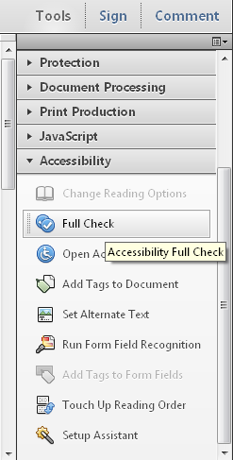
Accessibility Checker
Run the Accessibility Checker
Automatically appears as the last step in the wizard
Run the Accessibility Checker from the Tools Panel > Accessibility Pane

Slide 15
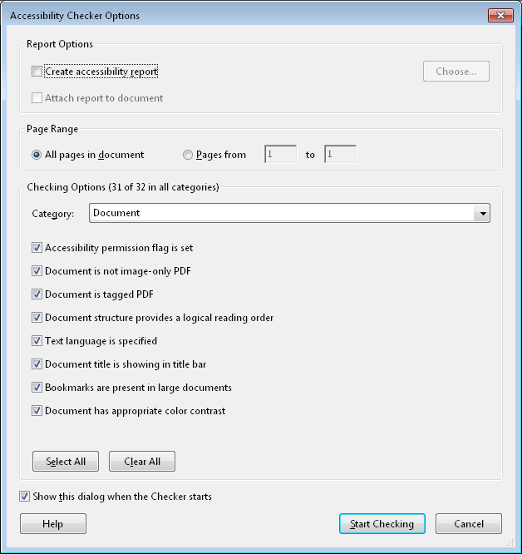
Accessibility Checker (cont.)
Choose Accessibility Checker Options

Slide 16
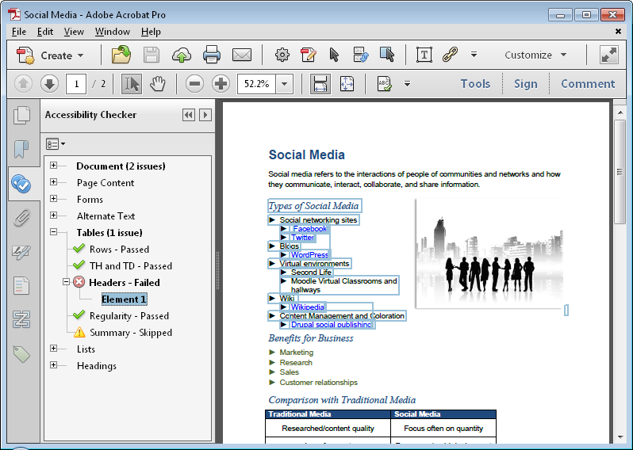
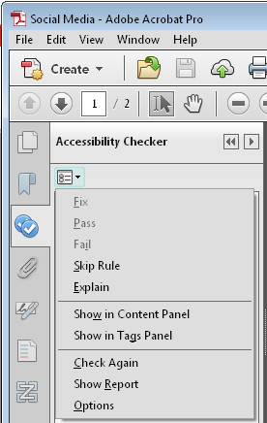
Accessibility Checker (cont.)
Review the Results

Slide 17
A Quick Demo
Using “Good_Structured_Document_Example.docx” create a tagged PDF
  Saved from Word native functionality
  Saved via PDF functionality
Run Full Accessibility Check
  Note issues in each format

Slide 18
Formal Evaluation
After conversion to PDF review the document for accessibility via
  Acrobat Professional Accessibility Checker
  Manual tag tree review
  Screen reader review
  Other accessibility tests
Screen readers include JAWS, NonVisual Desktop Access (NVDA) and Window-Eyes
“Read Out Loud” tool in Acrobat can work as well
      View > Read Out Loud > Activate Read Out Loud
View with Reflow option
  View > Zoom > Reflow
View in high contrast
  Edit > Preferences > Accessibility > Replacement Document Colors
Notes:
Note: the NonVisual Desktop Access (NVDA) is a free and open source screen reader for the Microsoft Windows operating system and is available at www.nvda-project.org.
Note that this tool is limited and may not reflect how actual users with disabilities will use assistive technology with a PDF file.

Slide 19
Fixing Things

Slide 20
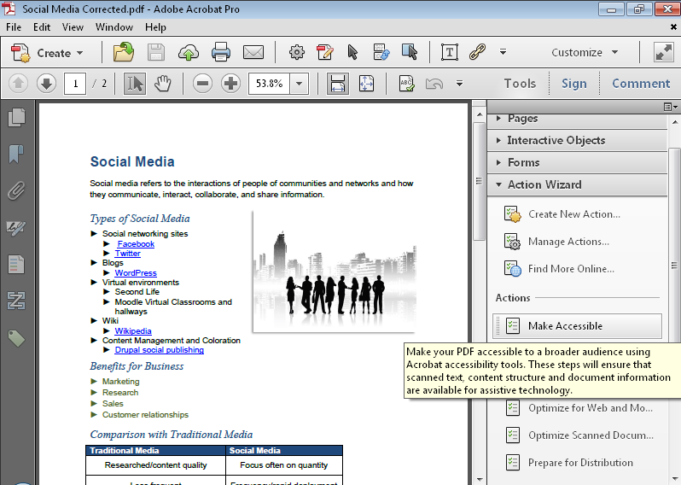
Make Accessible Wizard
Run the Make Accessible Wizard from Tools > Action Wizard

Slide 21
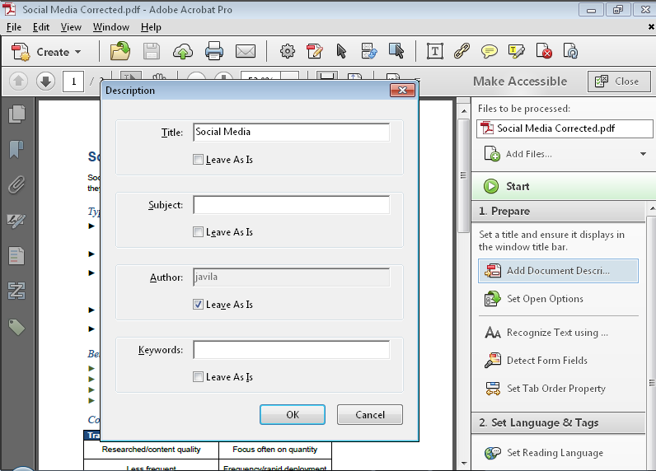
Make Accessible Wizard (cont.)
Complete the Wizard
Set description
Set options
Recognize text
Detect form fields
Set tab order
Set language
Add tags
Set alternative text
Accessibility Checker

Slide 22
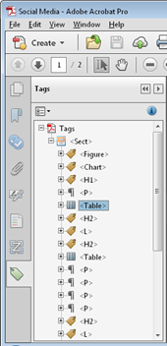
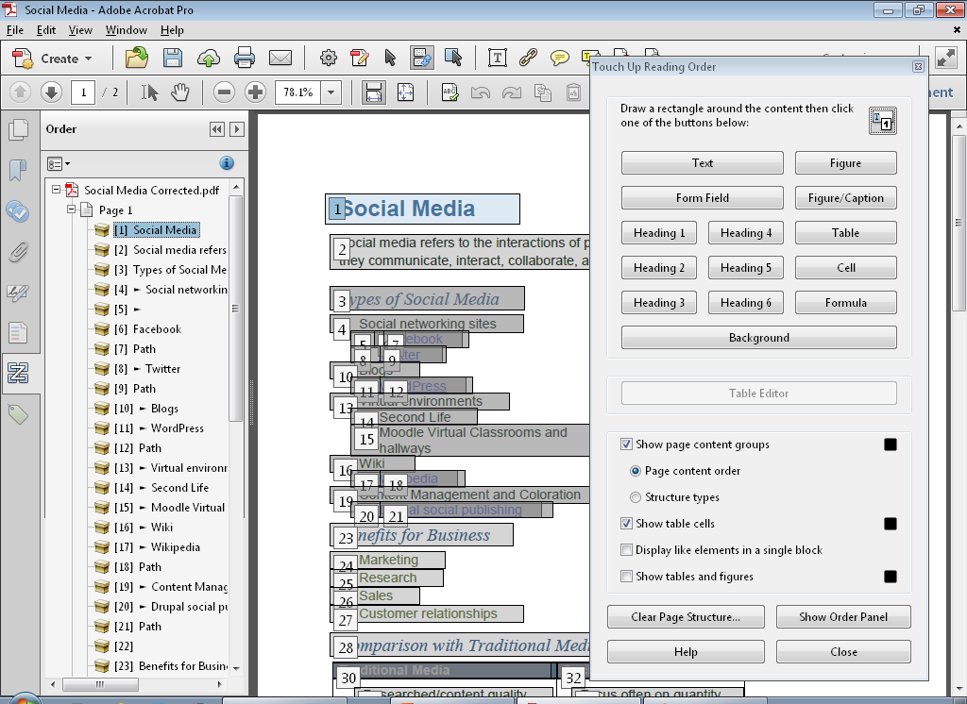
Address Accessibility Issues
Use the Touch Up Reading Order and Tags Panels
Right click on the desired page in the index and select “Show reading order panel”

Slide 23
A Quick Demo
Using “Bad_Not_Structured_Document_Example.docx” create a tagged PDF
  Saved from Word native functionality
  Saved via PDF functionality
Fix everything using the Accessibility Wizard
  Show all the issues that can be fixed
  Show the issues that can’t be fixed
  Are we done? Not quite – how about headers and structure?
Fix using Touch-up Pane
  Heading
  Lists?

Slide 24
Best Practices
Best practices to maintain and update document creation processes and ensure ongoing accessibility
Create design standards
Knowledge transfer
  Best Practice library
  Training
Testing/Quality Check
  Test with users who have disabilities
Automatically check content when posted
Scan for untagged content

Slide 25

Questions?

Slide 26





Thank You
Contact Us
Tim Springer
tim.springer@ssbbartgroup.com
Brenda Roukey
brenda.roukey@ssbbartgroup.com
Follow Us
@SSBBARTGroup
linkedin.com/company/
SSB-BART-Group
facebook.com/
SSBBARTGroup
SSBBARTGroup.com/blog

Slide 27
Appendix A

Slide 28
Resources
Adobe’s Accessibility Website: www.adobe.com/accessibility
Adobe’s Voluntary Product Accessibility Templates (VPAT): www.adobe.com/accessibility/products/compliance/
Adobe TV Accessibility Channel: http://tv.adobe.com/channel/government/accessibility/
Accessibility Management Platform (AMP): https://amp.ssbbartgroup.com

Slide 29
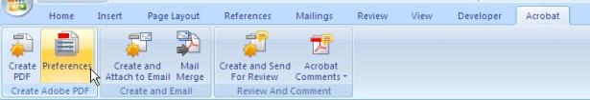
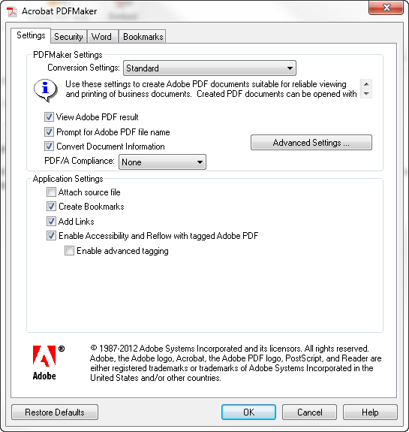
Enable Accessibility Tagging (Word)
Acrobat Ribbon > Preferences
Acrobat PDFMaker dialog appears > Settings Tab
Ensure Create Bookmarks is checked (default)
Ensure Add Links is checked (default)
Accessibility and reflow of tagged document (default) should be checked
Notes:
Enable Accessibility/Tagging in Preferences (applies to PDF plug-in only – see Save as – Options button for Save as PDF Word options).

