Slide 1
Tips for evaluating the VoiceOver Experience of an iOS application
Janna Cameron
Sr. Usability Specialist, Desire2Learn

Slide 2
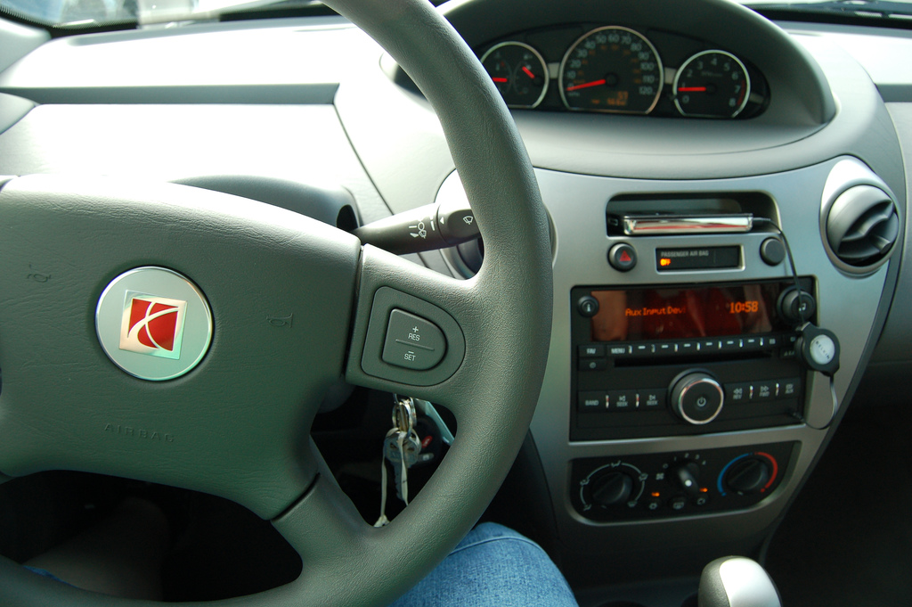
It’s just like a new car…

Slide 3

..maybe a solar car?

Slide 4
Some VoiceOver basics
Go to: Settings > General > Accessibility
Adjust accessibility shortcut
The rotor – swipe up and down
Between all elements – swipe side to side
Go to first/last – 4 finger tap
Scan with one finger

Slide 5
Some important notes
I am not from Apple
I am a User Experience design person

Slide 6
The usual things
Headings
Labels

Slide 7
More about labels
Keep your expectations high
Ensure labels sound human
Ensure that items that look unlabelled have labels
Check that hints are available

Slide 8
Tip - Screen curtain
3 finger triple-tap

Slide 9
The usual things
Headings
Labels
Images
Selected states
Reading order
Clear distinction between foreground and background
Communicate the current state
Feedback

Slide 10
More about feedback
Important times to deliver feedback
  Immediately after a manual trigger
  If a significant system event occurs
  If the user reaches an edge
  If the system cannot execute a command
  When the system is processing

Slide 11
Ways to give feedback
Change focus to the new item
Announce changes on the page
Play a sound

Slide 12
Some new things
Keyboard entry

Slide 13
More about keyboard entry
Questions to ask:
  Can the information be pre-populated?
  Does the interface remember things?
  Can I shorten the list of options?
  Are actions easy to find?

Slide 14
Some new things
Keyboard entry
Grouped items
Buttons
Gesture support

Slide 15
More on gesture support
Three important gestures
  Escape gesture
  Paging – three finger scroll
  Magic tap

Slide 16
Some new things
Keyboard entry
Grouped items
Buttons
Gesture support
You can tell if VoiceOver is on

Slide 17
Credits
“New car” picture by elvissa on Flickr
“Solar car” picture by IntelFreePress on Flickr
Feedback points from “Microinteractions” by Dan Saffer
Thank you to my colleagues Carin Headrick and Andrew Patterson

Slide 18
Questions?

