Slide 1
Strategies for Accessible Multimedia
Lee Christopher, Director eLearning, Arapahoe Community College
Raj Sen, Instructional Designer, Arapahoe Community College

Slide 2
Outcomes of the Session
Learn about the rise of multimedia at ACC
Learn about the challenges with the rise
Understand the available strategies for captioning and transcribing media content
Learn about how we implemented at ACC, the challenges we faced and how we overcame them

Slide 3
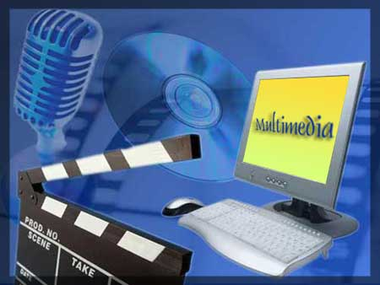
The Rise of Multimedia at ACC

Slide 4
Problems Associated with the Rise of Multimedia
Lack of centralized location of videos
Inconsistent formats
Inability to play across platforms (PC, MAC & Mobile)
Slow loading due to high buffering times

Slide 5
Problems Associated with the Rise of Multimedia Continued…
And most importantly…
None of it was accessible
AND
We were not even thinking about accessibility!

Slide 6
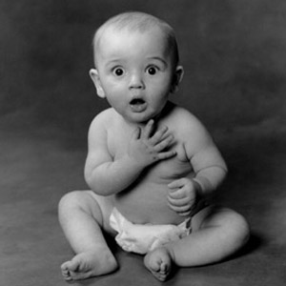
Eye Opener

Slide 7
Next Steps
Met with disability services
Training with disability services
Researched extensively Universal Design for Learning (UDL)
Self-assessed the scope of UDL in our department
Set up processes for making multimedia accessible

Slide 8
Strategies for accessible Multimedia
Closed-captioning for videos
Transcripts for audio lectures

Slide 9
Implementation Options
Hire third party captioning service
Captioning on YouTube
Captioning using Camtasia Studio 8.0
Speech to text software (Dragon Naturally Speaking) for transcriptions
Transcribing using foot pedals (Infinity USB) and software (FTW Transcriber)
Plain old transcribing

Slide 10
Implementation at ACC
Captioning (YouTube and Camtasia Studio 8.0)
Transcripts (Infinity Foot Pedal and FTW Transcriber application)

Slide 11
Challenges with Implementation
Staff
Tracking of videos
Time of completion

Slide 12
Solutions
Hire Work Study Students
Two-week pilot to estimate time to caption a minute of video
Design a Caption Estimator

Slide 13
Future Considerations
Audio description for videos

Slide 14

Questions??
Contact us: lee.Christopher@Arapahoe.edu raja.sen@Arapahoe.edu

