Slide 1


Framework for Localisation of AT and Online Technologies for Ease of Access
E.A Draffan
Notes:
This paper discusses the research undertaken and challenges met when localising an open source browser-based toolbar in an environment and language not known to the developers. It shows how a framework can be created, based on an inclusive design process that results in a set of criteria to support the development of this type of technology in other linguistic settings and cultures. The resulting toolbar offered Arabic speaking web surfers the chance to personalise webpages, providing additional accessibility options when using their chosen browser. The criteria used encompassed a journey of discovery, translation in its widest sense, creation and development including the need for localised guidance materials to aid sustainability and future development.

Slide 2
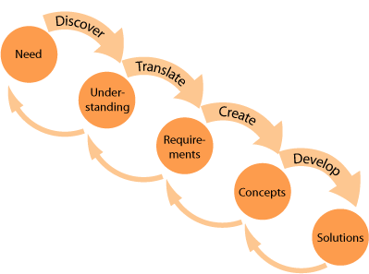
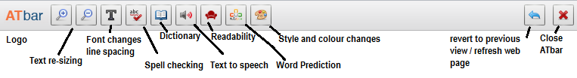
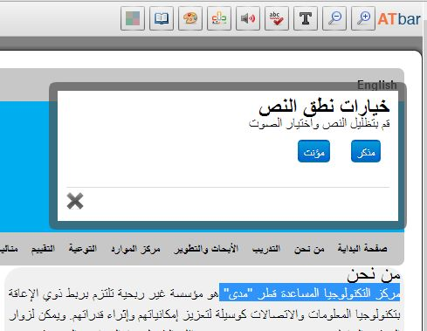
The Journey
http://www-edc.eng.cam.ac.uk/betterdesign/process/
Notes:
The Need – Discover – gain understanding –translate –Requirements
Start to create – based on the concepts – develop and offer solutions.

Slide 3
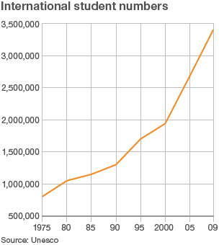
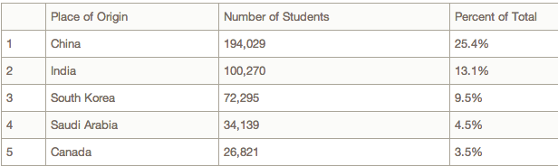
The Need
Globalisation
Internationalisation
Localisation
Case Study – Qatar/UK
Notes:
Gloablisation and Internationalisation. Graphs showing a rise in international student numbers

Slide 4
Discover
% figures
Base:
211
52
49
87
119
Those with learning difficulties appeared to be those who were most unaware of how AT could help.

Slide 5
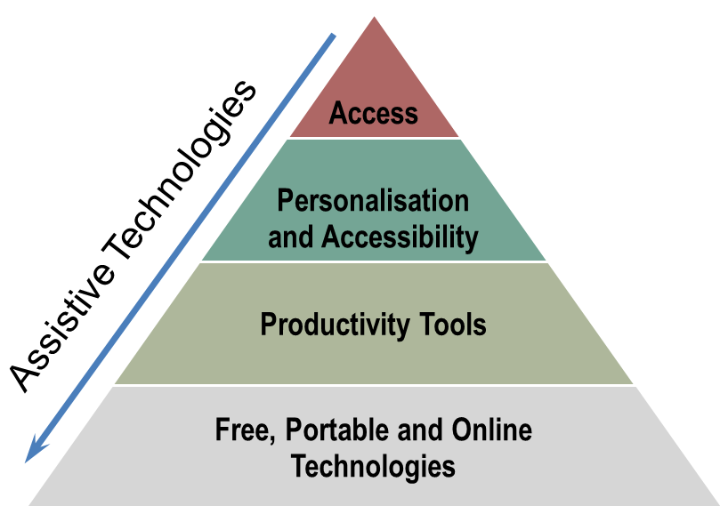
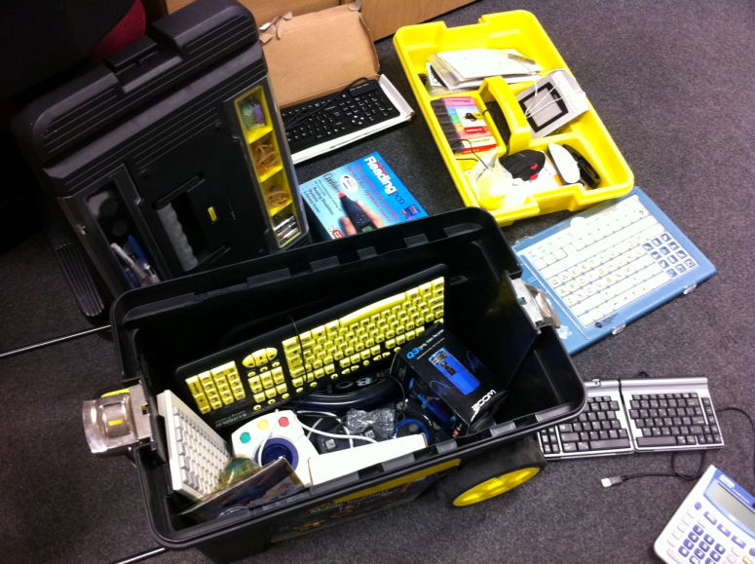

Translate
Starting with simple ideas
Notes:
Entry level – first step to more advanced solutions
Stimulus to more complex solutions
Stimulus to innovation

Slide 6
Understanding
Cultural Nuances
  National Cultural Dimensions
  Cultural Appropriateness
Addressing Design
Language
  Language impact on Layout
  Translation options
Technical Issues
Individual Needs
http://localisation.atbar.org/

Slide 7
Requirements
Free Arabic voice for text to speech and screen reading
Spell checking and word prediction corpus expansion
Accessible Arabic digital content needs to be increased in amount available and quality.
Optical Character Recognition work to be done
Speech Recognition improvements
AAC symbol systems to fit the culture and the language
Community Support for translation
Dissemination of information and resources that come out of research

Slide 8
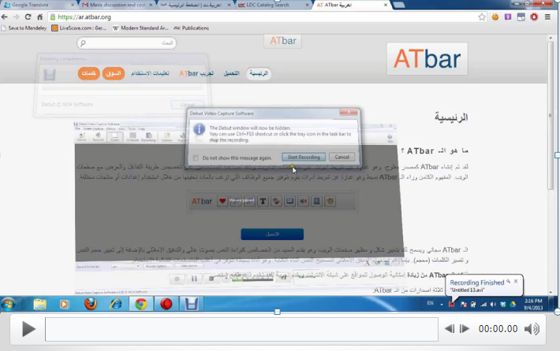
Create
http://youtu.be/yp3Y-VSyqT4

Slide 9
AT Localisation Framework
Visionary / User /Owner
Discover
Create
Translate
Develop
Test
Cultural Context Dimensions Appropriateness Environment Demographics
Individual Needs Activity Skills
Language Impact on Design Translation Technical
Users
Designers
Developers
Linguists

Slide 10
Develop
Open Source – Free but must be licensed appropriately
Main developer and small contributions from others
Make it possible to add small amounts of code to help a project e.g. ATbar plugins
Need to have agreement about the code that will be accepted
Open, online communication http://access.ecs.soton.ac.uk/blog/atbar/
Notes:
“... codebases that are more modular or have more option value increase developers’ incentives to join and to remain involved in an open source development effort; and decrease the amount of free-riding in equilibrium.’
The Architecture of Participation:
Does Code Architecture Mitigate Free Riding in the
Open Source Development Model
Baldwin and Clark, 2005
http://www.people.hbs.edu/cbaldwin/DR2/BaldwinArchPartAll.pdf

Slide 11
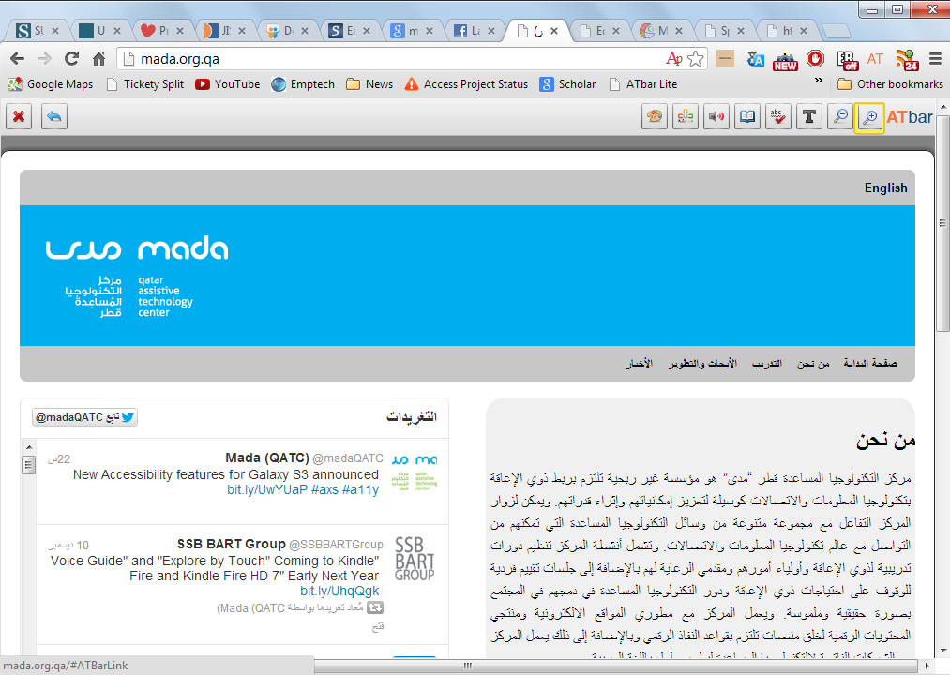
Arabic ATbar – AT Challenges
Voices
Bi-lateral text, font sizing
Layout
Images
Language used in help files
Testing
Communication with users
Ongoing Feedback
Maintenance
www.atbar.org

Slide 12
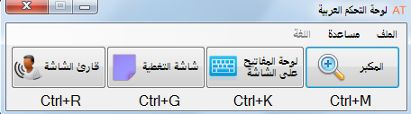
Desktop ATbar for Windows
Text to Speech and Screen Reading
Coloured Overlay and Ruler
Onscreen Keyboard
Magnification
Available from https://ar.atbar.org/desktop-atbar/

Slide 13
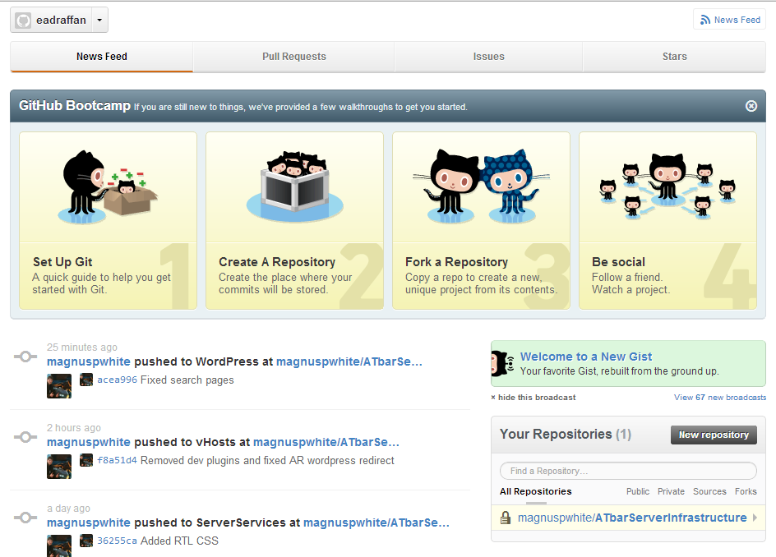
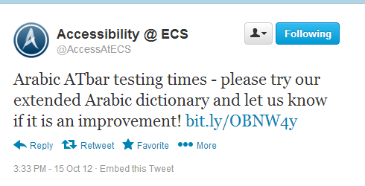
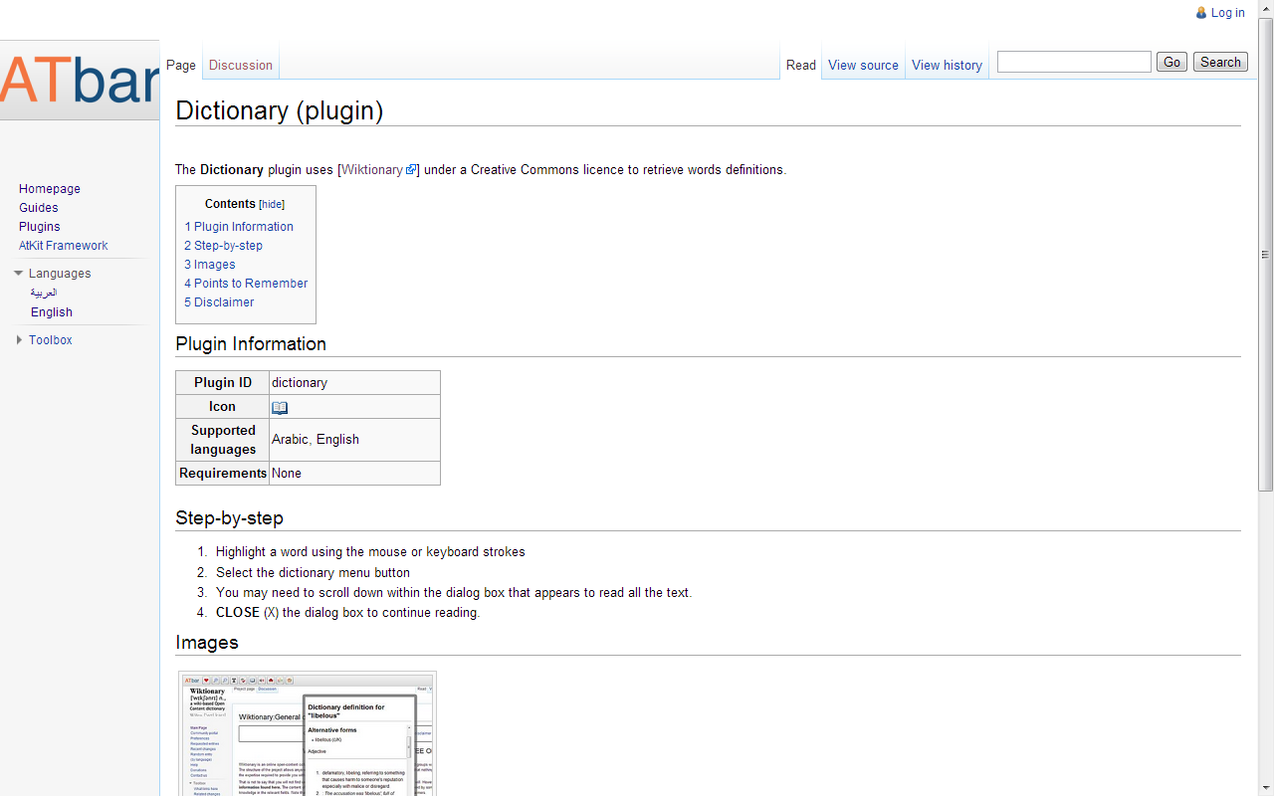
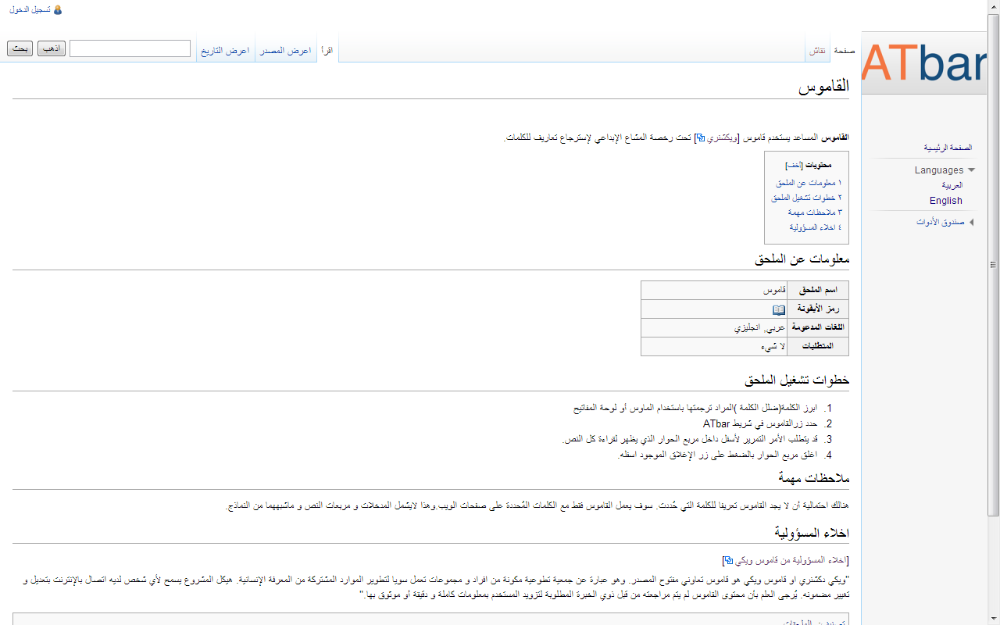
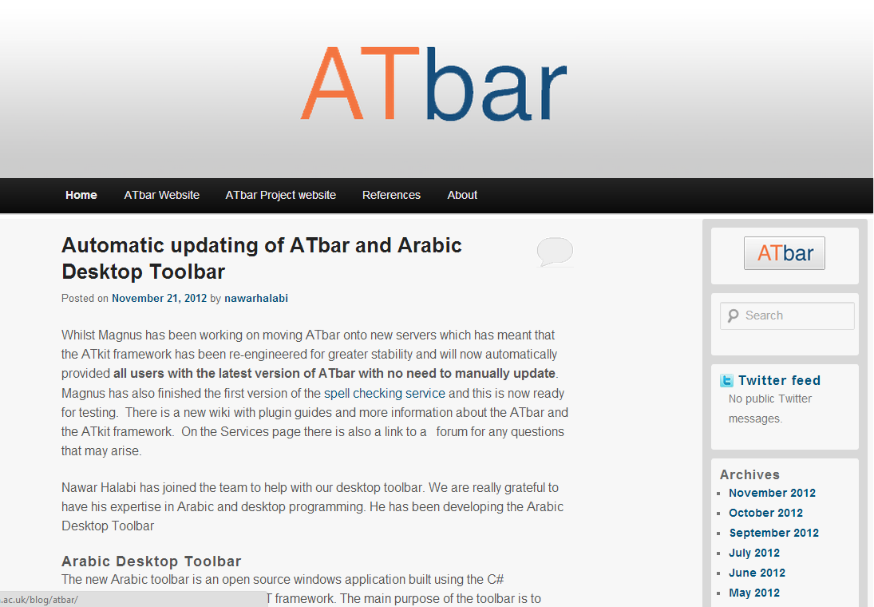
Documentation
www.arbar.org

Slide 14
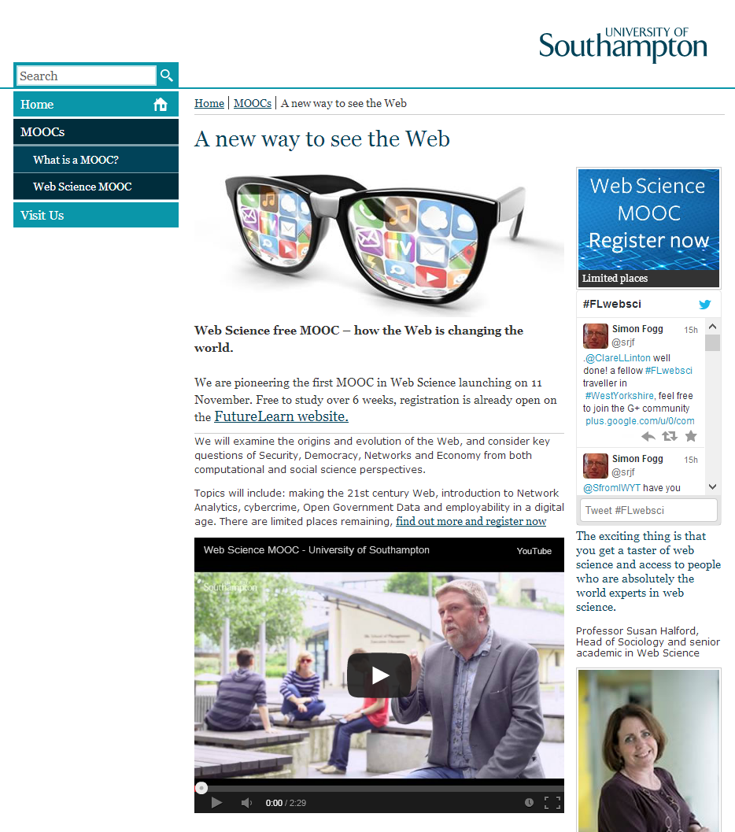
ATBar and the MOOC!

Slide 15
Solutions
Collaborative working
Good code - it is open source! https://github.com/AccessAtECS/ATBar
Problems shared – bug tracking, issues raised, comments made, new ideas.
Social media – wikis for documentation, tweets and blogs for news
Multiple means of representation, expression and engagement to accommodate individual differences.

Slide 16
References
Furstenberg et al., (2001). Giving a virtual voice to the silent language of culture: The CULTURA project http://llt.msu.edu/vol5num1/furstenberg
LeDoux, J. (2002). Synaptic self: How our brains become who we are. New York: Penguin.
Thorne, S.L., (2003a). Artefacts and cultures-of-use in intercultural communication http://llt.msu.edu/vol7num2/thorne
Crystal, D. (2001) Language and the Internet (Cambridge: Cambridge University Press)
O’Dowd, R. (2001) In search of a truly global network: hhtp://callej.org/journal/3-1/o_dowd.html
Marcoccia, M. (2012) The internet, intercultural communication and cultural variation. Language and Intercultural Communication, 12:4, 353-36 http://dx.doi.org/10.1080/14708477.2012.722101
Ersoz, S. (2009) Cultures in Cyberspace: Interpersonal communication in a computer-mediated environment http://maltepe.academia.edu/SelvaEesoz/Papers/563123/Cultures_in_cyberspace_interpersonal_communication_in_a_computer-mediated_Envrionment
Würtz, E. (2005). A cross-cultural analysis of websites from high-context cultures and low-context cultures. Journal of Computer-Mediated Communication, 11(1), article 13.http://jcmc.indiana.edu/vol11/issue1/wuertz.html

Slide 17
Thank You
David Banes
Mada Center
http://mada.org.qa/en/
E.A. Draffan
ead@ecs.soton.ac.uk
ECS Accessibility Team
http://access.ecs.soton.ac.uk

