Slide 1
Achieve. Grow. Build.
Designing, Developing, and Implementing Accessibility for Efficiency: A Case study from DeVry Education Group

Slide 2


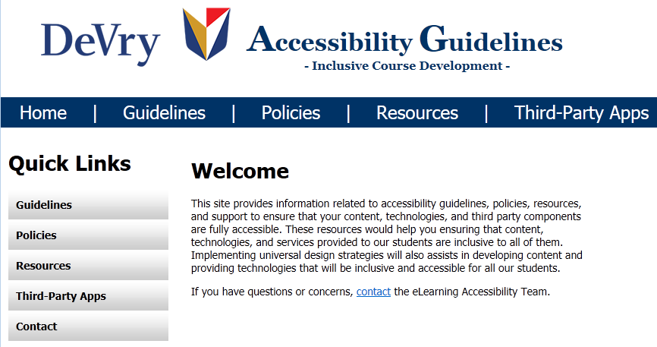
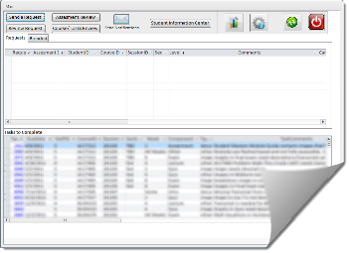




Main
Design
Designing, Developing, and Implementing Accessibility for Efficiency
Develop
Build
Conclusion

Slide 3
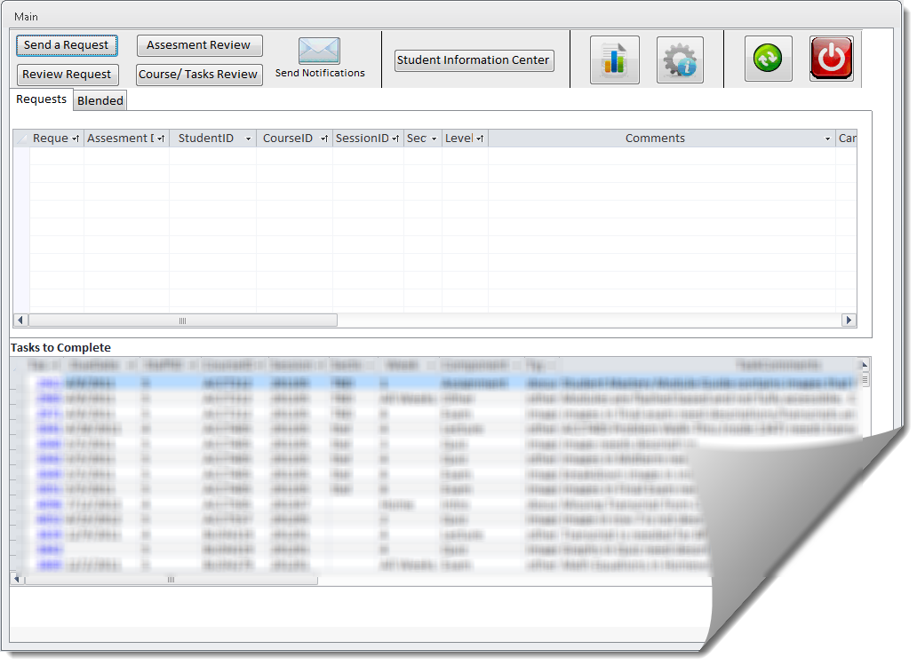
Designing inclusivity in – Success factors
Be ahead of the curve: Work closely with ADA officers to identify student needs and provide support before the student experiences difficulties
  Identifying courses and going through remediation process
      Working with Academics to identify faculty and SME support
      Using a database to maintain records and assist with support processes.
  Assisting Students as needed while taking courses

Slide 4
Designing inclusivity in – Success factors
Develop gatekeepers: Ensure Instructional Designers and Course Developers become accessibility “gatekeepers” for web accessible content development
  Proving guidelines, documentation and support
  Helping them to be accessibility keepers
  Development of “Accessibility Guidelines for Inclusive Course Development” website.

Slide 5
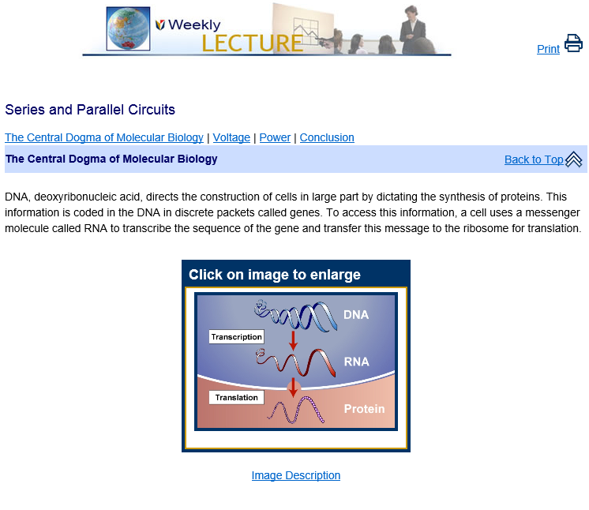
Designing inclusivity in – Success factors
Make it easy: Develop accessible templates and tools for creating web accessible content
  Building course templates that are WCAG 2.0 Level AA compliant
  Implementing offline build process to ensure clean and compliant code
  Implementing HTML and JavaScript interactive assemblers to replace Flash components
  Implementing MATHML to show math content

Slide 6
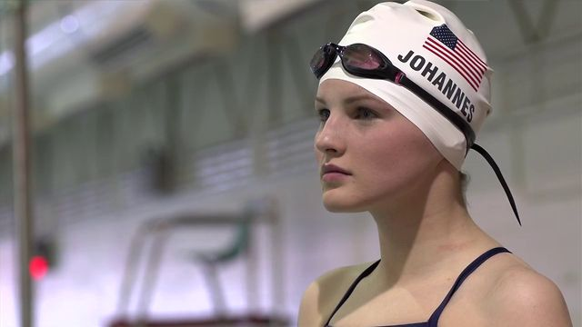

Designing inclusivity in – Success factors
Support the front line: Provide processes and tools for fast and effective support
Assisting ADA student with a student planning process
Providing alternatives and support systems to our students
Identifying tools and services to support students
  Closed Captioning
  eBooks and Publishers
    AMAC
    Pearson (Strong Relationships)
  Transcript services
  Accessibility Experts to test systems and courses

Slide 7

Building accessibility in from the START
Build the right team – Coders with deep understanding of accessibility tools
      Web Developer with deep understanding of accessible techniques
      eLearning Accessibility Team

Slide 8

Building accessibility in from the START
Build with the right principles - Universal Design: Access and options for all (multiple delivery channels for student selectivity)

Slide 9

Building accessibility in from the START
Build with the right tools - CSS, HTML5, JavaScript, MathML.

Slide 10

Develop with efficiency and future proof in mind
  Use accessibility and universal design as the key to open many more doors
    Don’t only support better your ADA students but also ALL students
    Create content that is more usable; therefore, students are more likely to use the content and learn more.
    Keep more students in the long run. This translates to more revenue
    Create content that has longer live span

Slide 11
Develop with efficiency and future proof in mind
  Use accessibility and universal design as the way to be future proof
    Use technologies that are widely available and supported
    Develop components that are flexible/modular
    Always think about the future and don’t get stuck with current technologies
  Accessible = Efficiency + Future proof
    Content is easier to maintain and support
    Adding newer technologies is not as complex anymore
    Delivery of content in other ways is now possible (Audio, mobile, etc)
    More importantly, you are meeting the student’s needs

Slide 12
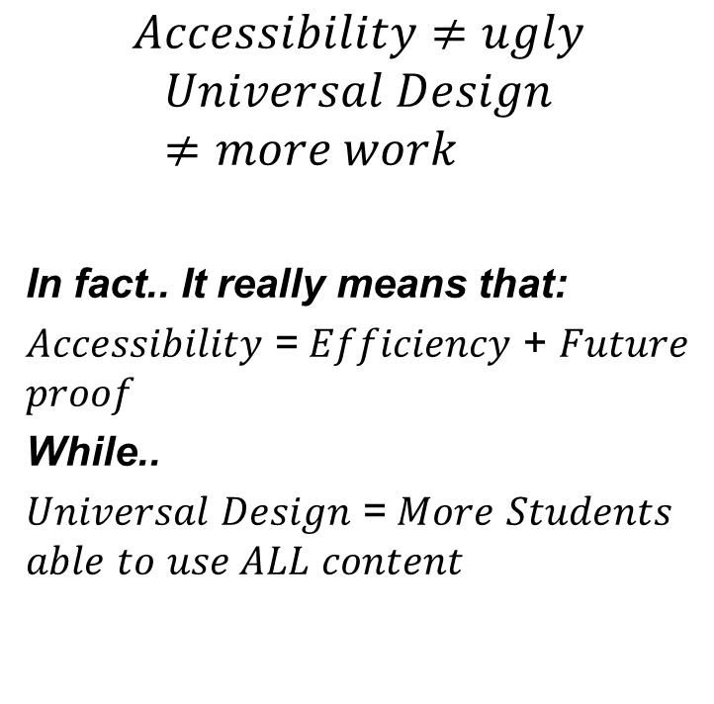
Conclusion
$$Accessibility≠ugly$$
$$Universal Design≠more work$$
In fact.. It really means that:
𝐴𝑐𝑐𝑒𝑠𝑠𝑖𝑏𝑖𝑙𝑖𝑡𝑦 = 𝐸𝑓𝑓𝑖𝑐𝑖𝑒𝑛𝑐𝑦 + 𝐹𝑢𝑡𝑢𝑟𝑒 𝑝𝑟𝑜𝑜𝑓
While..
𝑈𝑛𝑖𝑣𝑒𝑟𝑠𝑎𝑙 𝐷𝑒𝑠𝑖𝑔𝑛 = 𝑀𝑜𝑟𝑒 𝑆𝑡𝑢𝑑𝑒𝑛𝑡𝑠 𝑎𝑏𝑙𝑒 𝑡𝑜 𝑢𝑠𝑒 𝐴𝐿𝐿 𝑐𝑜𝑛𝑡𝑒𝑛𝑡
In other words why not have this?
Accessibility + Universal Design
= Student Success!!

Slide 13
Giovanni Duarte
Web Services Manager
DeVry Education Group gduarte@devry.edugduarte@devry.edu

