Slide 1
Creating a safety net for moving your classroom to the web
Presented by: Van Credle
Assistive Technology Specialist
The Catholic University of America

Slide 2
Technology is Awesome
“Big breakthroughs happen when what is suddenly possible meets what is desperately necessary.”
– Thomas Friedman May 15, 2012 New York Times
http://www.youtube.com/watch?v=U6FvJ6jMGHU
http://www.youtube.com/watch?v=QUCfFcchw1w
http://www.youtube.com/watch?v=Z0uAuonMXrg
http://www.nytimes.com/2012/05/16/opinion/friedman-come-the-revolution.html
http://www.nytimes.com/2013/03/06/opinion/friedman-the-professors-big-stage.html?_r=0

Slide 3
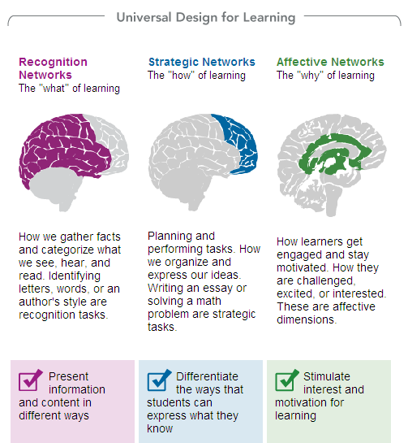
Universal Design for Learning is Awesome

Slide 4
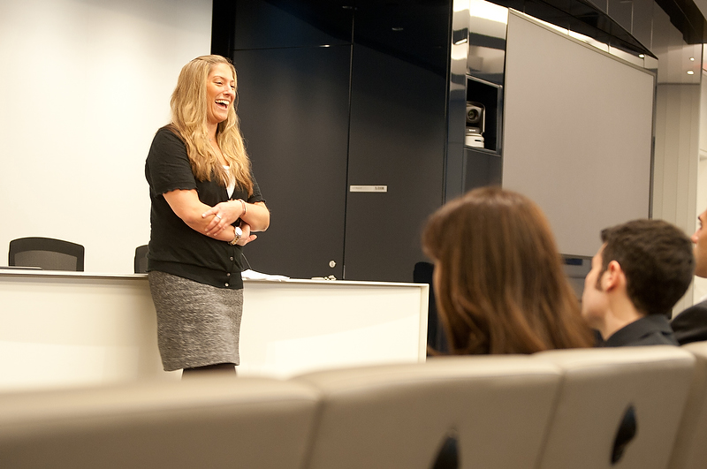
DSS + UDL = Faculty Trainings
Notes:
Cultural awareness too
New faculty & TA orientations

Slide 5
Thinking ahead means less work
Alternative Assignments
Less office administration
Fewer testing spaces
Faculty create accessible documents
No conversion wait time
Fewer student workers
Faculty use microphones
No additional FM equipment
Better quality recorded lectures
Notes:
Benefits to DSS of teaching UDL

Slide 6
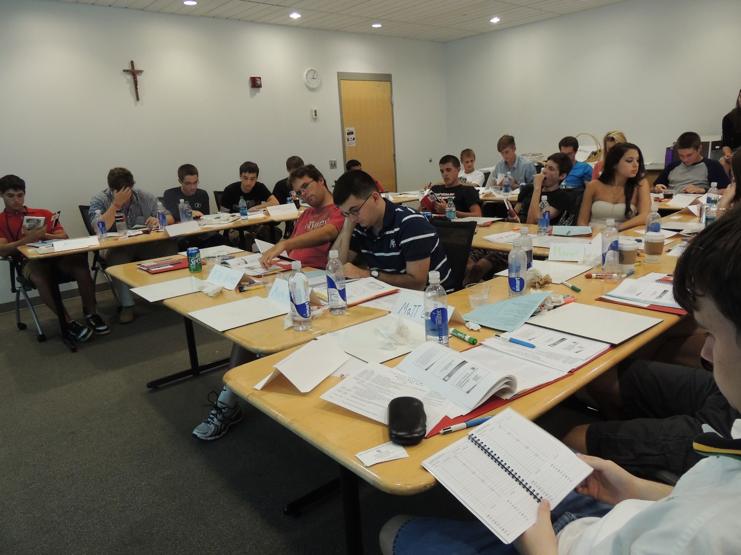
Practicing What We Preach:
Notes:
UDL in Orientation (prompt for other presentation

Slide 7
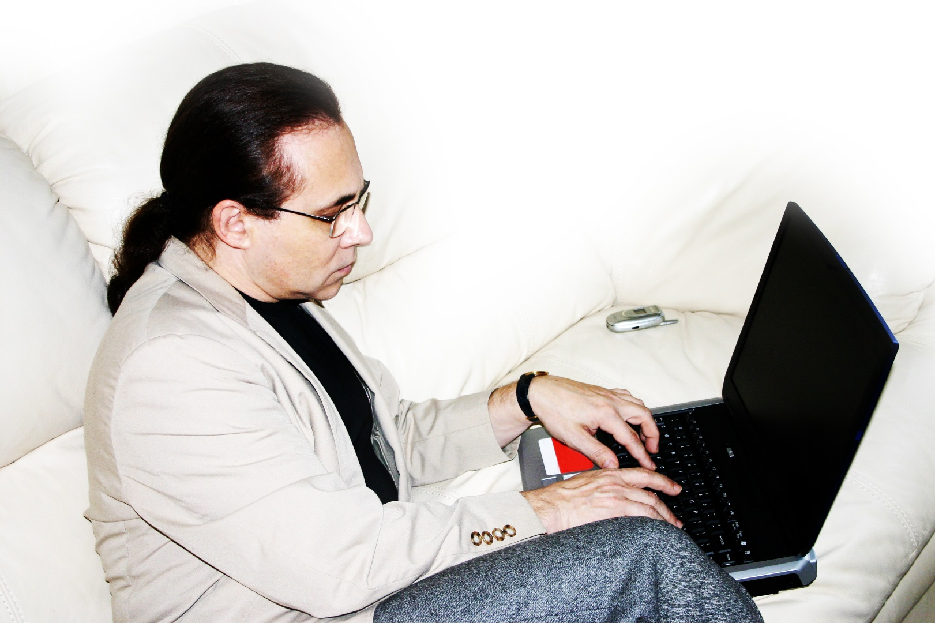
A Wrench in the Works:
Online Classrooms?
Notes:
Moving to online classrooms

Slide 8

Techies + Training = Better Learning
Catholic University launched its first fully online degree program
The college realized that the vendor may not be providing all the answers to accommodations that the university provides for on-campus courses
Technology Services and Disability Support Services met the vendor and discussed accommodation responsibilities
Notes:
Collaborating with Technology Services on facilitating online course

Slide 9
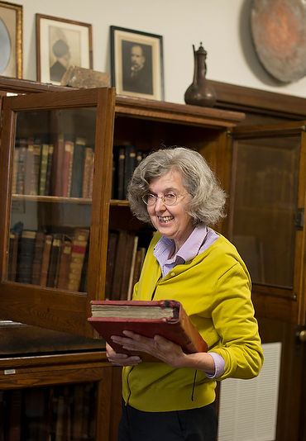
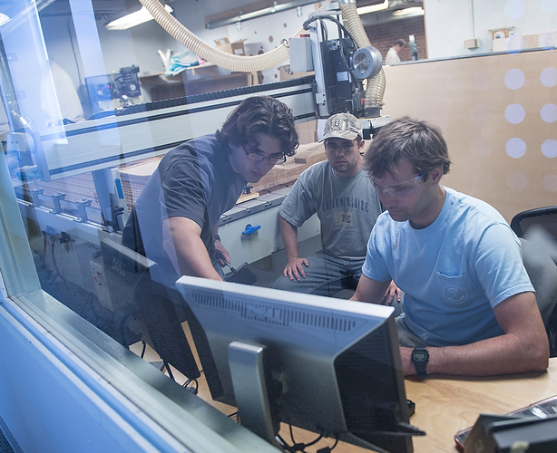
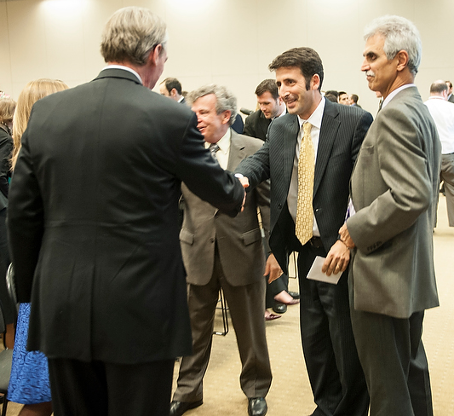
Who Else is on the Team?
Notes:
Other collaborators and supporters

Slide 10
Far-reaching Solutions for
Distance Problems
Blackboard Exams
Provide faculty with instructions to create extended time exams
Encourage alternate assignment options
Deaf Student Presentations
Establish protocol for faculty to use caption services
Establish protocol for student to use voice interpretation
Print Material Accessibility
Provide distance students with easy methods to request and receive alt formats
Accommodations
All syllabuses must include disability access statement
All online courses list DSS as a resource

Slide 11
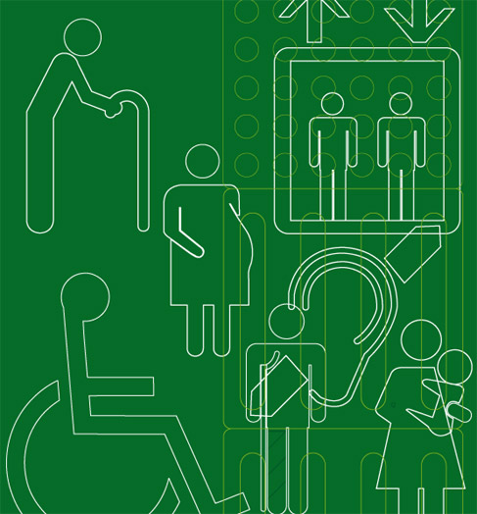
The Password is UDL
The digital instructional design specialist saw the benefits of incorporating UDL throughout the course to create better online classrooms
Notes:
Integrating UDL throughout the course. What we do in the course

Slide 12
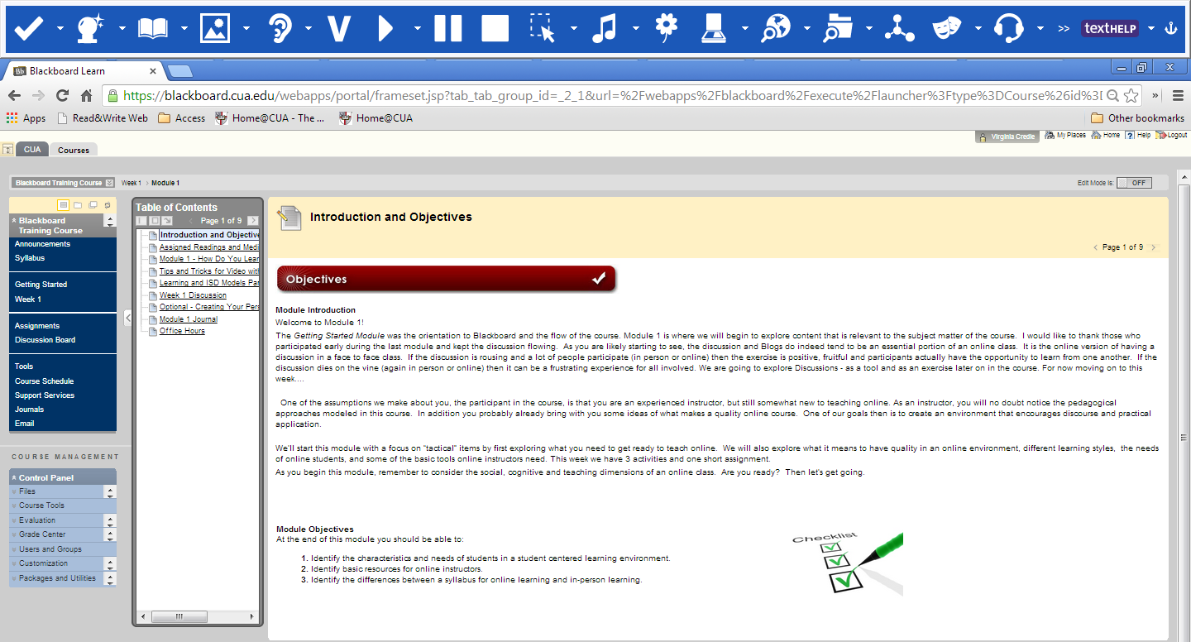
The Fine Print: Details covered
Notes:
Five modules,

Slide 13
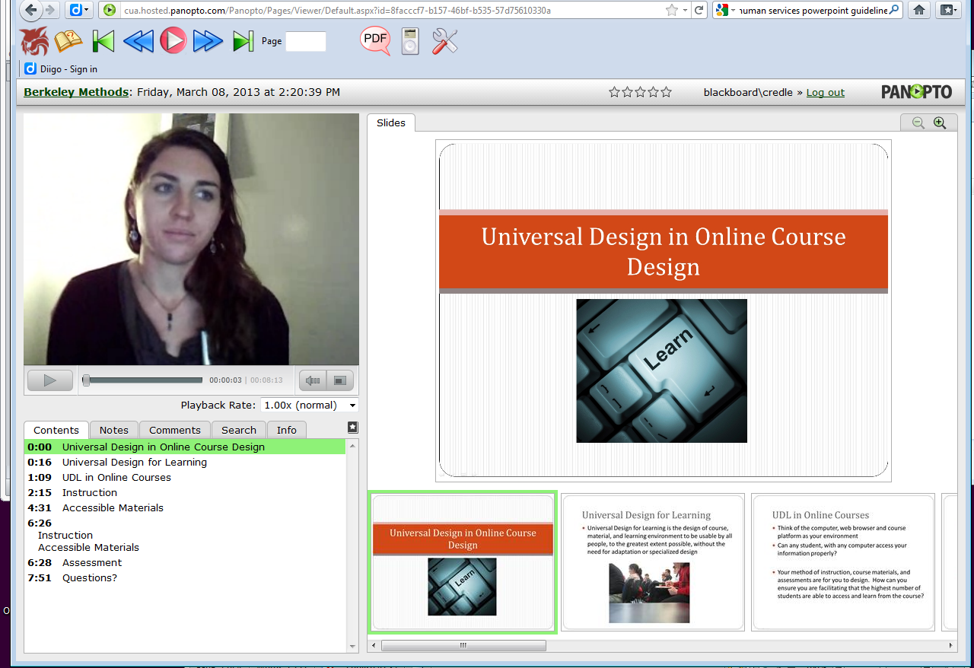
An Insider’s Look
Notes:
Frames/video of the course: UDL taught in the course

Slide 14
Success!
All students ranked course satisfaction 7 or greater.
Nearly half of the first cohort had poor or ambivalent opinions about Blackboard.
These improved dramatically for the third cohort with all responses as 6 or greater.
>90% students reviewed optional material (100% for 3rd cohort)

Slide 15
Success!
70% said that they wanted to participate in an optional short form of the course later
90% said they would recommend the course to a colleague
Most students commented that they would actually like more resources, modules, and instruction on online course development and the topics presented

Slide 16

We Can Build a Better Mousetrap
More universally accessible elements in our presentation
Additional research and practical development tools
Extended presentations, particularly on learning styles and UDL

Slide 17

How Does this Relate to Me?
Over the last few years, online enrollments have grown substantially faster than overall higher education enrollments. In 2011, 6.7 million post secondary students took at least one online course. Online learning has grown from a 10% rate of enrollment in 2002 to a 32% rate of enrollment in 2011. (Changing Course, 2013).

Slide 18
How can Faculty Do More to Make their Courses Accessible?
What your office is doing and how much of this can and should be done by faculty?
How does your office address online accessibility?
What does your administration do to support these efforts?
Notes:
Discussion

Slide 19
To Accessibility and Onwards!
Contact
Van Credle
The Catholic University of America
credle@cua.edu
dss.cua.edu

