Slide 1
Removing Barriers: The Evolution of a Web-based Application for Accommodated Exam Requests
Accessing Higher Ground – October 2013
Presented by
Justin Lozano & Becca Terry
University of Missouri

Slide 2
2010 - 2011
Increase in student numbers
Paper, paper everywhere!
Data entry = OVERWHELMING

Slide 3
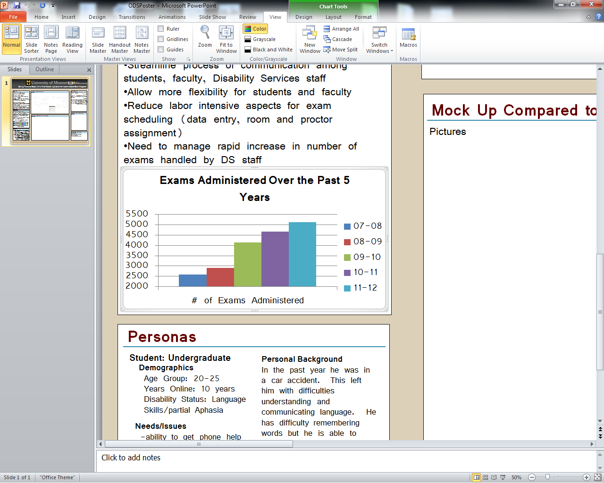

Slide 4
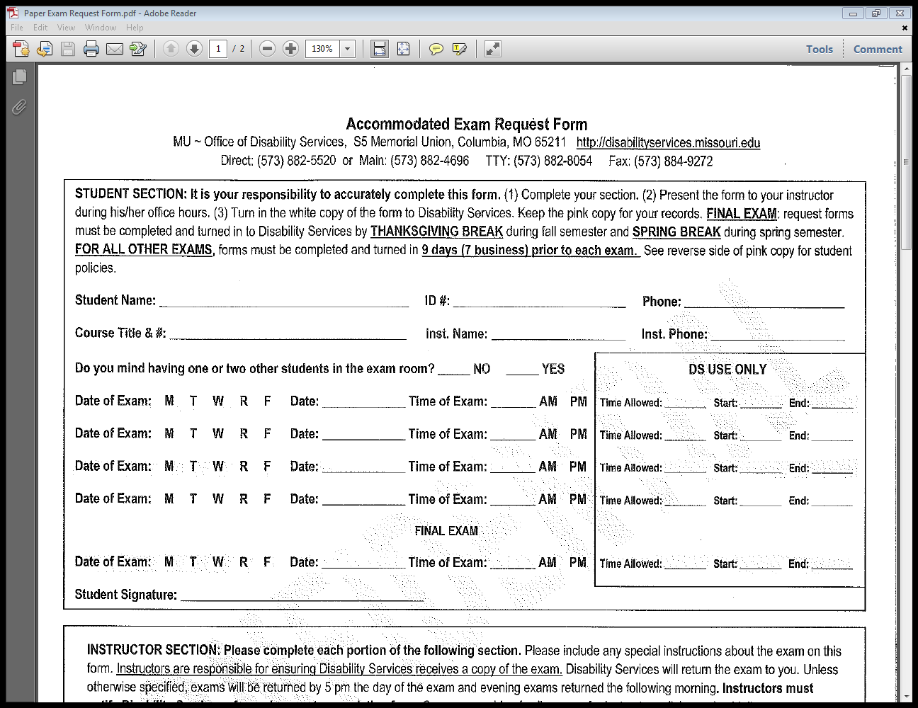
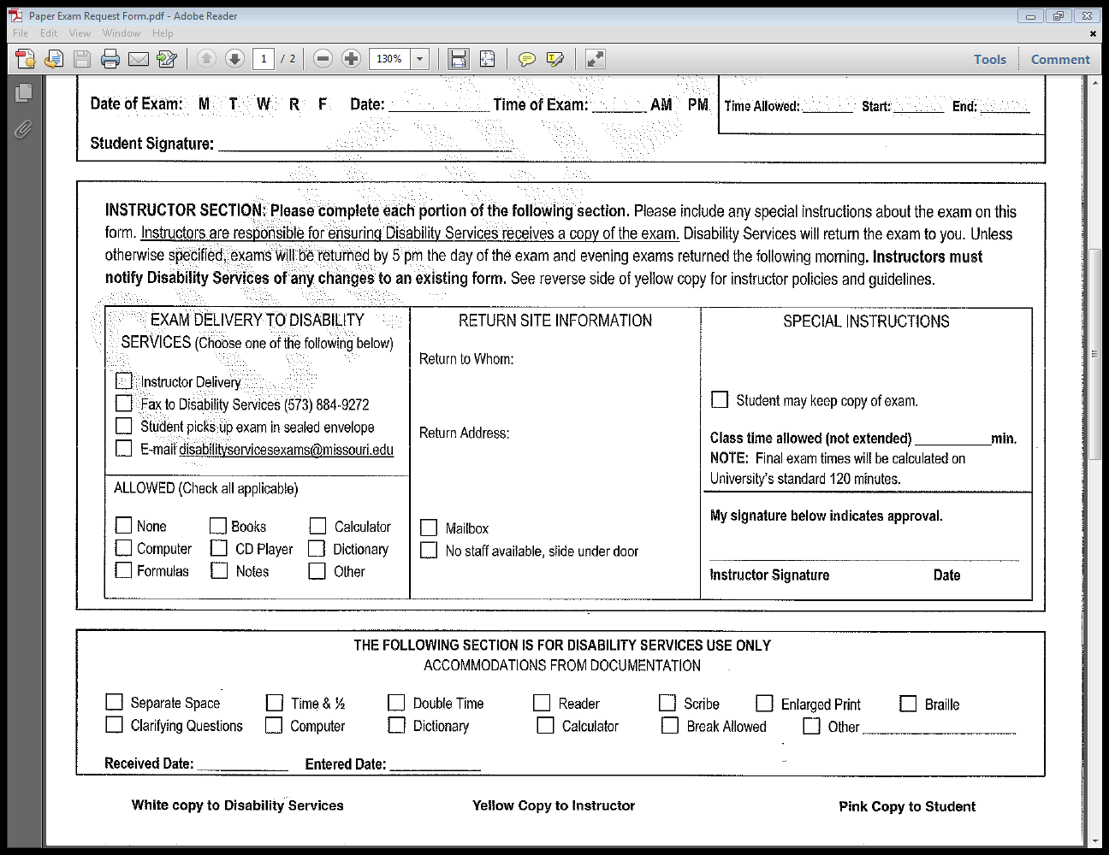
2010 - 2011
Triplicate
Paper Form
To be
completed
for each
course

Slide 5
2010 - 2011
Collaborated with Application Development Network (ADN)
Research began to streamline a paper process

Slide 6
Research Galore
Created student personas
Consulted with Adaptive Computing Technology Center (ACT)
Worked directly with students with various disabilities

Slide 7
Persona Example
Student: Undergraduate
  Demographics:
    Age Group: 20-25
    Years Online: 10 years
    Disability Status: Language
    Skills/partial Aphasia

Slide 8
Persona Example
Personal Background
  Was in a car accident
  Left with difficulties understanding and communicating language
  Has difficulty remembering words but is able to communicate
  Often gets frustrated when words get mixed around or does not pronounce them correctly
  Still learning how to cope with new adversities

Slide 9
Persona Example
Needs/Issues:
  Ability to get phone help
  Information overload is a concern
  Determined to cope and is always looking for “additional help” or “tutorials” so can do on their own

Slide 10
Fall 2011
Beta testing of 20 students and their instructors
Recorded feedback from both students and instructors
Notes:
Feedback sessions
Surveys
Email & Phone communication throughout the process

Slide 11
Spring 2012
Full launch
Included updates based on feedback
Educated students and instructors in multiple ways
Notes:
Created powerpoint tutorials, emailed and posted to our website
Explained to students when picking up their accommodation memos
Created help sessions for students and instructors to attend for one on one help
Presented to departments

Slide 12
Key Issues
Faculty buy-in
Office buy-in
Changes in workload, office processes
Orientation for faculty and students to new process
Constant communication with ADN

Slide 13
Fall 2012
Office transitions
New academic year, new challenges!
The system…new updates. Wow. Back to paper?
Notes:
Promotions
Using report system
Generating labels
Creating delivery report
Still office pushback, even in version 3
How did it end up?
Impact on the office…changing our business practice?

Slide 14


Slide 15
A Revelation
AHAAAAAA!!!
Changing our business practice benefits everyone!
No more forms
Provide process for instructors that empowers them to embrace more universal design concepts
Notes:
No ‘form’
Exam based requests
Provide a process for professors that not only reduces their workload, but empowers them to embrace more universal design concepts
We expect professor pushback
Remind them of old process disadvantages
Create/take advantage of opportunities for professor buy in
Rewards professors who plan ahead for the semester, allowing them to only have to enter information once
In turn, provides ODS with more notice to plan ahead in regards room and proctor scheduling

Slide 16
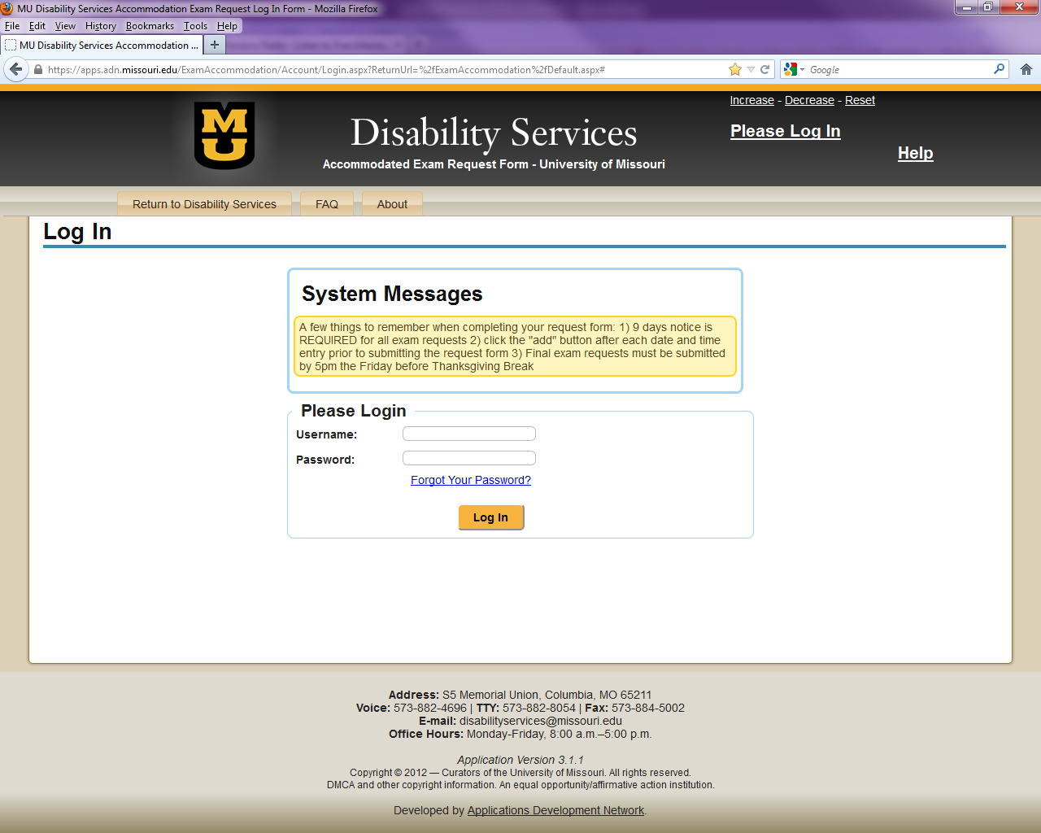
Pawprint
Same password as MyZou

Slide 17

Student Log In

Slide 18
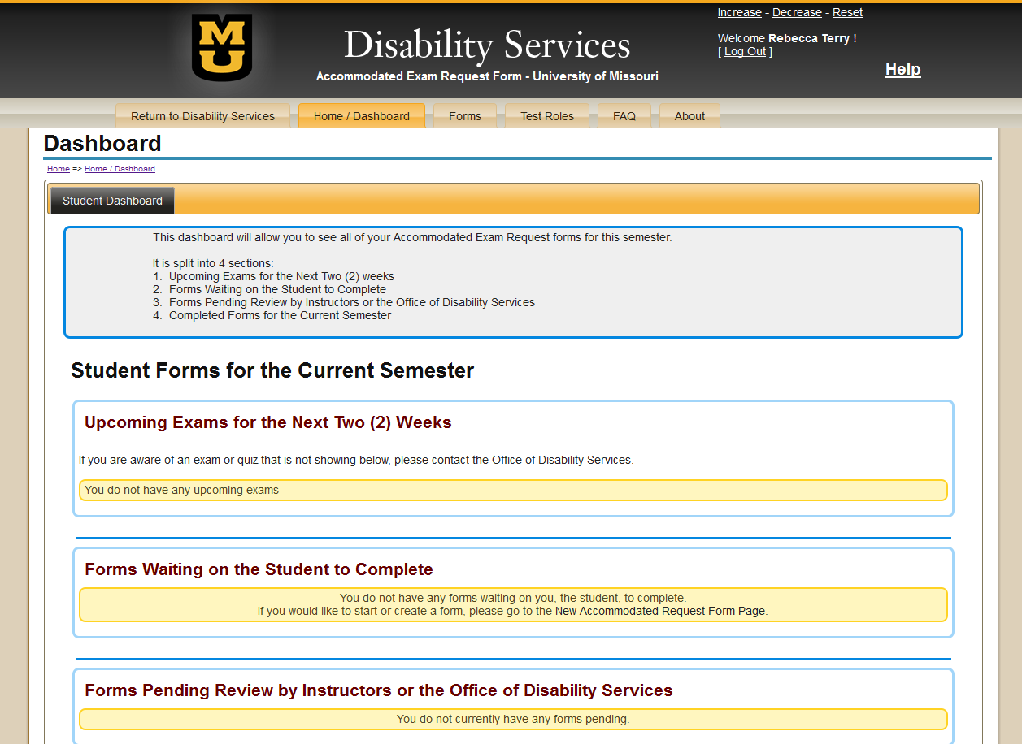
Click Here to Begin Request

Slide 19
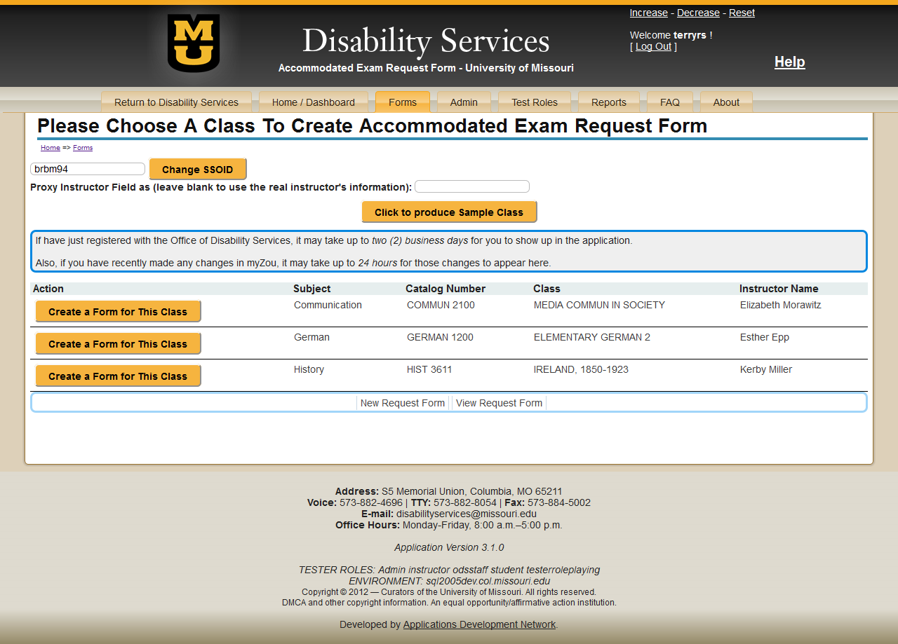
Click To Create Form For Desired Class

Slide 20
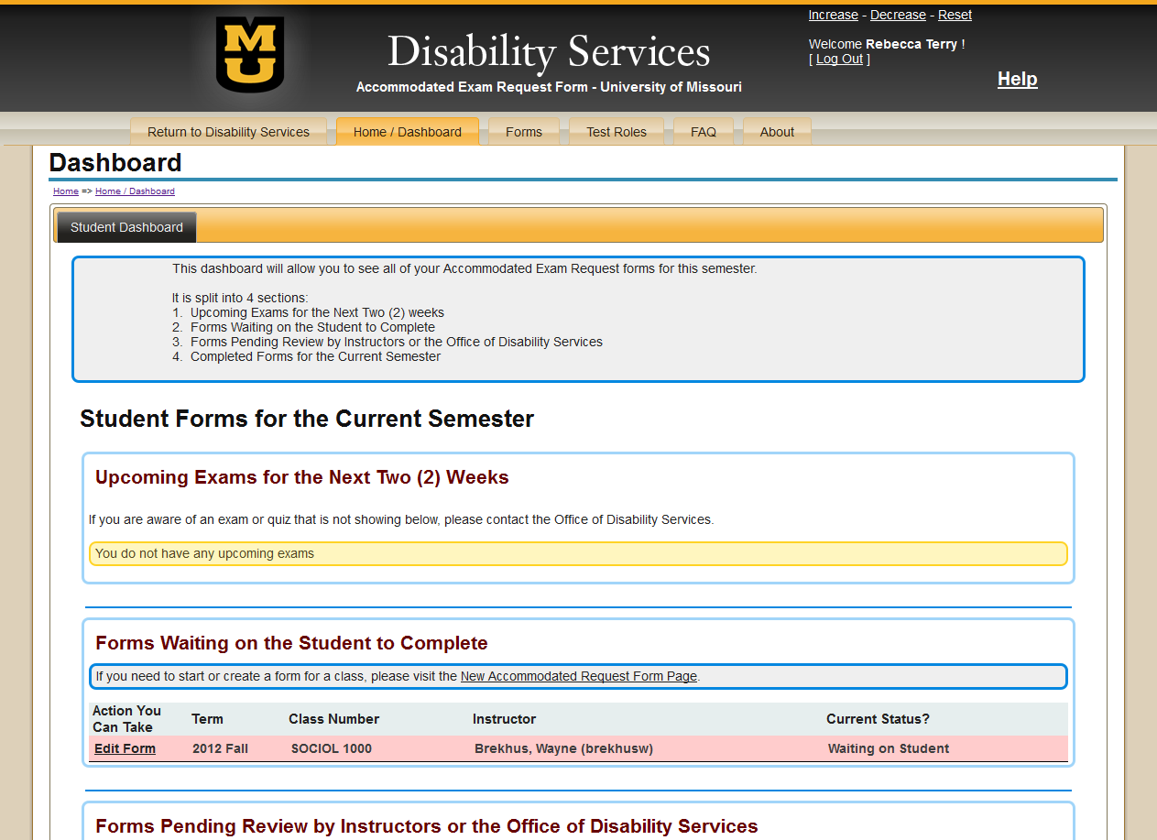
Click Here To Enter Dates

Slide 21
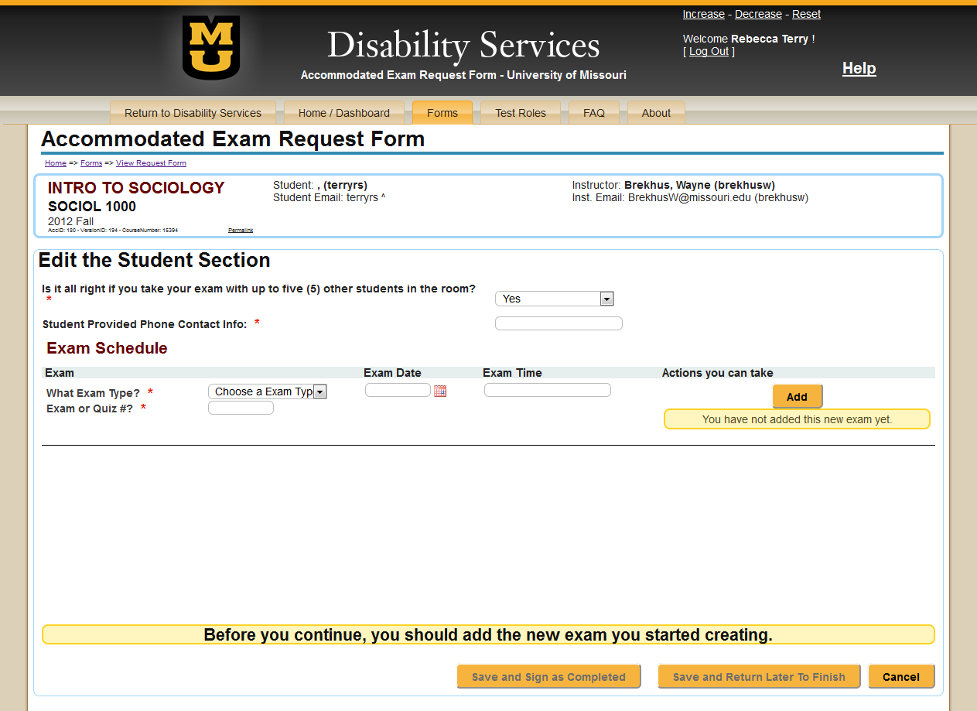
Course Information
Student Information
Instructor Information

Slide 22
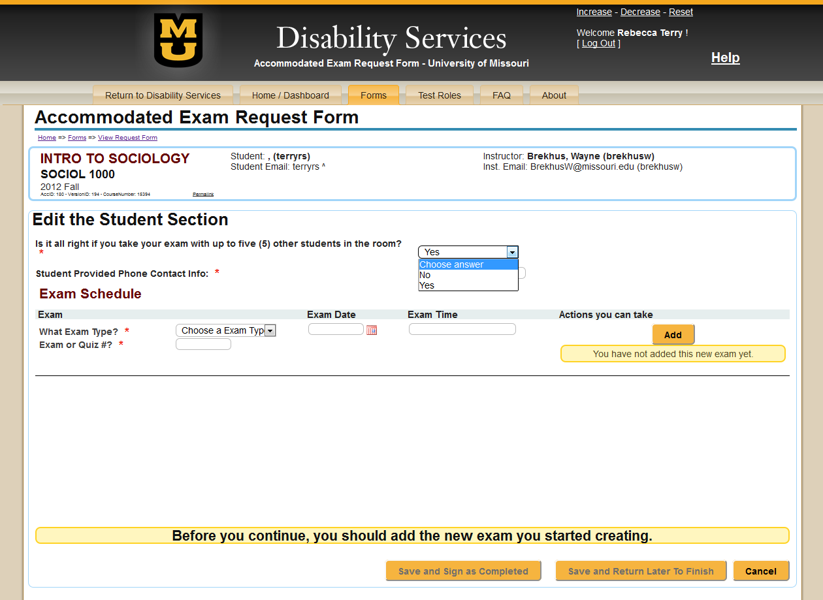
Course Information
Student Information
Instructor Information

Slide 23
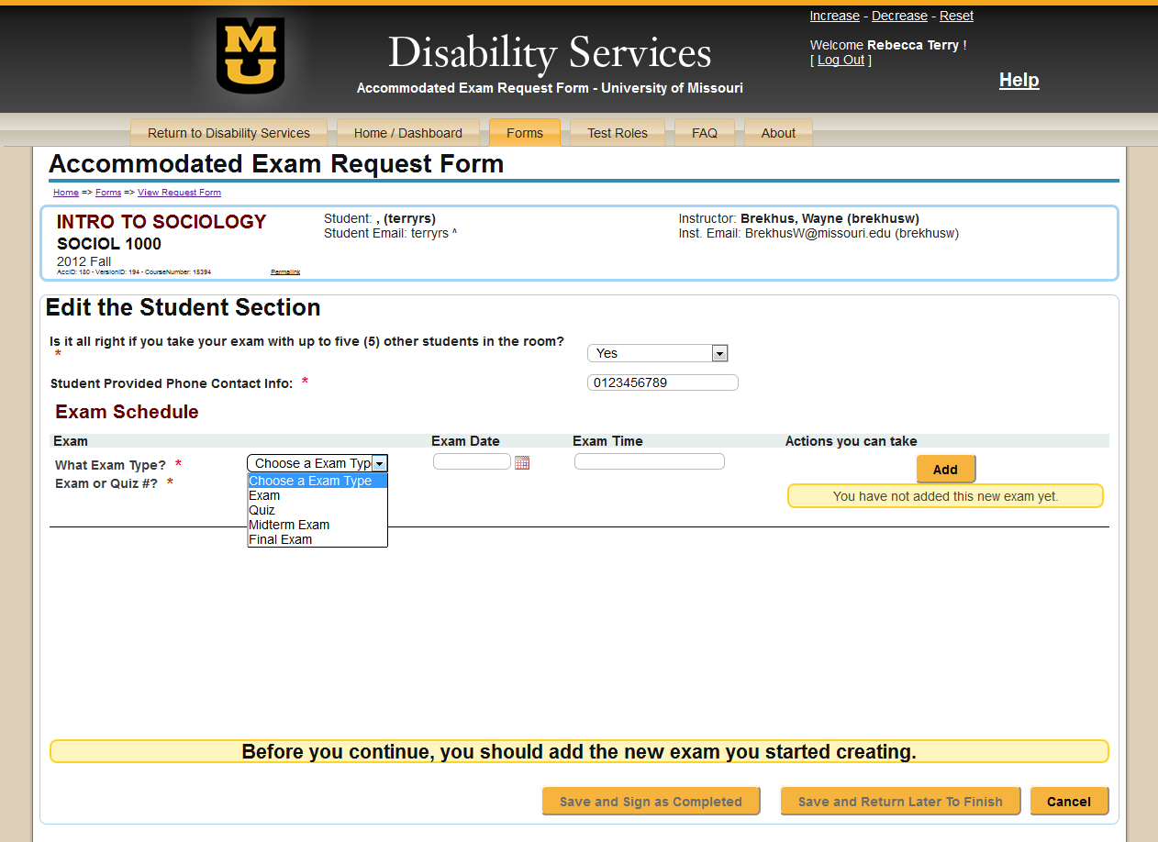
Course Information
Student Information
Instructor Information

Slide 24
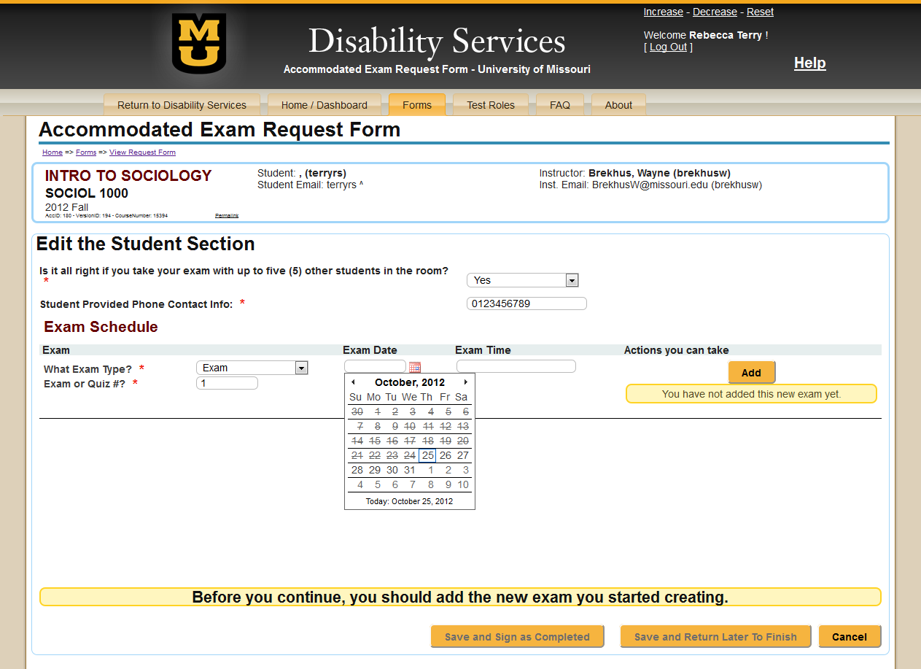
Course Information
Student Information
Instructor Information

Slide 25
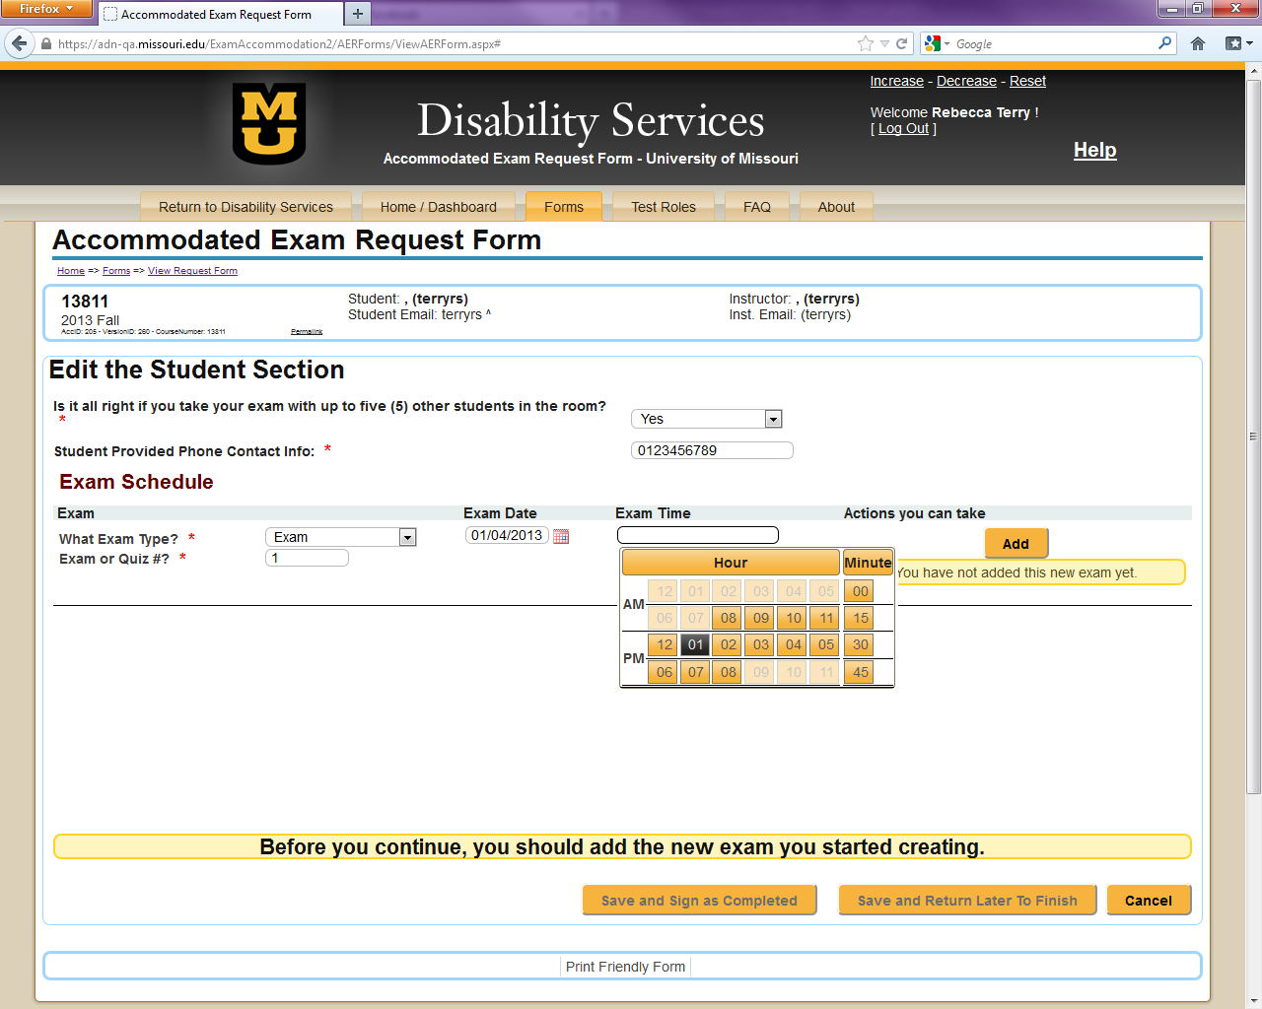
Course Information
Student Information
Instructor Information

Slide 26
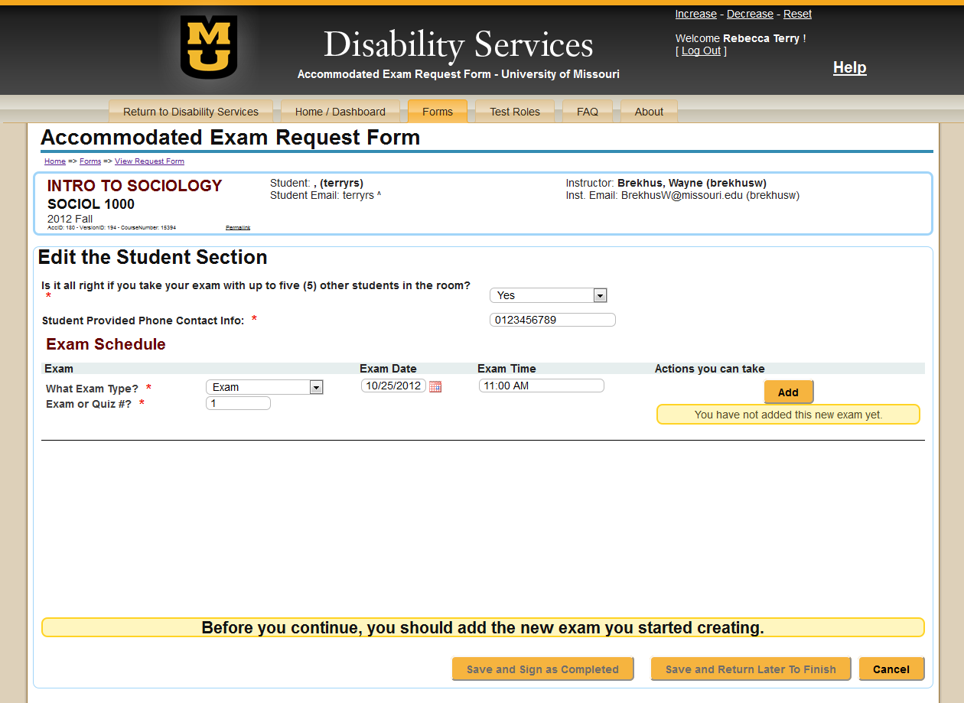
Course Information
Student Information
Instructor Information
Click Here To Add Date

Slide 27
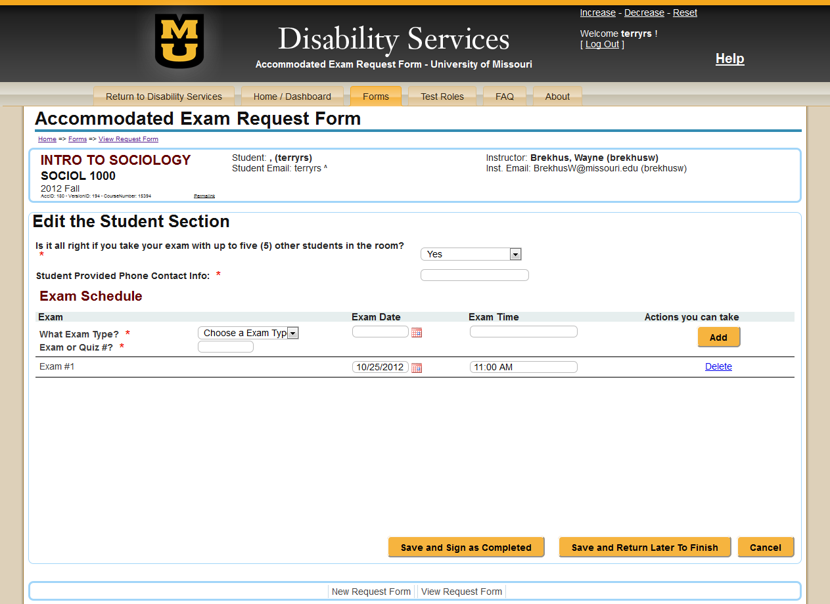
Course Information
Student Information
Instructor Information
Click Here To Submit The Requests For This Class Once ALL Dates Are Entered
Exam Date Populates Below To Allow For Additional Exam Dates To Be Entered

Slide 28
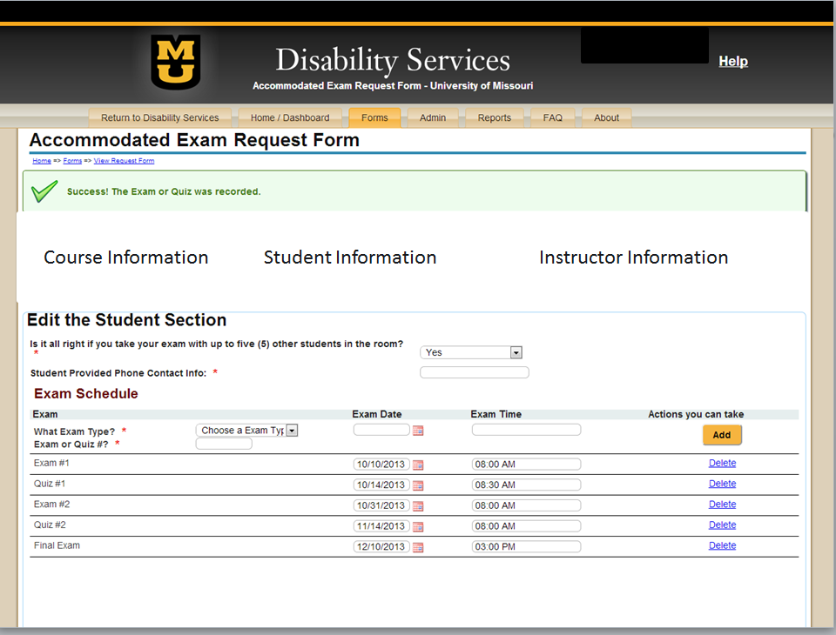

Slide 29
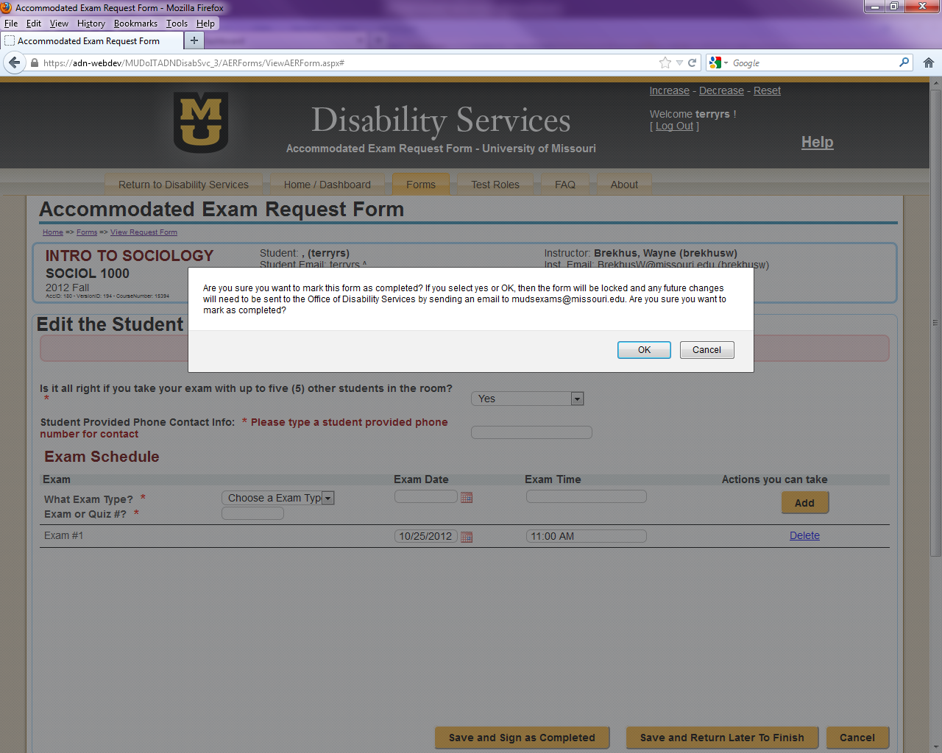
Course Information
Student Information
Instructor Information

Slide 30

Instructor Log In

Slide 31
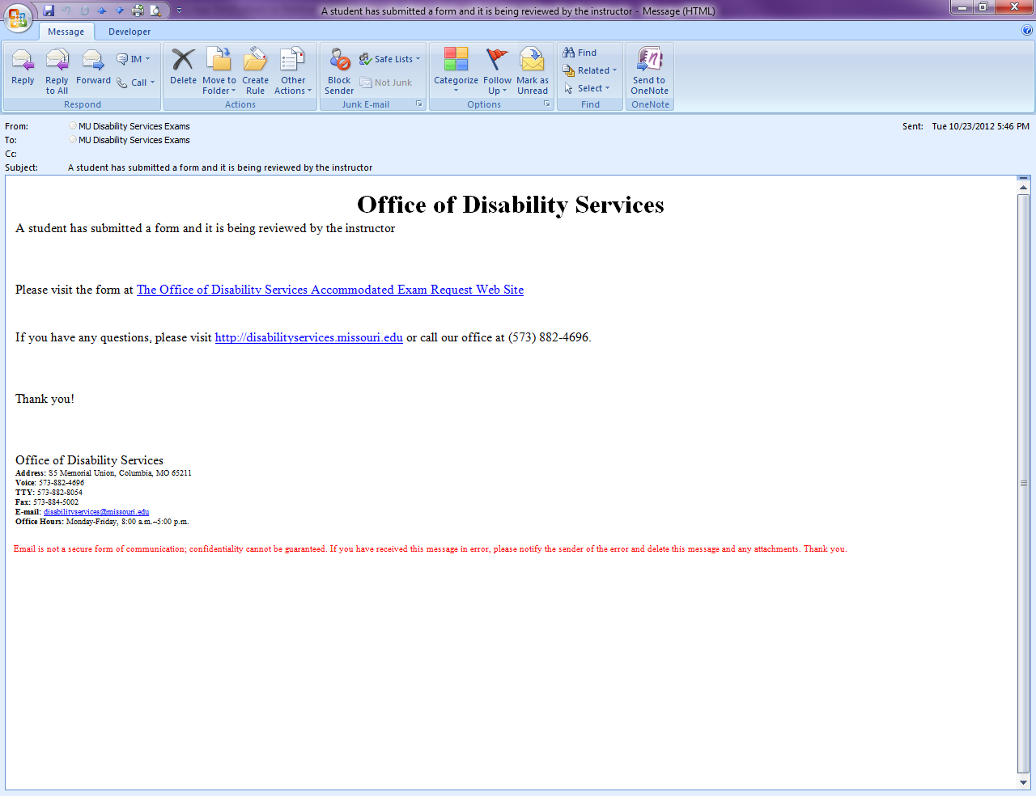
You have an Accommodated Exam Request form available for completion
One of your students has submitted an Accommodated Exam Request form. Please login to complete your portion of the form. Once completed, this information will be sent to the Office of Disability Services. Thank you for your assistance with this process.
Click Here

Slide 32
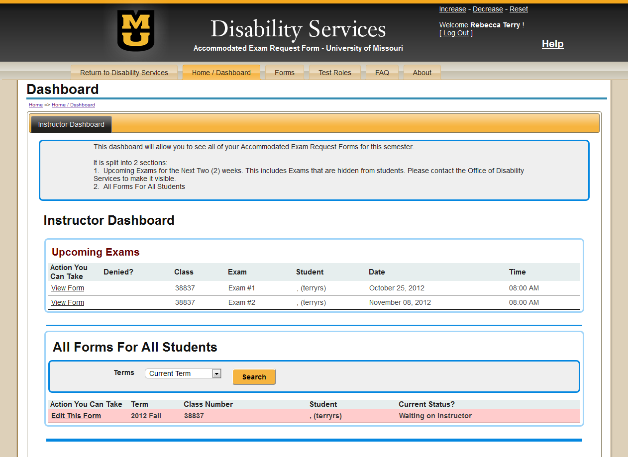
Click Here to Review Submitted Information
Tiger, Truman
Tiger, Truman
MZU 1000
Walker, Mort
Notes:
Log in is exactly the same

Slide 33
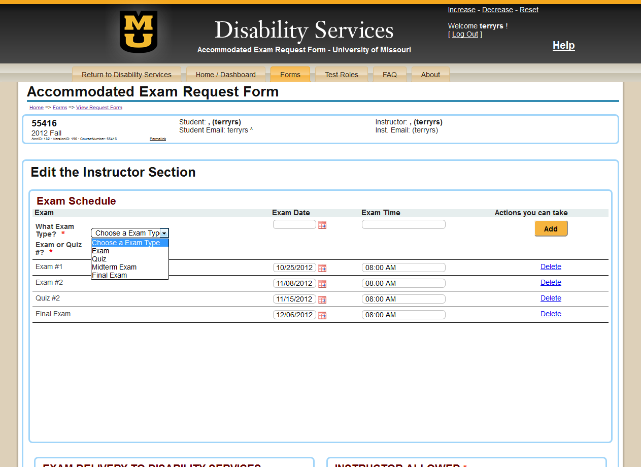
Course Information
Student Information
Instructor Information
If Date/Time Needs Added…

Slide 34
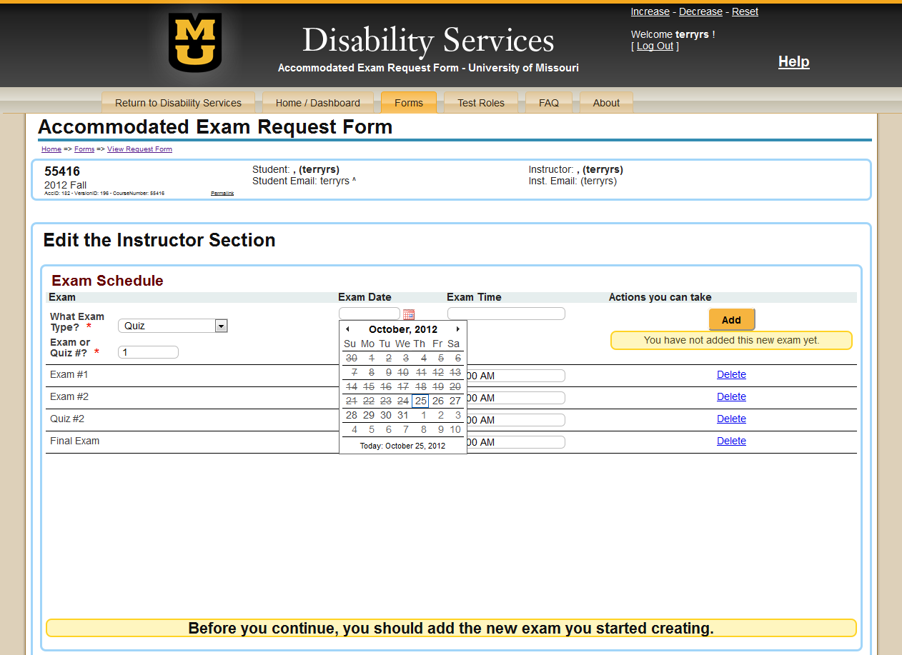
Course Information
Student Information
Instructor Information

Slide 35
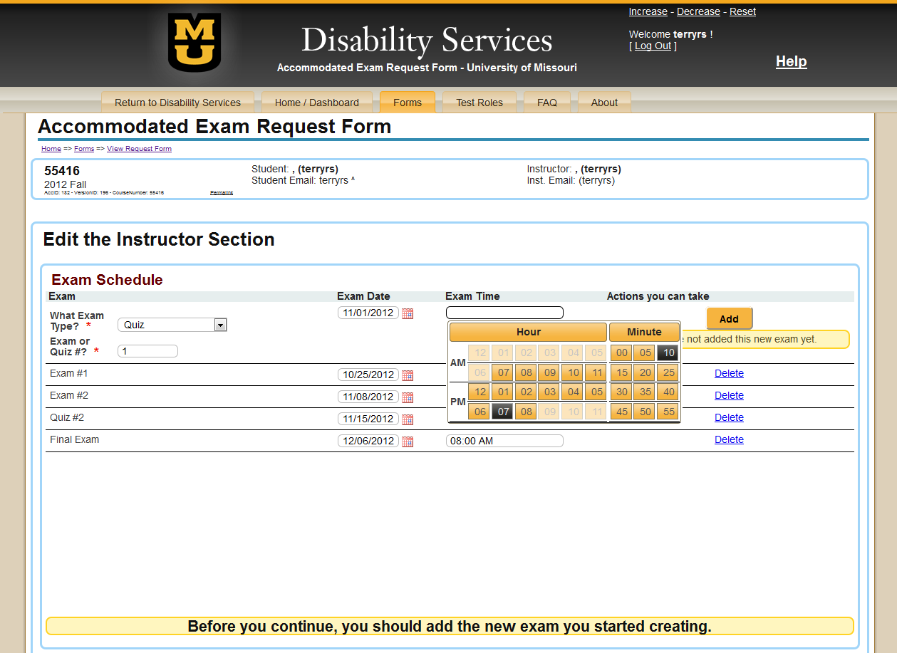
Course Information
Student Information
Instructor Information

Slide 36
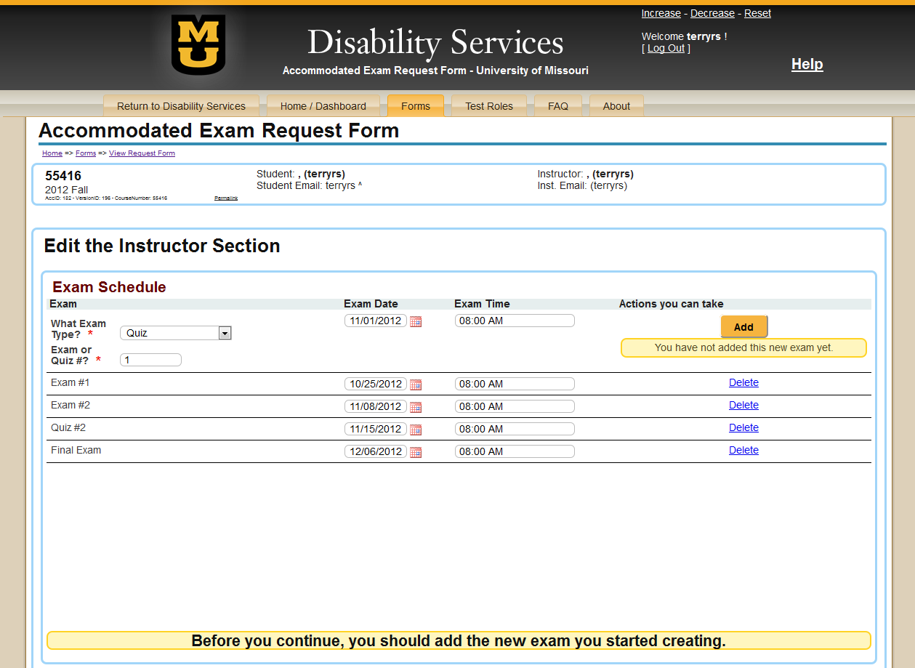
Course Information
Student Information
Instructor Information
Click Here To Add Date

Slide 37
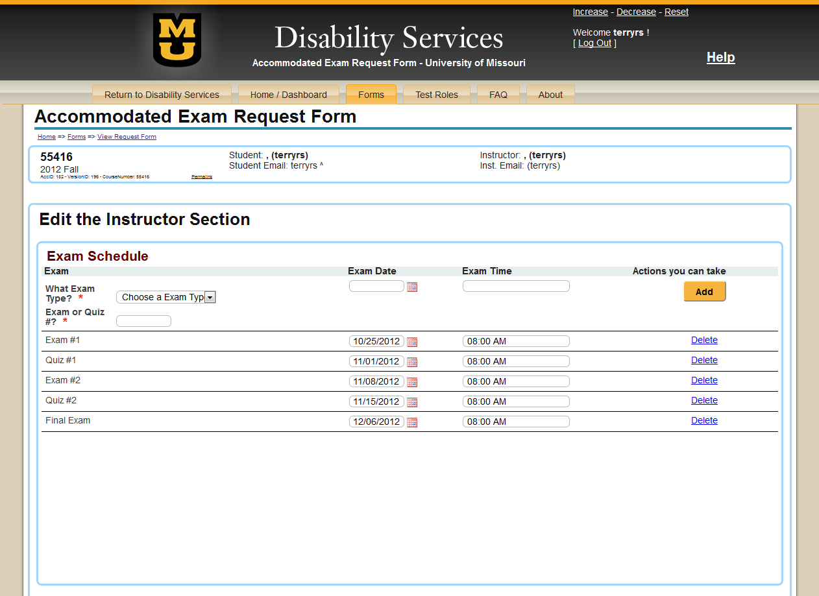
Course Information
Student Information
Instructor Information
Exam Date Populates Below To Allow For Additional Exam Dates To Be Entered

Slide 38
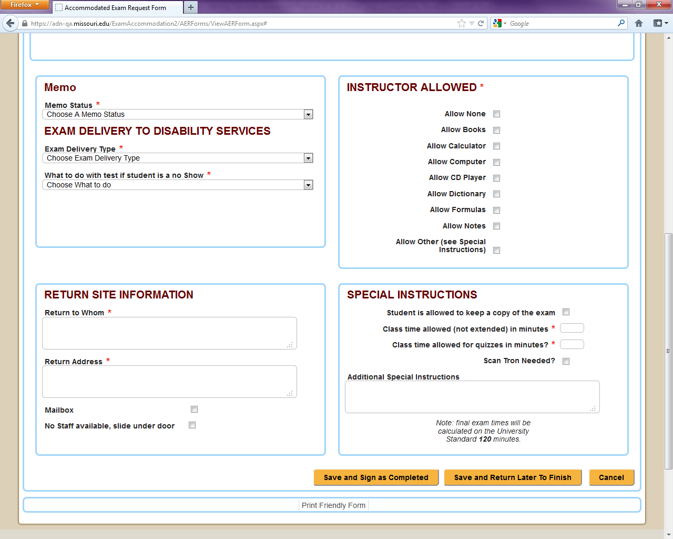

Slide 39
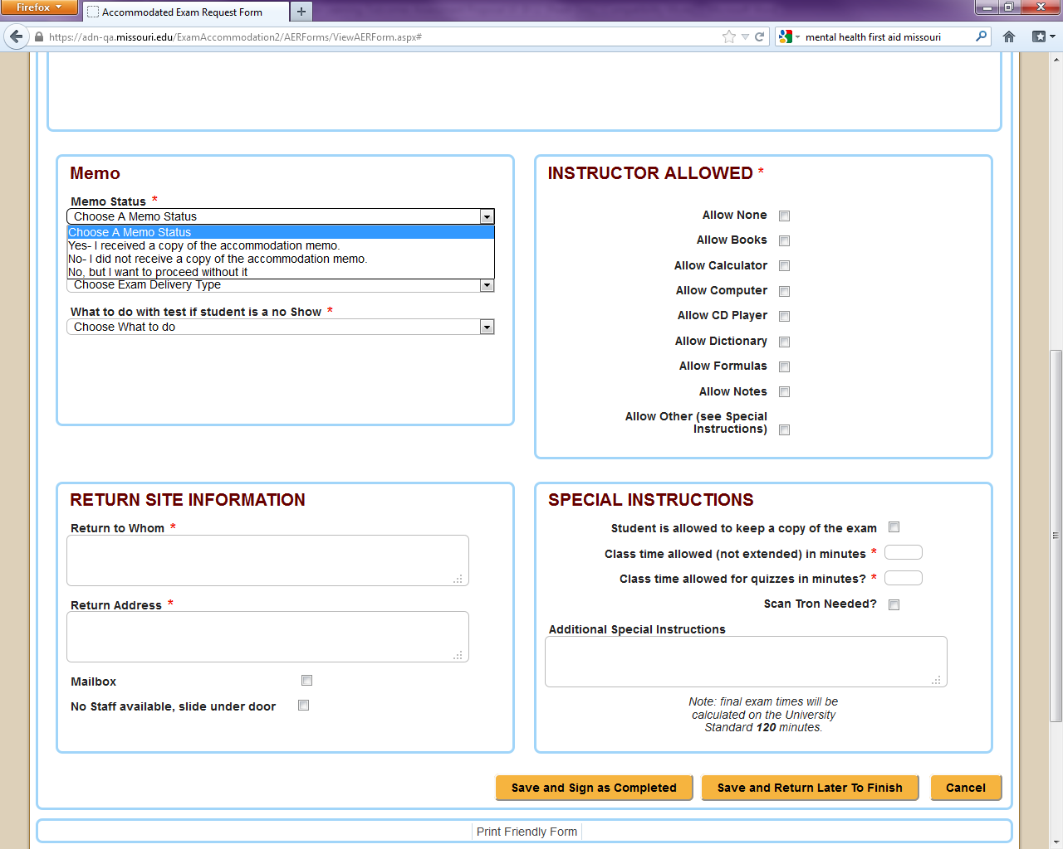

Slide 40
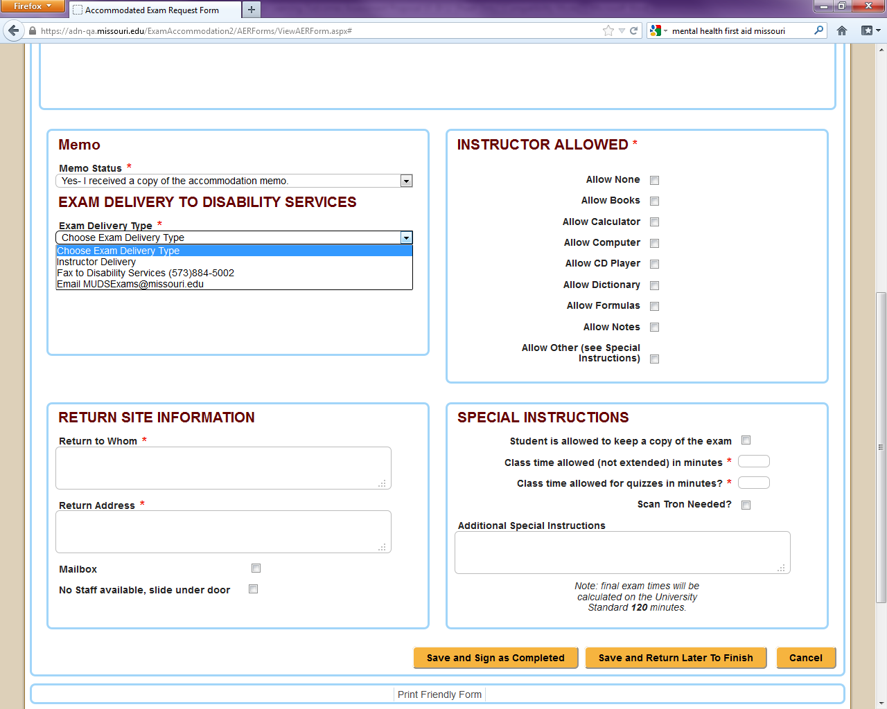

Slide 41
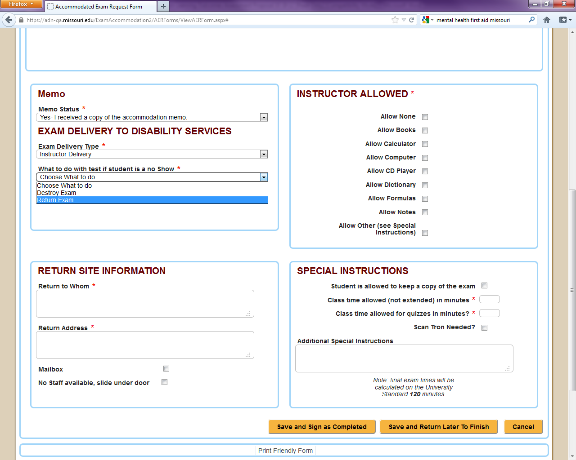

Slide 42
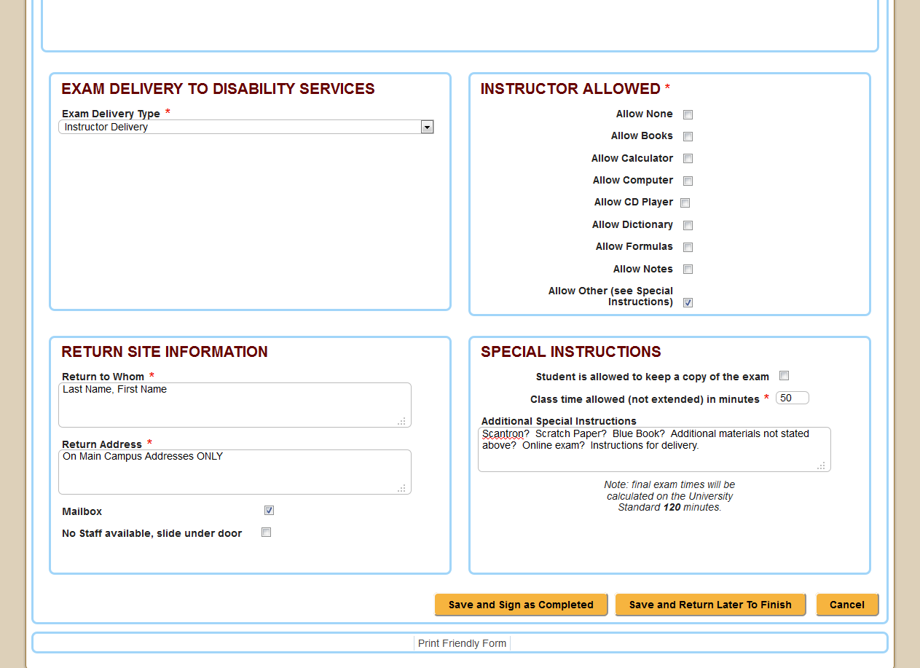
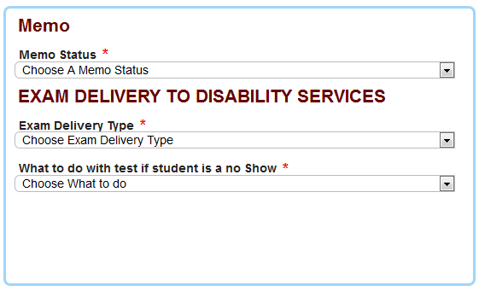
If you are not available, where would you like us to place exam?

Slide 43
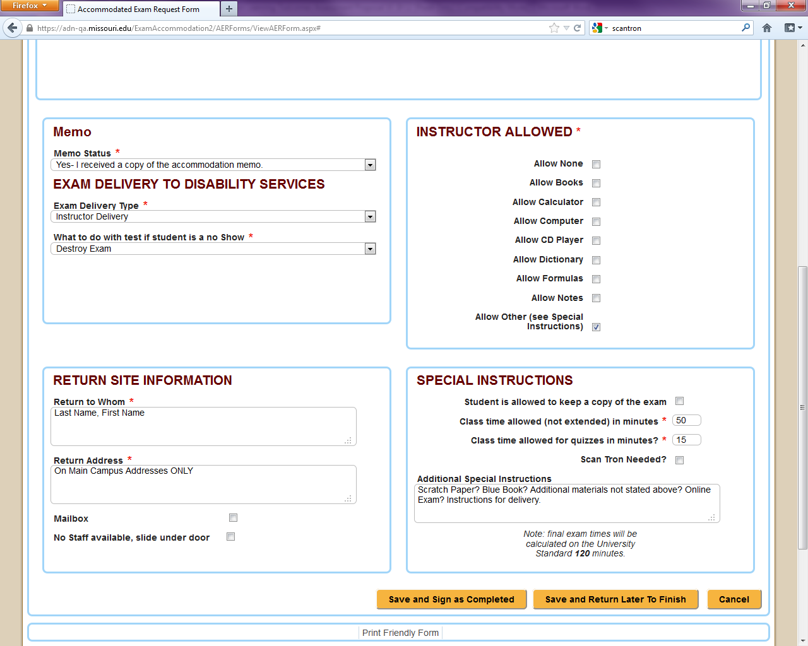
Submit Exam Information Once ALL Fields Are Completed

Slide 44
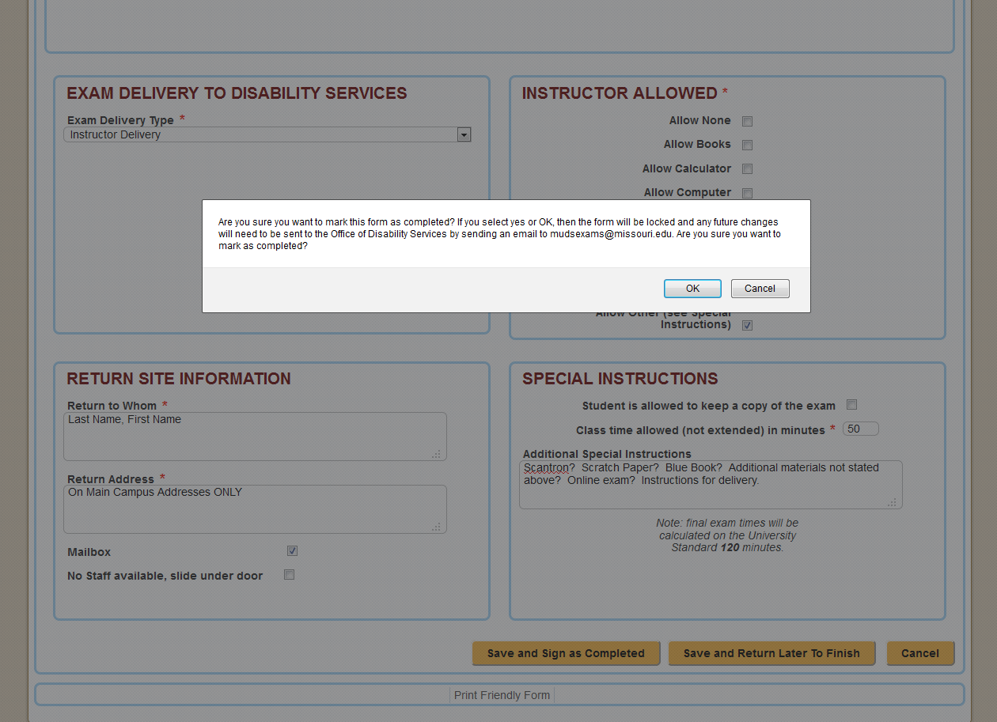

Slide 45
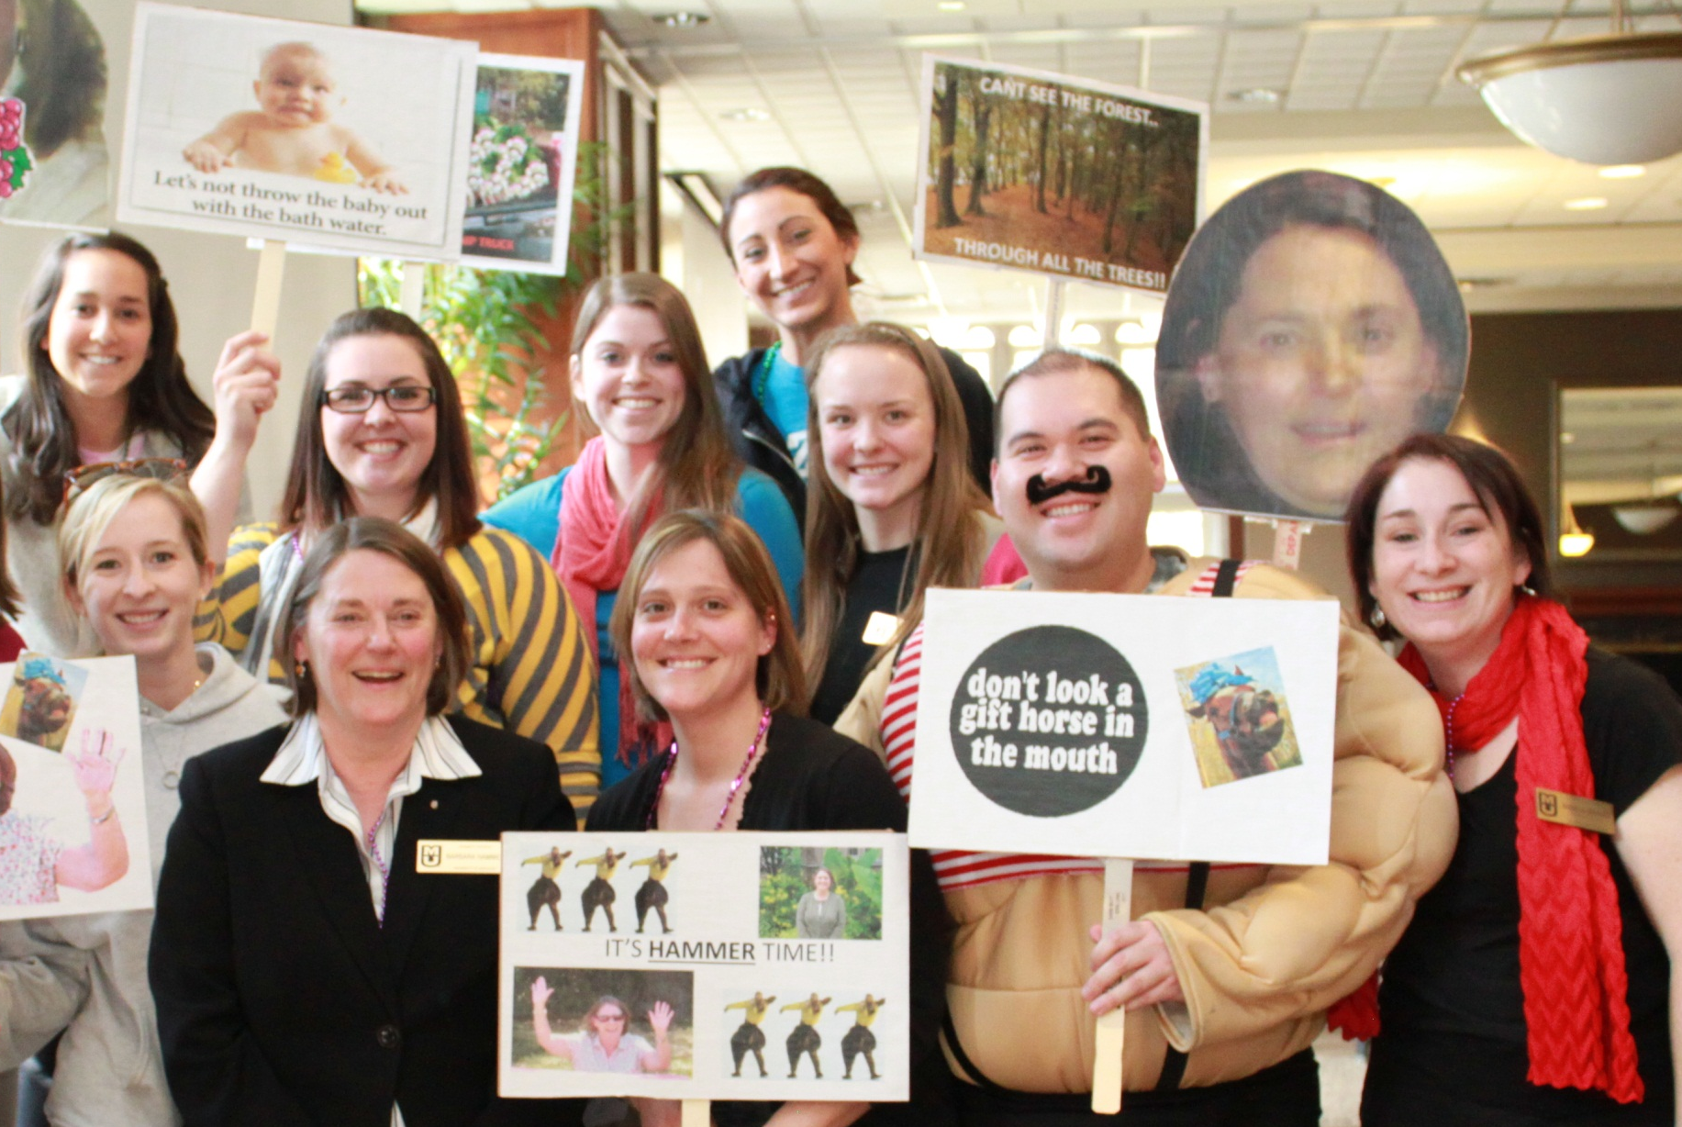
ODS Staff Log In

Slide 46
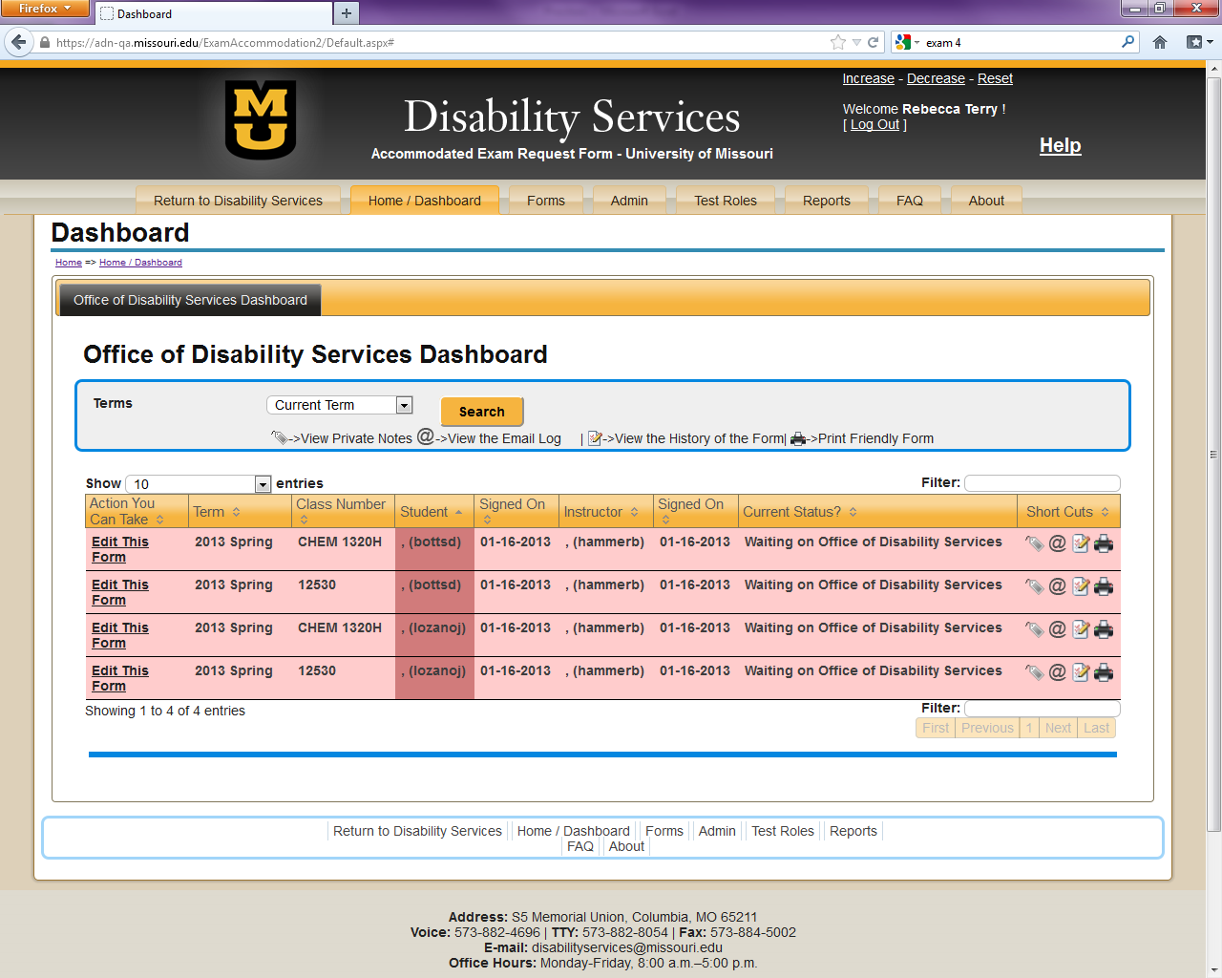

Slide 47
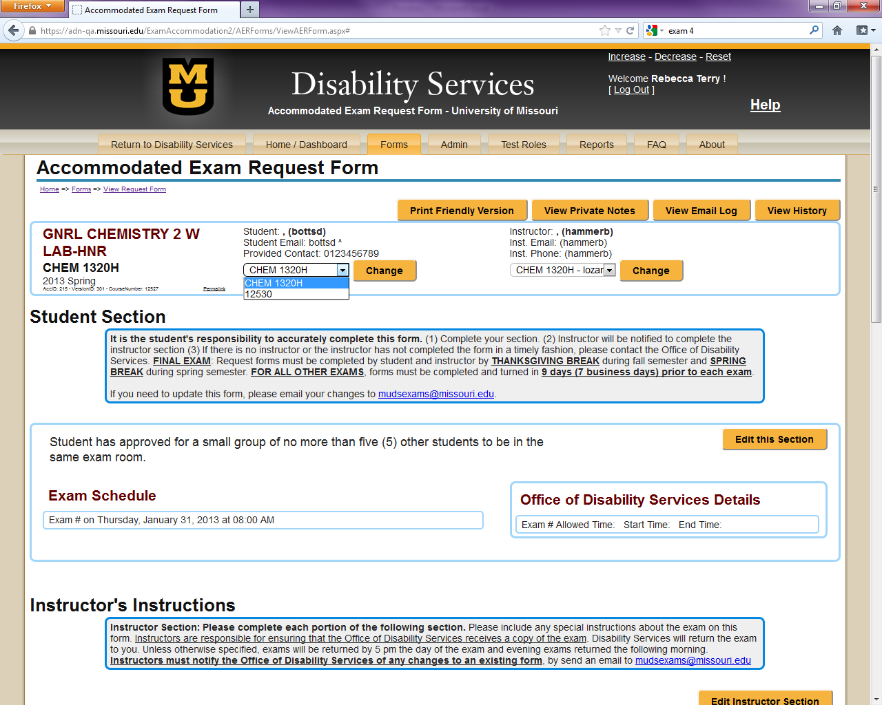

Slide 48
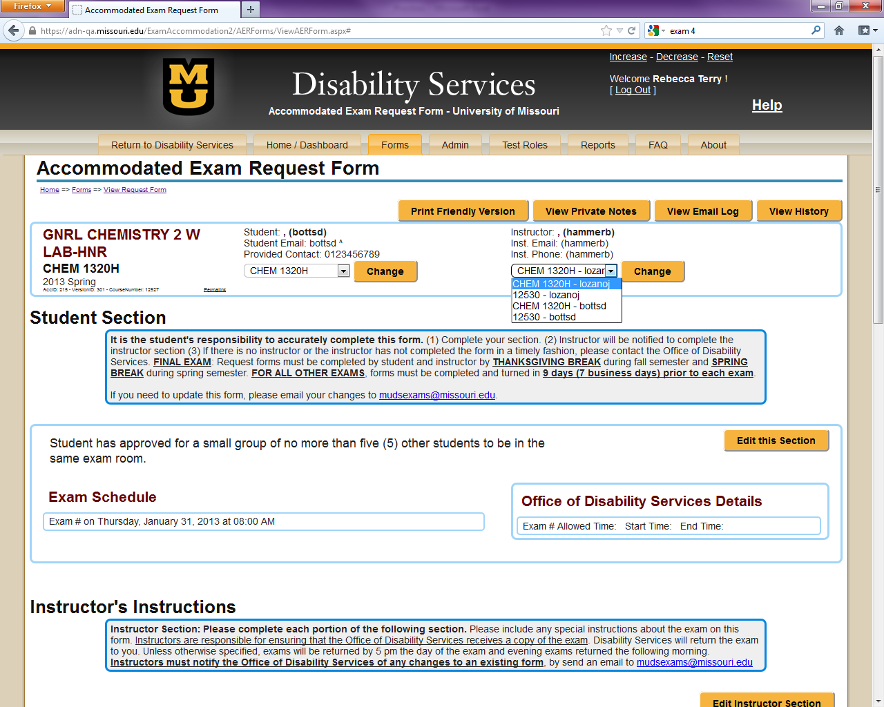

Slide 49
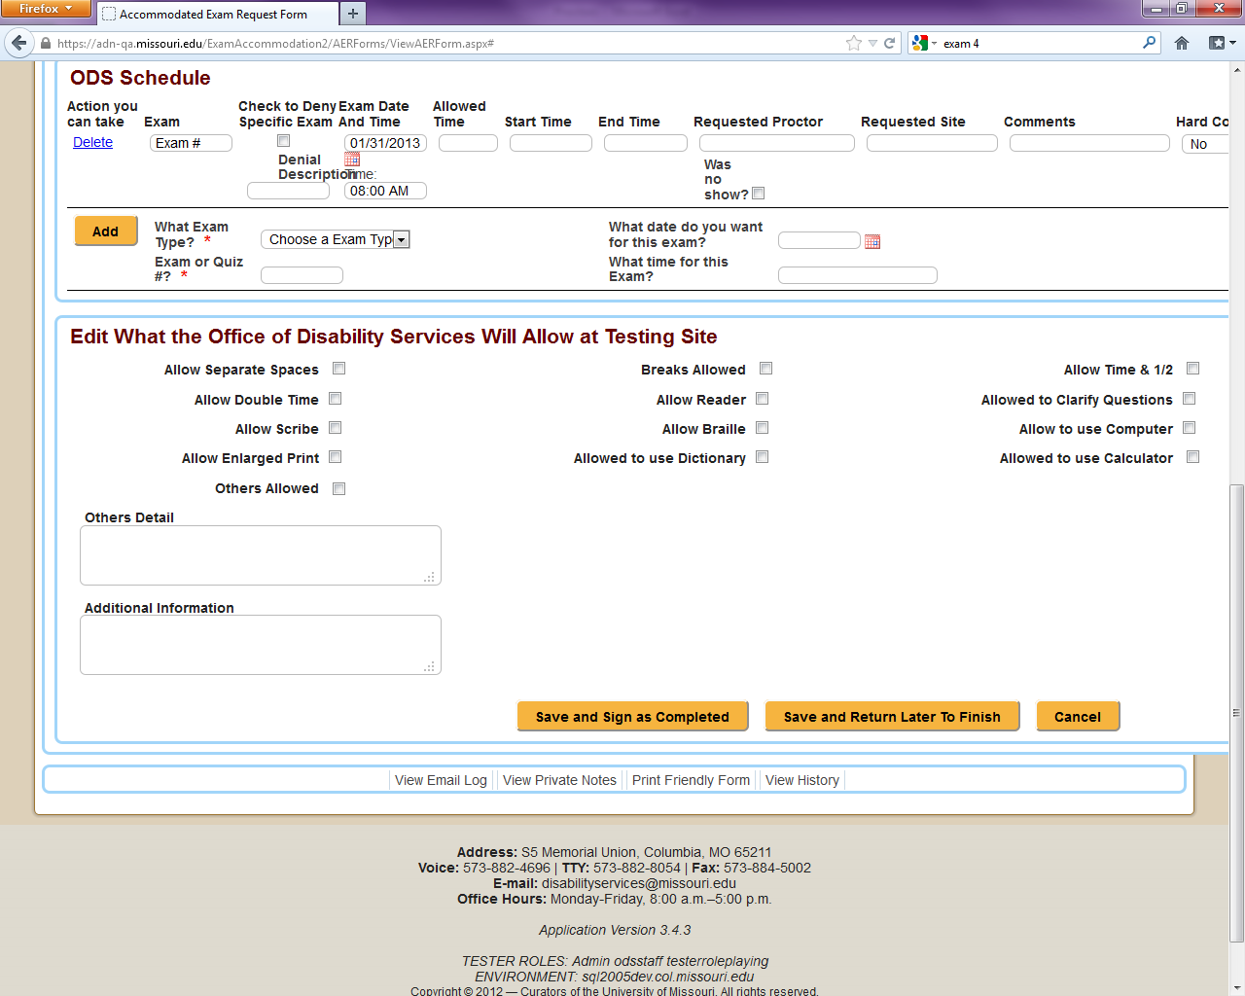

Slide 50
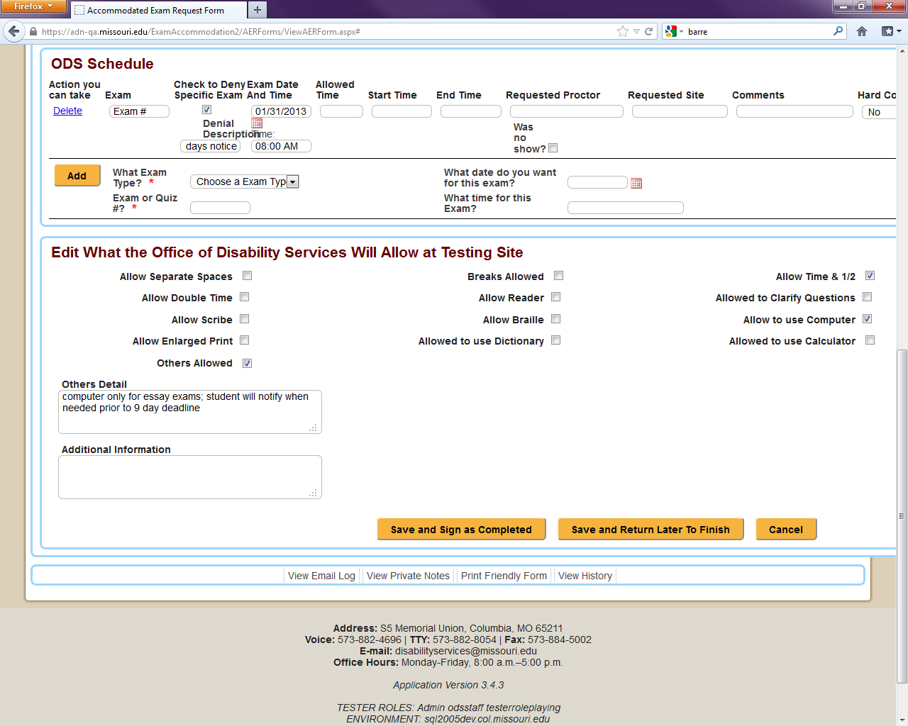

Slide 51
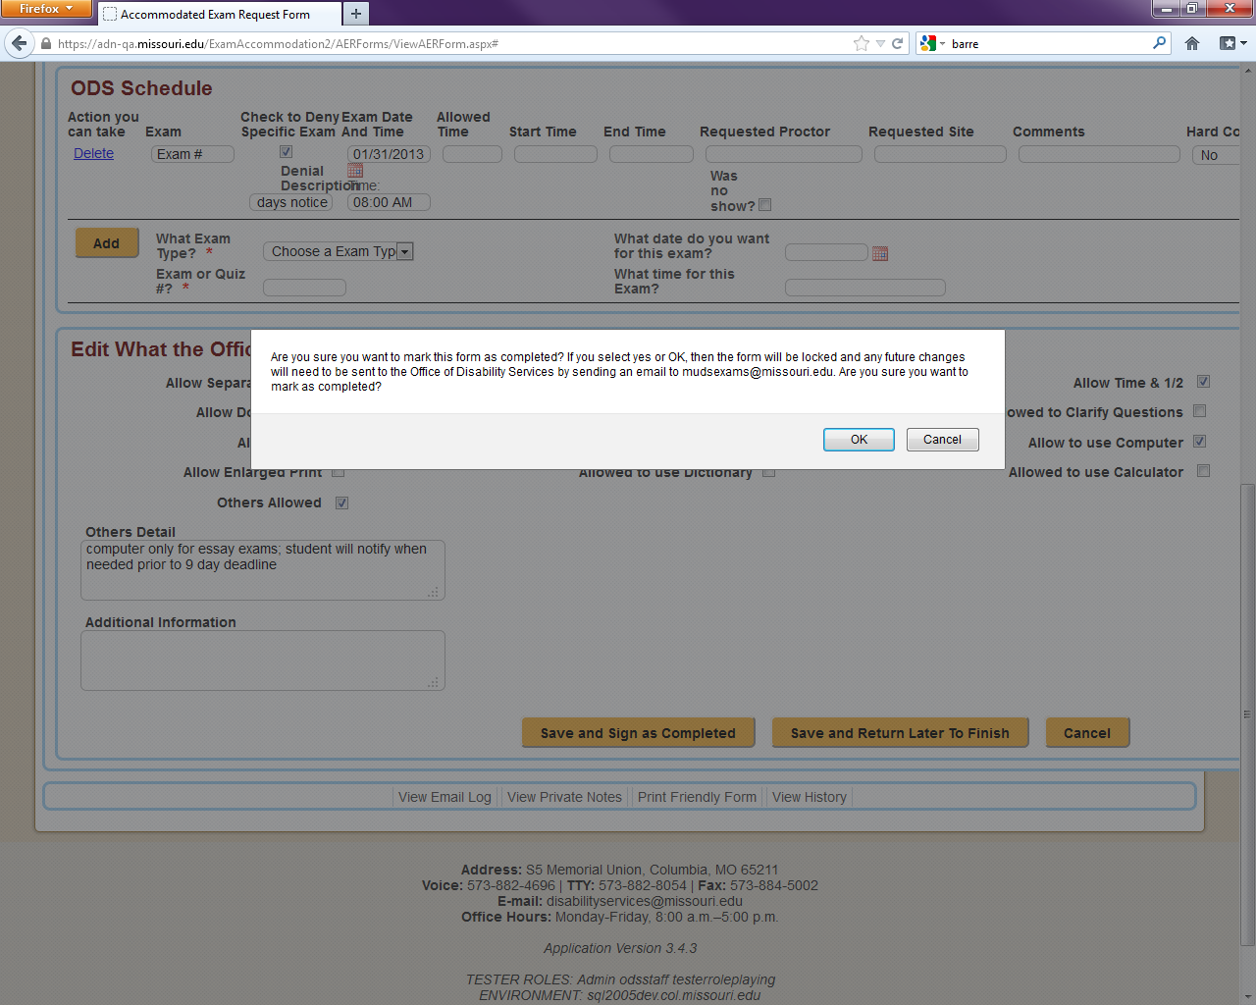

Slide 52
A Blessing
Reporting
Envelope Labels
Delivery Logs

Slide 53
A Blessing
Like it?
Guess what?!

Slide 54


BLOWIN’ UP THE FORM!!!

Slide 55
Version 4 – Launch Summer 2014
Moving away from the concept of a “form”
  Reduces “no shows”
  Reduces schedule changes
  Further reduces data entry
  Further reduction of paper and steps in process

Slide 56
Version 4
Professors asked for more control.
  Ask and ye shall receive!
Option to prepopulate information to requests
  Reduces the burden of the process for students and instructors
Notes:
The more the instructor works ahead of time the less steps they have to take later to set up exam accommodations…culture change

Slide 57
Version 4
Ability to apply information to the section level
Professor or student initiated
Students can be like “other” students
Step closer to “one stop shop” for everything accommodations
Notes:
The more the instructor works ahead of time the less steps they have to take later to set up exam accommodations…culture change
One stop shop – books, memos, classroom assistants, adjustable tables, interpreter, captioning, etc

Slide 58
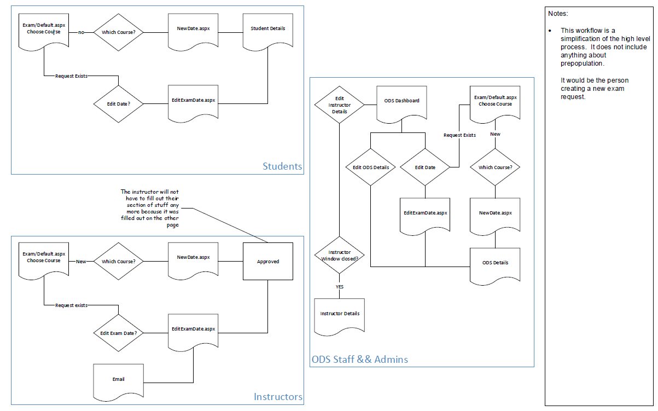
Version 4 Process

Slide 59
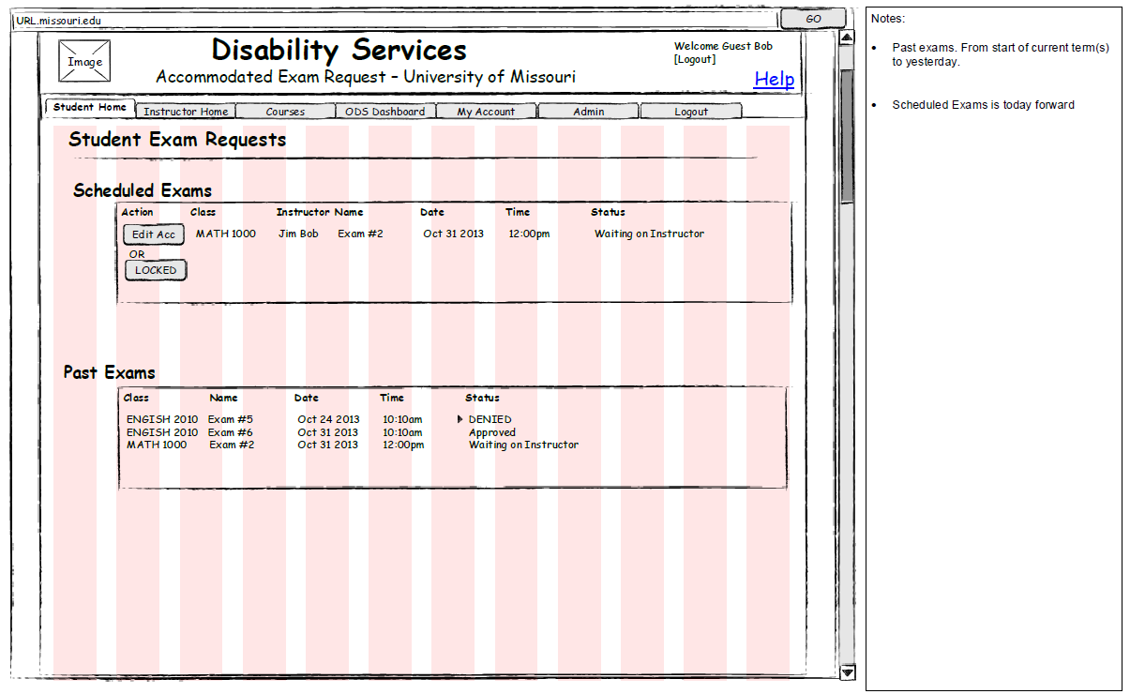
Version 4 Process

Slide 60
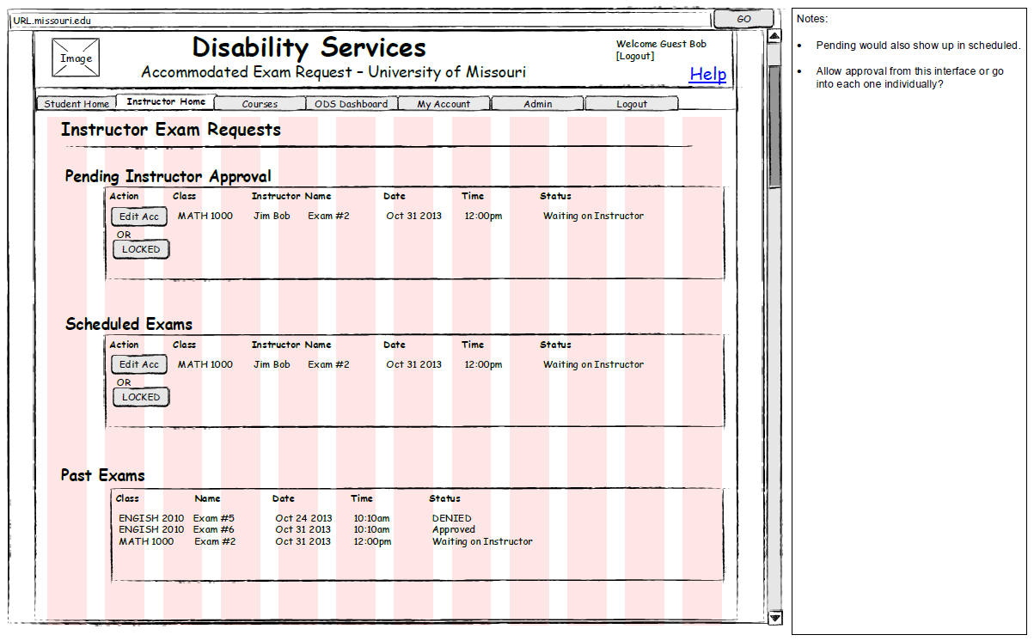
Version 4 Process

Slide 61
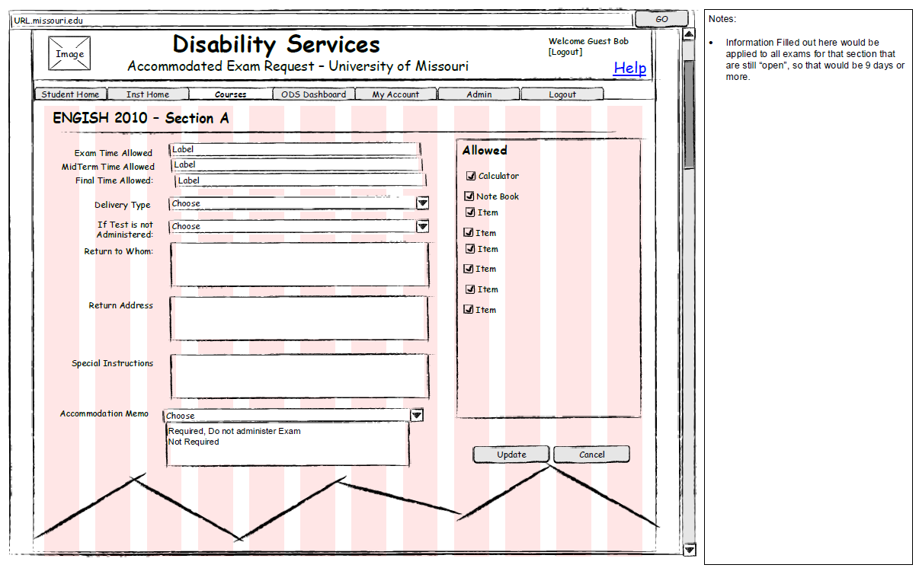
Version 4 Process

Slide 62
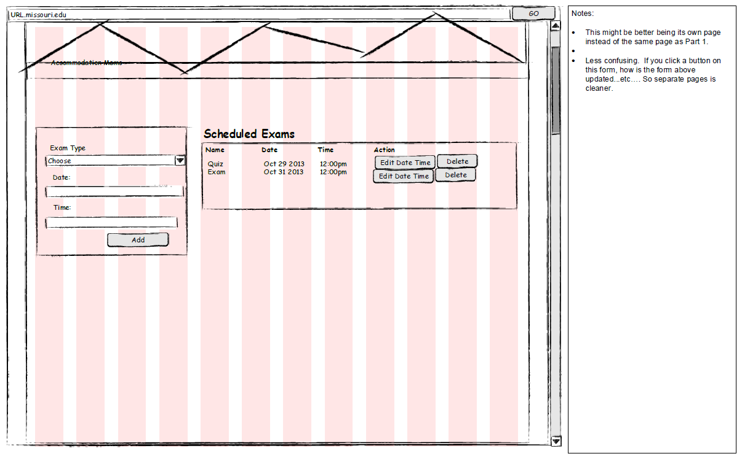
Version 4 Process

Slide 63
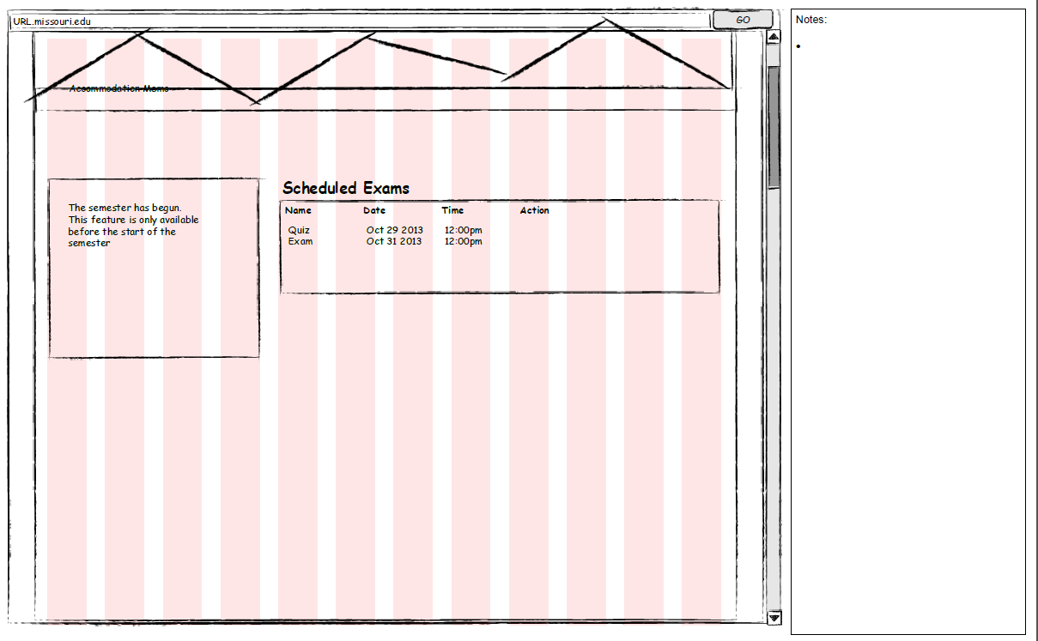
Version 4 Process

Slide 64
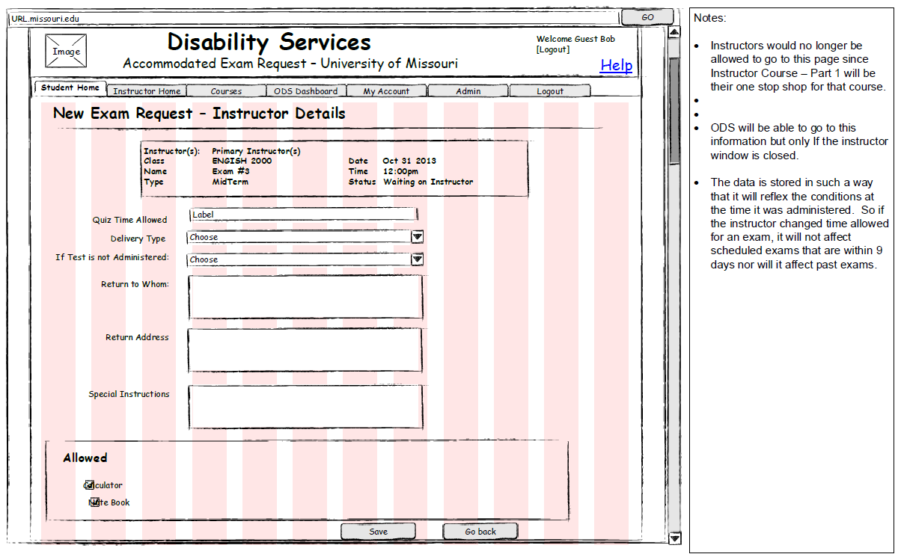
Version 4 Process

Slide 65
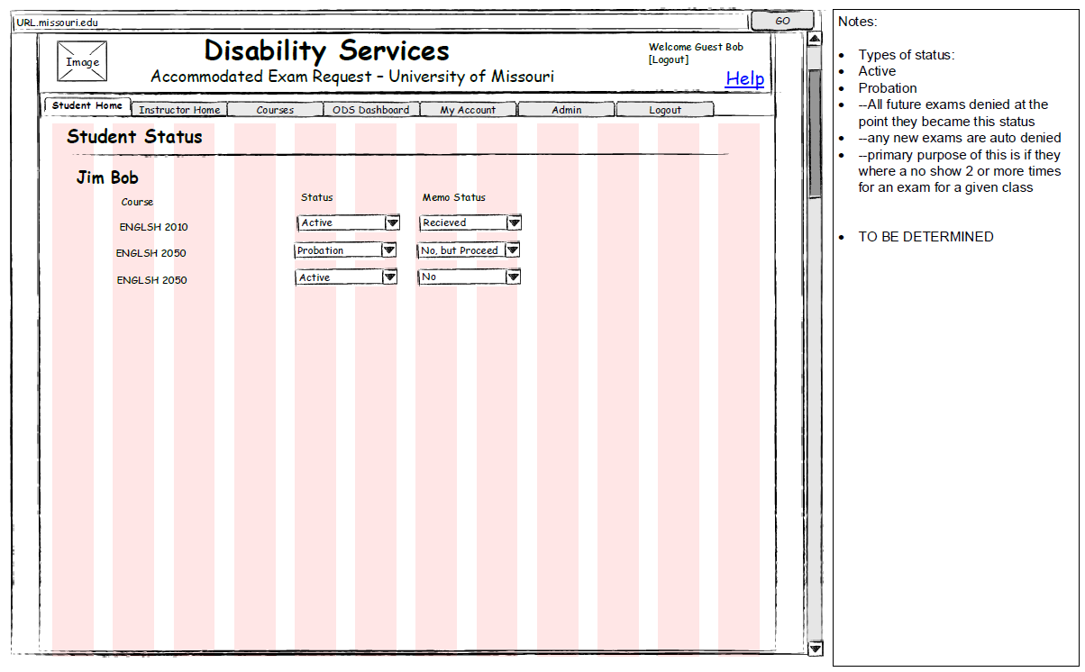
Version 4 Process

Slide 66
Questions & Information
Justin Lozano, M.S. Becca Terry, B.A.
Access Advisor Exams Coordinator
lozanoj@missouri.edu terryrs@missouri.edu
University of Missouri
Office of Disability Services
S5 Memorial Union
Columbia, MO 65211
573-882-4696
VP: 573-234-6662
Website: disabilityservices.missouri.edu
Email: disabilityservices@missouri.edu

