Slide 1
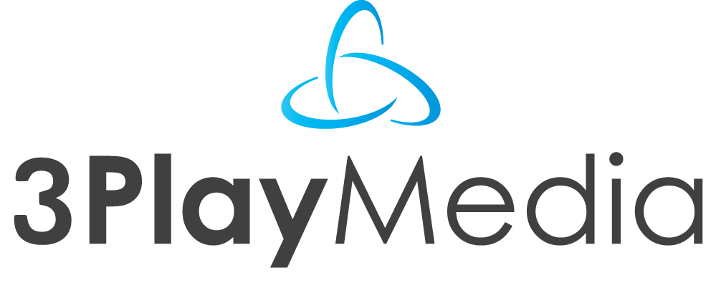
Making Lecture Capture Accessible
and
Captioning Technology for Interactive & Searchable Access
ATIA 2013
January 30, 2013

Slide 2
Agenda
Captioning basics
Process
Accessibility legislation
Value propositions
Beyond captions
Demos
Open discussion

Slide 3
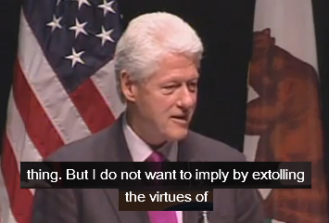
What Are Captions?
Captions are text that is time-synchronized with the media
Captions convey all spoken content as well as relevant sound effects
Originated in the early 1980s from an FCC mandate for broadcast TV

Slide 4
What Are Captions?
Terminology
Captioning vs. Transcription

Slide 5
What Are Captions?
Terminology
Captioning vs. Transcription
Captioning vs. Subtitling

Slide 6
What Are Captions?
Terminology
Captioning vs. Transcription
Captioning vs. Subtitling
Closed Captioning vs. Open Captioning

Slide 7
What Are Captions?
Terminology
Captioning vs. Transcription
Captioning vs. Subtitling
Closed Captioning vs. Open Captioning
Post Production vs. Real-Time

Slide 8
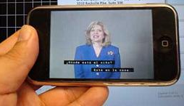
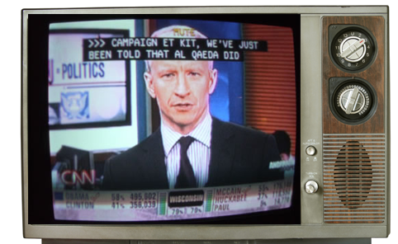
How Are Captions Used?

Slide 9
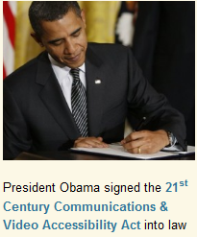
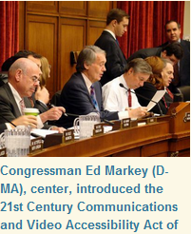
Accessibility Laws
Section 508
“All training and informational video and multimedia productions must contain captions …”
Section 504
“No individual, solely by reason of her or his disability…be denied the benefits of any program, service, or activity…”

Slide 10
Accessibility Laws
Section 508
“All training and informational video and multimedia productions must contain captions …”
Section 504
“No individual, solely by reason of her or his disability…be denied the benefits of any program, service, or activity…”
21st Century Communications & Video Accessibility Act (CVAA)
“Closed captioning on video programming delivered using internet protocol….”

Slide 11
Accessibility Laws
CVAA Phase-In Timeline
Sept 30, 2012: All prerecorded programming that is not edited for Internet distribution
Mar 30, 2013: Live & near-live programming originally broadcast on television.
Sep 30, 2013 : Prerecorded programming that is edited for Internet distribution.
Mar 30, 2014: Archival programming

Slide 12
Value Propositions
Accessible for deaf and hard of hearing
For ESL viewers
Flexibility to view anywhere, such as noisy environments or offices
Search
Reusability
Navigation, better UX
SEO/discoverability
Used as source for translation

Slide 13
Captioning Process
1. Upload
2. Download
3. Publish

Slide 14
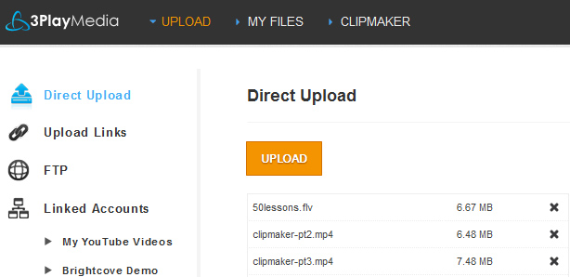
Step 1. Upload Media Files

Slide 15
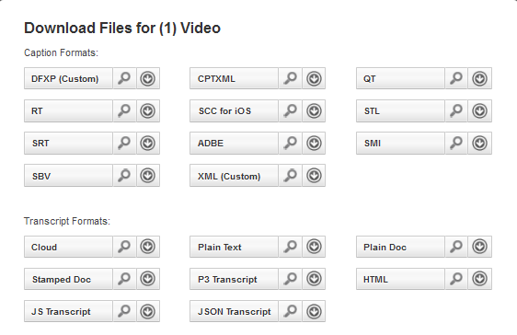
Step 2. Download Captions File

Slide 16
Step 3. Publish Captions

Slide 17
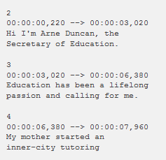
Captions Formats
Common Caption Formats
SRT Example
SRT | YouTube and other web players
DFXP | Flash players
SCC | iPods, iTunes, DVD encoding
SAMI | Windows Media
QT | QuickTime
STL | DVD Studio Pro
CPT.XML | Captionate
SBV | YouTube
RT | Real Media
WebVTT | Emerging HTML5
Custom XML | Custom formats
Custom Text | Custom formats
Emerging standards for HTML5

Slide 18
Simplifying the Workflow
Video Player / Platform Integrations

Slide 19
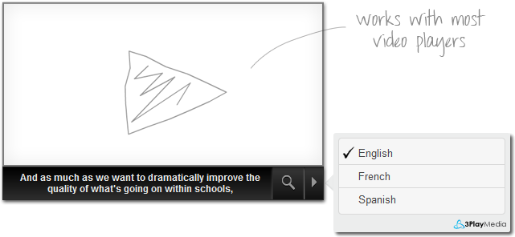
Captions Plugin
Works with most video players
Searchable
Supports multiple languages
SEO boost
Customizable
Free

Slide 20
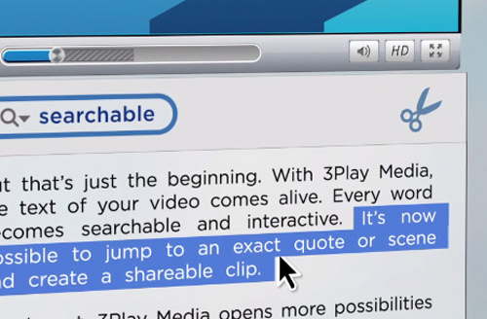
Beyond Captions

Slide 21
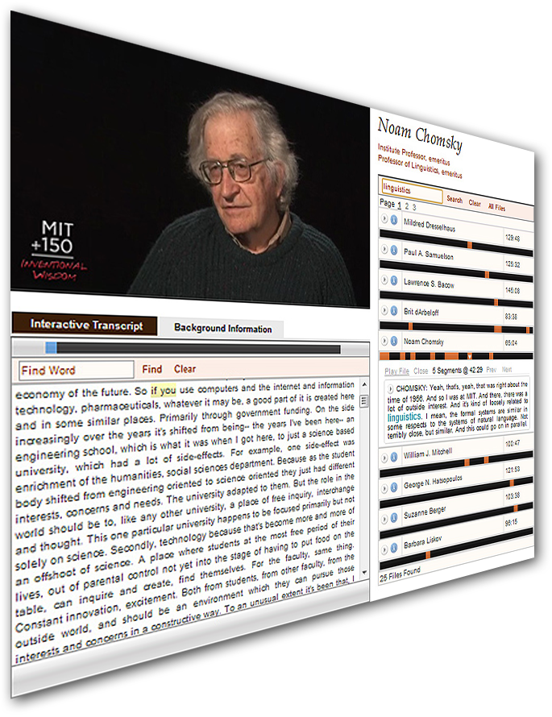
Demos
Implementations of captions + transcripts
Examples of automated captioning workflows
Searchable, interactive video libraries

Slide 22
Questions
Tole Khesin
3Play Media
tole@3playmedia.com
Tel (415) 298-1206
Resources
http://www.3playmedia.com/how-it-works/overview/

