Slide 1
PRE-10W New Technology & Accessibility in Higher Ed Promises and Challenges Alternate Format Production What’s new, what’s changed?
Julie K Balassa
Office for Students with Disabilities
Valencia College
http://valenciacollege.edu
1/30/2013 8:00am-9:15am

Slide 2
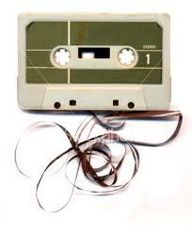
Where we came from
Books on tape
Image-backed PDF
Meet current standards?
Good enough? Better than nothing?
Legal?

Slide 3
We used to think…
Our alt format procedures depended on our resources.
Time
Money
Staff
Skill set
Our determination of alt format eligibility depended on the student’s evaluation scores and ability to succeed without accommodations.

Slide 4
Half a Dozen Cases to change our minds
Community College of Southern Nevada Violated the ADA and Section 504 by failing to ensure timely delivery and quality of text materials for students who are blind or learning disabled
Valdosta State University (GA) Violated the ADA and Section 504 by failing to timely provide textbooks in an alternate format
City College of San Francisco (CA) Violated the ADA and Section 504 by fialing to provide Brailled translation of textbook used in preparation for taking Test of English as a Foreign Language (TOEFL) exam
California State University, Fullerton (CA) Violated the ADA and Section 504 by failing to provide academic material in an appropriate, accessible alternative format and in a timely manner
Florida State University (FL) Violated the ADA and Section 504 by failing to provide equal access to the course materials used in FSU’s math classes.
NY Board of Law Examiners Violated the ADA and Section 504 by refusing accommodations because Bartlett failed to demonstrate a disability and had a Ph.D.

Slide 5
Half a Dozen Laws
Section 504 of the Rehabilitation Act of 1973
The Americans with Disabilities Act of 1990 (ADA)
The Americans with Disabilities Amendments Act of 2008 (ADAAA)
Section 504, the ADA, and the ADAAA apply to recipients of Federal financial assistance
Section 508 of the Rehab Act applies to Federal government and maybe education sector
Copyright Law
Fair Use
Chafee Amendment
State and local laws

Slide 6
ADA and ADAAA
A public entity shall furnish appropriate auxiliary aids and services where necessary to afford an individual with a disability an equal opportunity to participate in, and enjoy the benefits of, a service, program, or activity conducted by a public entity.
Title II of the ADA requires a public college to take appropriate steps to ensure that communications with persons with disabilities "are as effective as communications with others" .
jkb 2013

Slide 7
Section 504
A recipient . . . shall take such steps as are necessary to ensure that no disabled student is denied the benefits of, excluded from participation in, or otherwise subjected to discrimination under the education program or activity operated by the recipient because of the absence of educational auxiliary aids for students with impaired sensory, manual, or speaking skills.
jkb 2013

Slide 8
Alt Format is an Auxiliary Aid
Therefore, in the eyes of the law, it’s not optional.
jkb 2013

Slide 9
Enforcement
Office for Civil Rights (OCR)
Ordinarily handles grievances from students
Typically calls in the DOJ if litigation is involved
Department of Justice (DOJ)
Students can file a grievance directly with the DOJ
DOJ may refer it back to OCR if no litigation
Both the OCR and DOJ interpret the laws and make decisions that set precedents and standards.
jkb 2013

Slide 10
Important Interpretations
The OCR has repeatedly interpreted the term "communication" in this context to mean the transfer of information, including (but not limited to) the verbal presentation of a lecturer, the printed text of a book, and the resources of the Internet.
In construing the conditions under which communication is "as effective as" that provided to non-disabled persons, on several occasions OCR has regarded the three basic components of effectiveness as
timeliness of delivery
accuracy of the translation
provision in a manner and medium appropriate to the significance of the message and the abilities of the individual with the disability
AHEAD Position Statement

Slide 11
Limitation on Copyright Exclusive Rights Fair Use
…the fair use of a copyrighted work, including such use by reproduction in copies or phonorecords or by any other means specified by that section, for purposes such as criticism, comment, news reporting, teaching (including multiple copies for classroom use), scholarship, or research, is not an infringement of copyright.
4 factors to be considered:
Purpose & character of use
Nature of copyrighted work
Amount & substantiality of portion used:work as a whole
Effect of use upon potential market

Slide 12
Limitation on Exclusive Rights Chafee Amendment (PL 104-197)
"(a) Notwithstanding the provisions of sections 106 and 710, it is not an infringement of copyright for an authorized entity to reproduce or to distribute copies or phonorecords of a previously published, nondramatic literary work if such copies or phonorecords are reproduced or distributed in specialized formats exclusively for use by blind or other persons with disabilities.

Slide 13
Half a Dozen Alt Format Processes
Student request
Data entry
Order (Learning Ally, publisher, ATN, etc.)
Satisfied and download or receive CD
Denied and research other options
Safe Storage
Production
Delivery

Slide 14
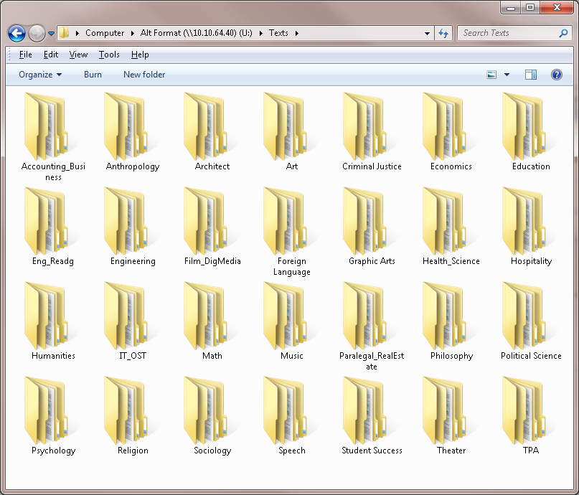
Digital Safe Storage - Folders

Slide 15
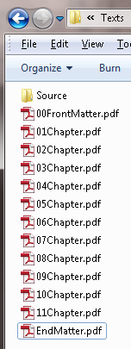
Digital Safe Storage – File Naming Convention

Slide 16
Production - Hardware Tool Kit
Decent computer with enough processor speed & memory
Dual monitors
High-speed scanner
Guillotine
Tactile graphics production equipment e.g. PIAF
Braille embosser
DAISY portable player for testing?
Mobile devices for testing?
Headphones, earplugs, ear buds

Slide 17
Production - Software Tool Kit
MS Word 2007
Abbyy FineReader or Scansoft OmniPage - OCR
Dolphin Publisher - DAISY production
Adobe Acrobat Pro – PDF production
Dreamweaver or Notepad - HTML production
Infty, Scientific Notebook and/or MathType - math production
Duxbury Braille Translation SW - Braille
Adobe Illustrator - tactile graphics production
Dolphin Easy Converter or K3000 - MP3 production
Dolphin Easy Converter - multi-purpose (11 in – 5 out)

Slide 18
Half a Dozen Accessibility Rules
Rule 1: It’s not real text just because it looks like text.
Rule 2: It’s not real math just because it looks like math.
Rule 3: A picture has no real text just because it looks like text.
Rule 4: It’s not real foreign language just because it looks like foreign language.
Rule 5: It’s not a real list just because it looks like a list.
Rule 6: It doesn’t stand out just because it looks like it does.

Slide 19
Demos
OCR and Word document structuring results
MathML
Alt Text
Foreign Language

Slide 20
Production Relief
Products
SARA/EVAS
Zoom Twix
Read & Write Gold, Claro Read, Kurzweil 3000
Dolphin Easy Converter
Staff
Permanent
Temporary (loaners, work study students)
Services
Word processing
File exchange e.g. via ATN, AMX DB
Outsourcing e.g. Badger Accessibility Services http://www.bas.wisc.edu/
Online conversion portals e.g. sensusaccess.com, robobraille.org
Accessible book sources e.g. Learning Ally, Project Gutenberg, Bookshare, APH

Slide 21
Welcome to the Community of Us
ATN (Access Text Network)
NFB (National Federation of the Blind)
AHEAD IMAG (Instructional Materials Accessibility Group)
ATHEN (Access Technology Higher Education Network)
DSSHE (Disabled Student Services in Higher Education)
AAP (American Association of Publishers)
HTCTU (High Tech Center Training Unit)
AMX DB (Alternate Media eXchange Database of the HTCTU)

Slide 22
Some Resources
ADA/Section 504 info http://www.pacificu.edu/studentlife/lss/faculty/ada504faq.cfm
Section 508 info http://www.justice.gov/crt/508/508law http://www.section508.gov/index.cfm?fuseAction=1998Amend
Auxiliary Aids info - OCR http://www2.ed.gov/about/offices/list/ocr/docs/auxaids.html
AHEAD http://www.ahead.org
American Printing House for the Blind http://www.aph.org/
ATHEN http://www.athenpro.org/
ATN (Access Text Network) http://www.accesstext.org/
Chafee NLS factsheet http://www.loc.gov/nls/reference/factsheets/copyright.html
Copyright info http://www.law.cornell.edu/wex/copyright
DAISY info http://daisy.org
DSSHE listserv http://listserv.buffalo.edu/cgi-bin/wa?A0=DSSHE-L
Dolphin http://yourdolphin.com/
Duxbury Systems http://www.duxburysystems.com/
HTCTU (High Tech Center Training Unit) http://htctu.net
Learning Ally http://www.learningally.org/
MathType, MathPlayer, MathDaisy http://www.dessci.com/en/
NFB info including listservs http://www.nfbnet.org/
Scientific Notebook http://www.mackichan.com/index.html?products/snb.html~mainFrame
Valencia OSD website http://valenciacollege.edu/osd

Slide 23
Thank you for attending this session
CEUs – Session Code for all-day session: PRE-10W
More info at: www.atia.org/CEU
For ACVREP, AOTA and ASHA CEUs, hand in completed Attendance Forms to REGISTRATION DESK at the end of the conference. Please note there is a $15 fee for AOTA CEUs.
For general CEUs, apply online with The AAC Institute: www.aacinstitute.org
Session Evaluation
Please help us improve the quality of our conference by completing your session evaluation form.
Completed evaluation forms should be submitted as you exit or to staff at the registration desk.
Handouts
Handouts are available at: www.atia.org/orlandohandouts
Handout link remains live for 3 months after the conference ends.

