Slide 1
Who is at the Controls? Take-off of the eText Pilot Program at UW
Dan Comden
University of Washington

Slide 2
Outline
Project Overview
CourseSmart
CourseLoad
Initial Results
Other studies
Fellow travelers

Slide 3
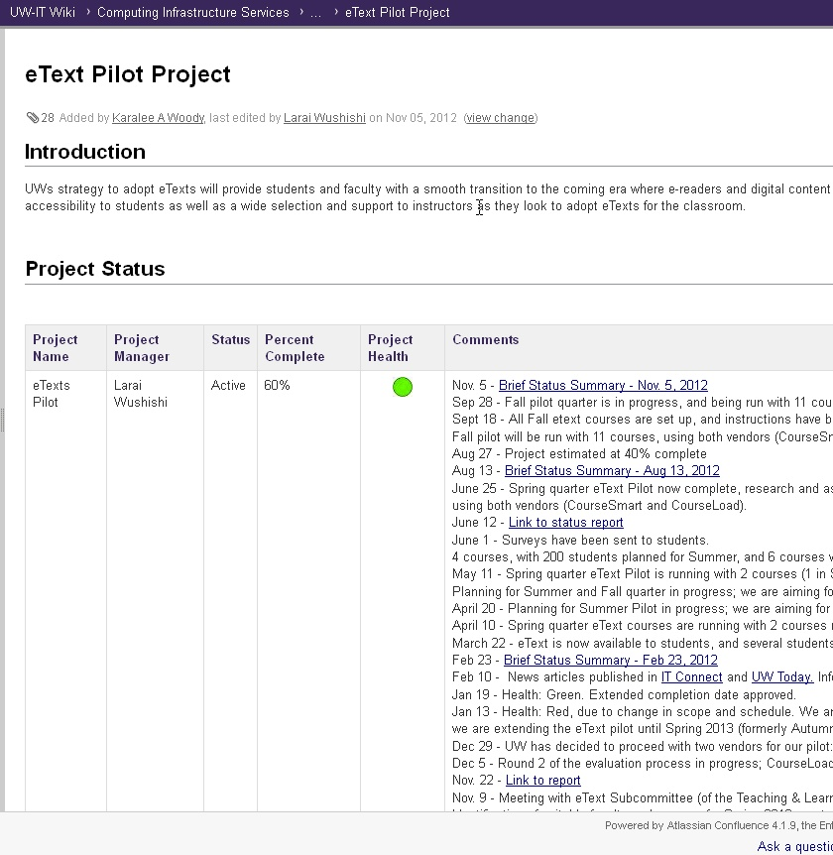
Congrats, it’s a project!

Slide 4
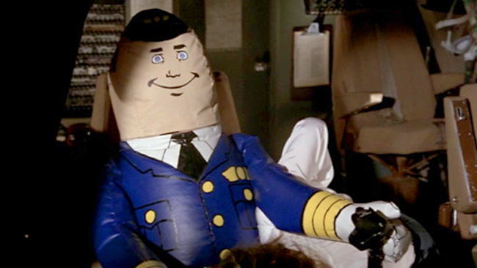
Pilot team members (who’s flying this thing?)
IT Learning Technology
IT Assessment & Research
IT Accessibility
IT Access Management
IT Student Systems
Finance Systems
Legal
Registrar
Bookstore
Purchasing

Slide 5
Why eText?
Push from Instructors
Push from Students
Push from IT Admin
Digital means Accessible?

Slide 6
Accessibility Testing
1. Keyboard only
2. Speech Input
3. ScreenReader
4. TTS apps
5. Mobile

Slide 7
CourseSmart Accessibility
Request “accessible” version of the reader from CS
Accessible = screen reader
Focus Indicator – LOST, then FOUND
No skipnav for keyboard users
(header nav for screenreaders)
Help system is messy
Default navigation text size is too small

Slide 8
CourseSmart demo

Slide 9
Courseload Accessibility
Focus indicator – LOST
Keyboard functionality – LIMITED
Screenreader Access to Content – NONE
TTS Access to Content – NONE

Slide 10
CourseLoad demo

Slide 11
What do students think?
Preliminary survey SPR12 and SUM12
Five courses:
Statisitical Inference
Information Management and Analysis
Advertising
Intro Geology
Intro to Women’s Studies
80 students responded (47%)
74% undergrad
63% women

Slide 12
What do students think?
How much reading?
4/5 courses: majority half or more of book
1/5: 92% less than half or none
How much highlighting? (Active vs Passive)
Courseload 52%
CourseSmart 28%
Pricing
65-80% want 50% off price
66% unhappy with all or none CourseLoad pricing

Slide 13
Results – completed reading

Slide 14
What do students think?
“[I] didn’t have to carry a textbook if I had my laptop”
“[I like] the ability to highlight and share notes with other students. I also liked that you can see where the professor highlighted information and left a comment.”
“I have more difficulty focusing when I read on the computer, probably because there are more distractions (the internet, etc) and also because I like the tangible feel of a physical book.”
“[t]he lack of feeling of texture while reading. And it does not work as well as using a [hard copy] textbook, even if it included the highlighting functions.”

Slide 15
What do staff think?
Accessibility is a big problem
Acquisition may be a bigger one
60% of titles with no problem
CourseLoad – 2-3 month turnaround
More survey results coming in 2013

Slide 16
We are not alone
Internet2 CourseLoad pilot 2012
Internet2 CourseSmart pilot 2013

Slide 17
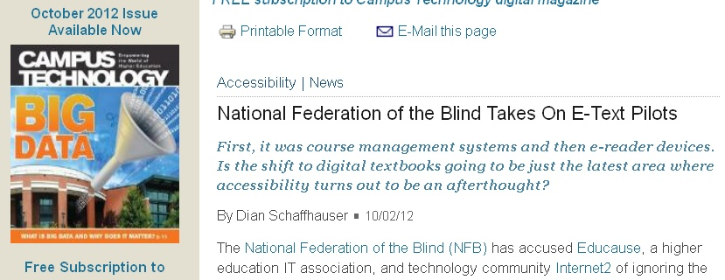
Internet2 Spring2012 eText Project
Cornell University
Indiana University
University of Minnesota
University of Virginia
University of Wisconsin

Slide 18
Fellow Travelers

Slide 19
If you take a flight…
Verify accessibility claims
Keyboard only access
Use ALL functions/features
Involve SWDs if possible
Demonstrate what YOU do!

Slide 20
FIN

