Slide 1
HTML5 & WAI-ARIA Forms with jQuery Validation
Paul J. Adam
Accessibility Evangelist
@pauljadam

Slide 2
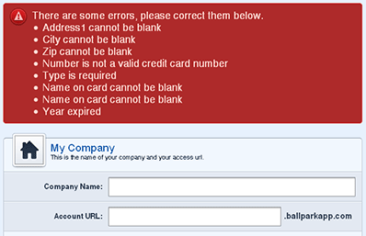
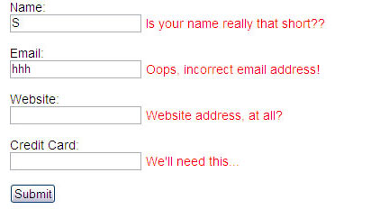
Connecting labels to inputs is easy!
But what about:
required fields
error messages
& keyboard focus?
Notes:
http://www.smashingmagazine.com/2009/07/07/web-form-validation-best-practices-and-tutorials/

Slide 3
Most Forms Fail Accessibility

Slide 4
Accessibility Considerations
Screen Readers
Screen Magnification
Voice Control
Keyboard-Only Users
Small Click Targets
Mobile Usability
Fat Fingers, Tiny Buttons
Cognitive Accessibility
Notes:
http://podlipensky.com/post/2011/01/17/Mobile-usability-sliders.aspx

Slide 5
Every. Single. Field. Needs. A. Label.
Click labels, does focus go into input?
Use semantic, hidden labels to keep forms visually pleasing yet fully accessible.

Slide 6
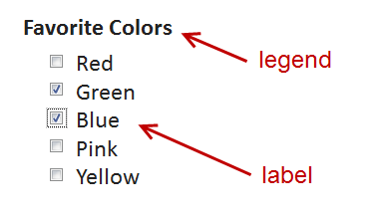
Radio Buttons & Checkboxes Need a Fieldset & Legend
Group related form elements

Slide 7
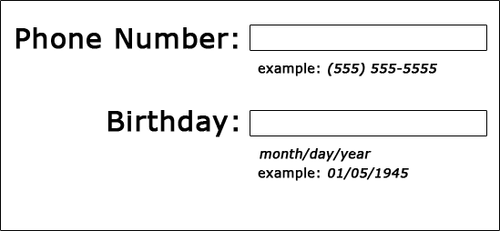
Are Input Formats Spoken?
Indicate correct format for dates, phone numbers, etc.
Are ALL instructions spoken?
Notes:
Why do large companies still not account for accessible validation and error messages?
Why do most web forms still not send the user’s keyboard focus to the list of error messages or the first invalid field?

Slide 8
Error Messages & Focus
Keyboard focus sent to errors?
Are Errors spoken and helpful?
Errors in the label?
Or list of Errors?
Notes:
Why do large companies still not account for accessible validation and error messages?
Why do most web forms still not send the user’s keyboard focus to the list of error messages or the first invalid field?

Slide 9
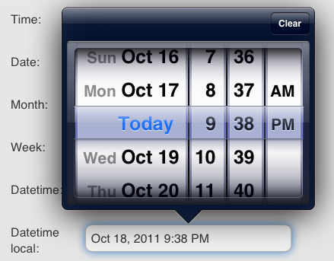
HTML5 Form Attributes
Accessible Validation = Browser/OS Responsibility
Input types
Tel
Email
Date
Required Boolean
Current State of HTML5 Forms
Notes:
http://ie.microsoft.com/testdrive/HTML5/Forms/default.html

Slide 10
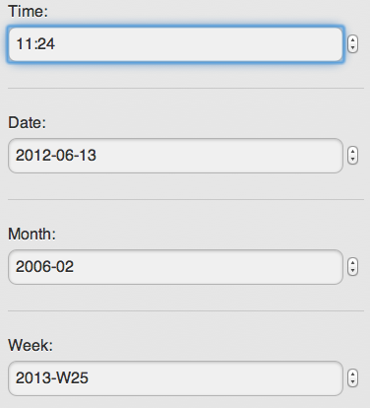
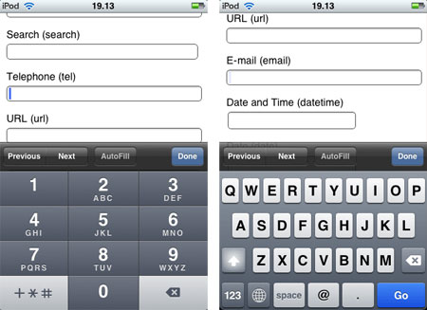
HTML5 Input Types
<input type="tel" />
<input type="email" />
<input type="date" />

Slide 11
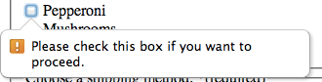
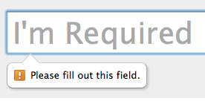
Required Attribute
<input type=text required name=foo>
Demo Form w/ HTML5 Required Attributes
Notes:
http://wufoo.com/html5/attributes/09-required.html
http://yaccessibilityblog.com/library/required-inputs-aria-html5.html
VoiceOver announces required

Slide 12
aria-required="true"
No HTML5? WAI-ARIA to the rescue!
NVDA ignores * at default verbosity setting
<input type=text required aria-required=true name=foo>
Demo Form w/ aria-required added

Slide 13
Old Browsers? Old AT?
jQuery Validation works on all JavaScript enabled browsers!
Even IE6!
Notes:
http://bassistance.de/jquery-plugins/jquery-plugin-validation/

Slide 14
Tweak the Validation Plugin
Options for the validate() method
errorPlacement
errorElement
Remove novalidate
Focus Behavior
focusInvalid
invalidHandler
Before Tweaks Demo
After Tweaks Demo

Slide 15
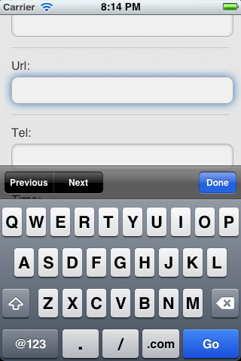
Label Placement
Top-aligned labels are good for Mobile and Screen Magnification.
jQuery Mobile does responsive design for you.
Fix Safari label bug
Notes:
http://css-tricks.com/snippets/javascript/redirect-mobile-devices/

Slide 16
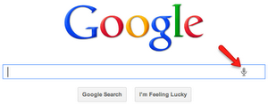
Voice Input
Siri
Dragon Naturally Speaking
Use real <button>’s or <input type=button>
Chrome only <input type="text” speech x-webkit-speech />

Slide 17
DON’T MAKE ME THINK!
Usability = Accessibility
Users will love you for saving them one or two extra clicks!
HTML5 input types progressively enhance your forms!
Same with WAI-ARIA

Slide 18
Forms Can be Painful & Inaccessible!
Let’s change this problem with data entry on the web!

Slide 19
Go Forth and Be Accessible!!!

Slide 20
Connecting with Deque
Twitter LinkedIn Web Email
@dequesystems Deque Systems deque.com info@deque.com

